Slide 1
GREAT: Green, Resilient, and Equitable Actions for Transformation
Cassandra Ceballos
Caroline Reed
Beth Sawin

Slide 2
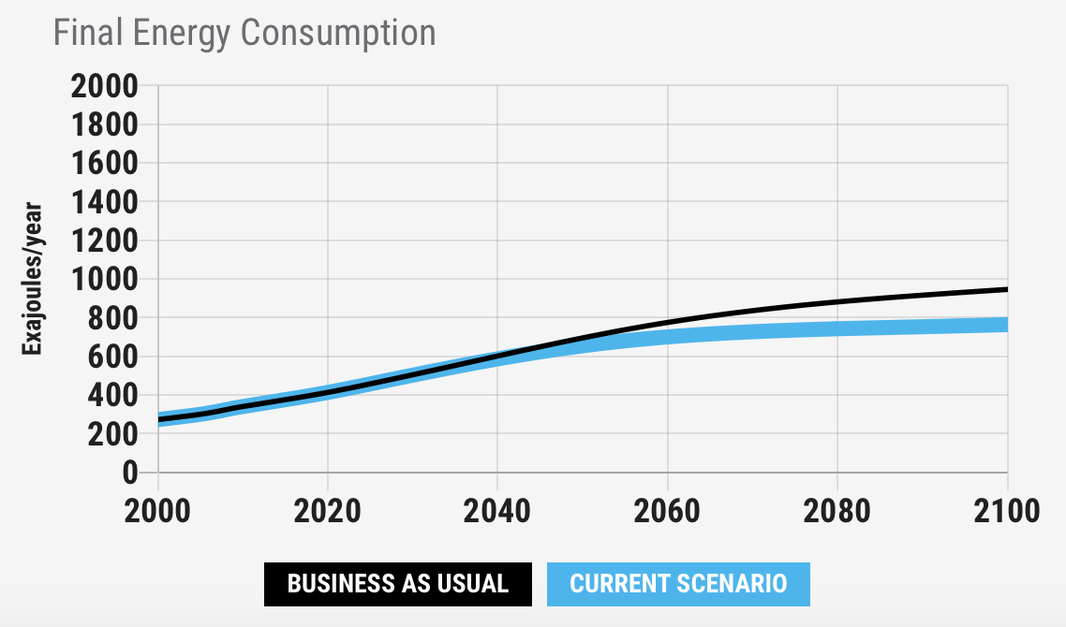
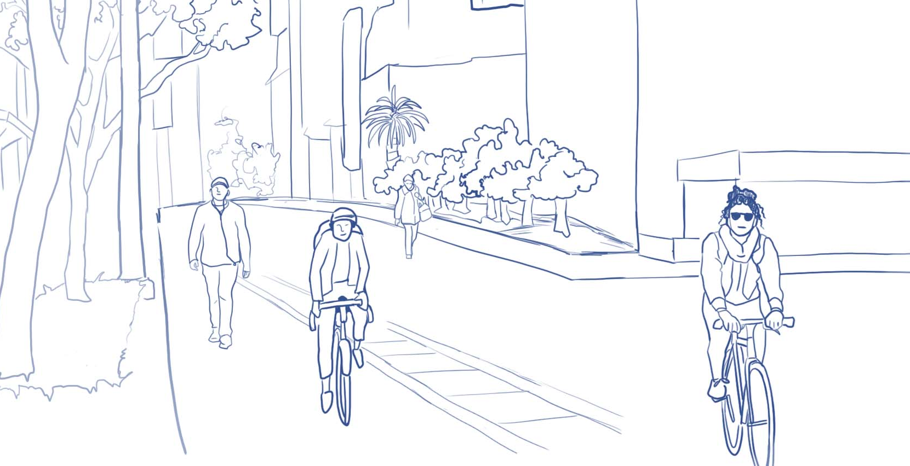
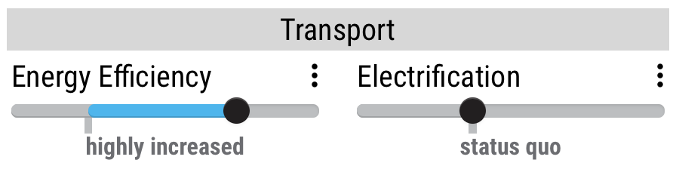
Oakland, California USA
Source
Final Energy Consumption
Oakland, California, announced their city will soon be creating more outdoor space and safer corridors for essential travel by foot or bike. Oakland will restrict access to vehicles on nearly 74 miles of city street – about 10% of the city’s street network.
How can reducing ground transportation in Oakland impact our energy consumption?
Related
Co-benefits
Notes:
Copy and paste the link below to access the source:
https://www.citylab.com/transportation/2020/04/slow-streets-oakland-car-free-roads-pedestrians-covid-19/609961/

Slide 3
Equity considerations
In general, investments that open streets to walkers and cyclists give people without cars or drivers licenses more options for mobility. How can the investments in Oakland provide access for or support people with disabilities?

Slide 4
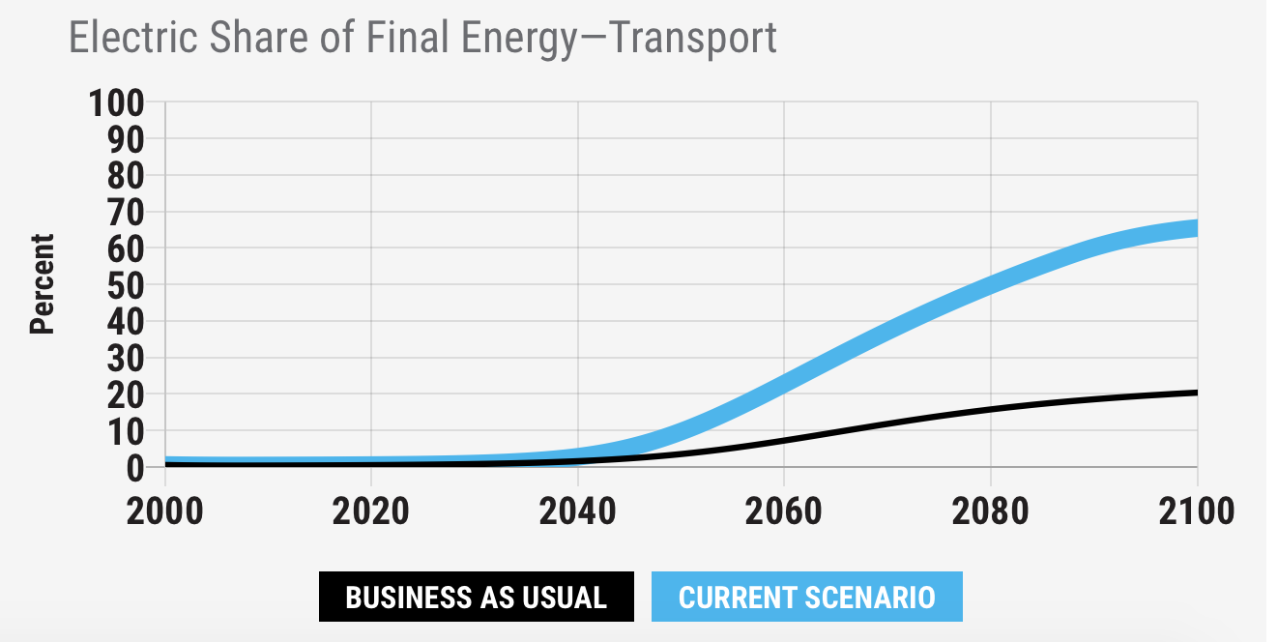
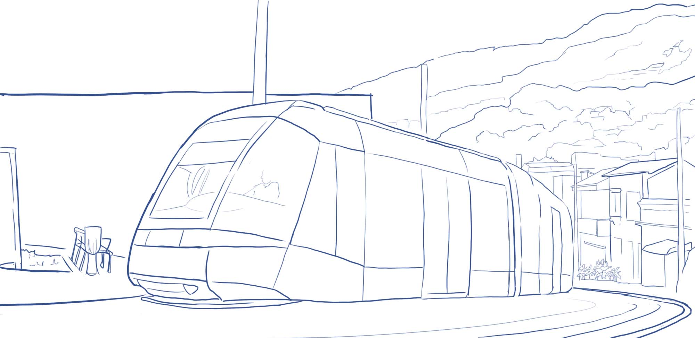
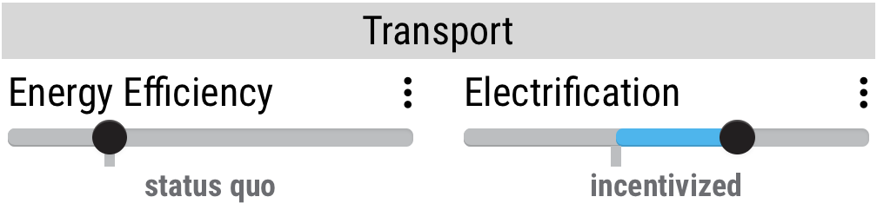
Medellín, Colombia
Source
Electric Share of Final Energy – Transport
City officials say they will expand bike lanes by almost 50% within three years, to 145 kilometers, and more than double the number of interconnected public transport lines, including overland trains, trams and cable car lines, to 26 by 2030.
How can expanding public transportation in Medellin impact the electric share of final energy?
Related
Co-benefits
Notes:
Copy and paste the link below to access the source:
https://www.reuters.com/article/us-health-coronavirus-colombia-climate-c/colombias-medellin-pushes-eco-city-aims-in-coronavirus-recovery-idUSKBN2321XZ

Slide 5
Equity considerations
Income and race often determine proximity to public transit and high-quality biking infrastructure. How can investments in cycling and public transportation better serve everyone?

Slide 6
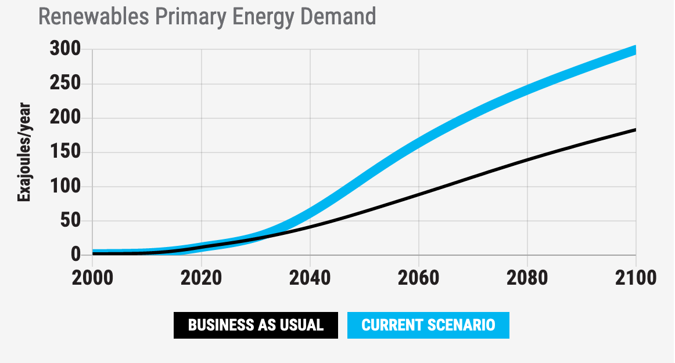
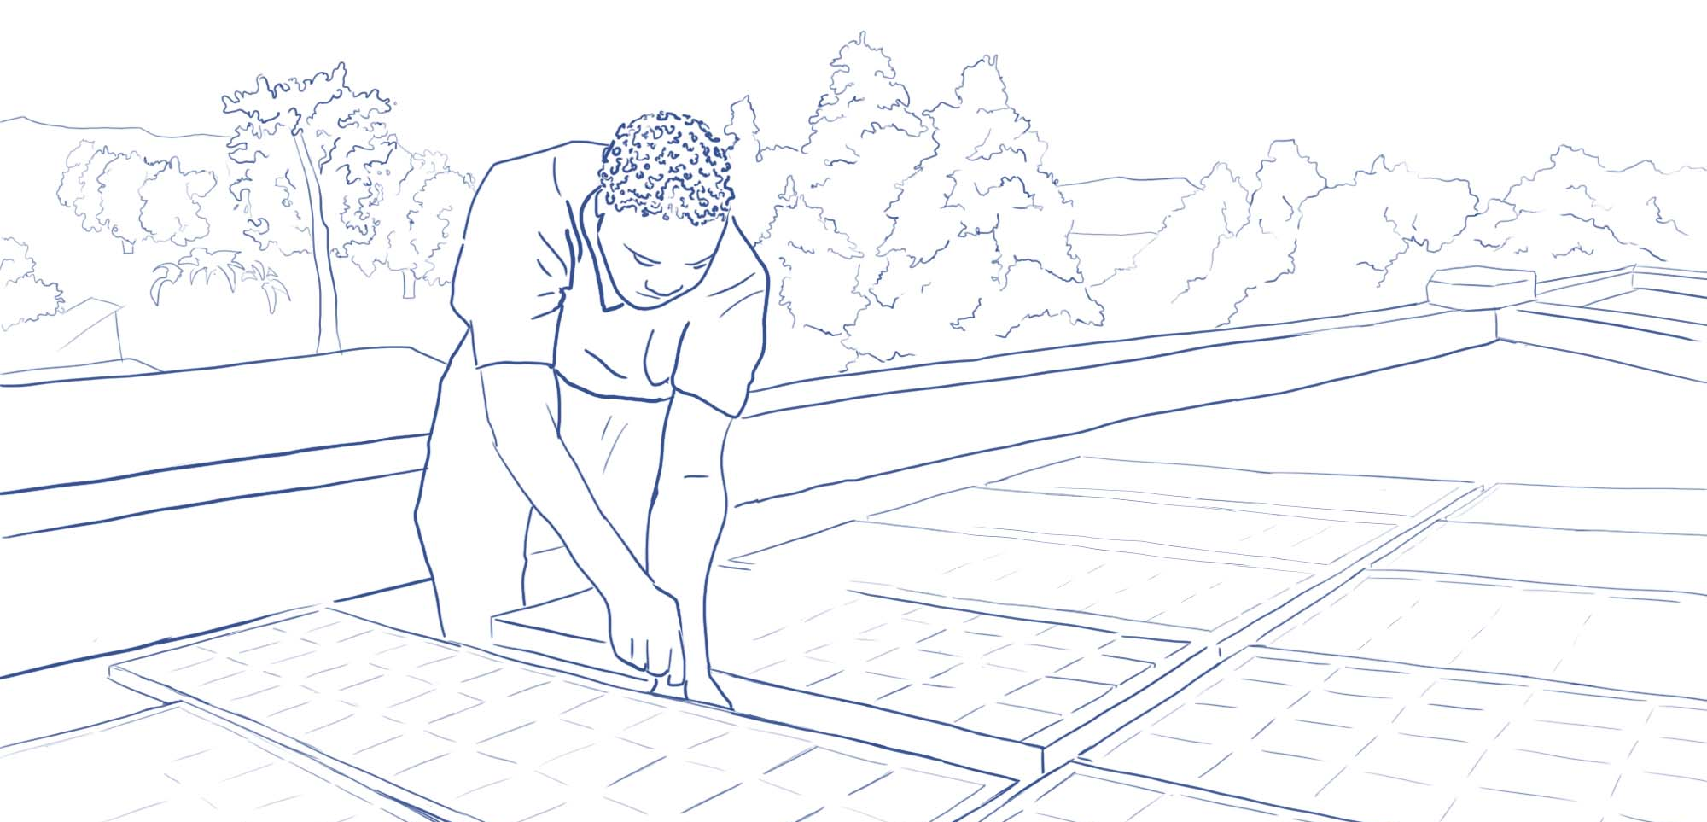
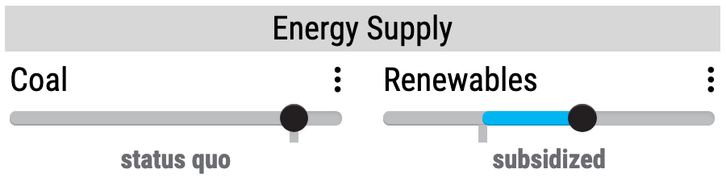
Nigeria
Source
Renewables Primary Energy Demand
Nigeria’s Rural Electrification Agency is partnering with the African Development Bank and World Bank to fund the installation of residential solar systems in areas currently without electricity, as well as mini-grids for medical and health centers.
How can expanding solar power in Nigeria impact renewables primary energy demand?
Related
Co-benefits
Notes:
Copy and paste the link below to access the source:
https://www.energyvoice.com/otherenergy/245447/nigeria-plans-solar-household-boost/

Slide 7
Equity considerations
Jobs in renewables and energy efficiency continue to grow faster than any other energy jobs. How can governments design policy to help channel green employment opportunities to marginalized groups?

Slide 8
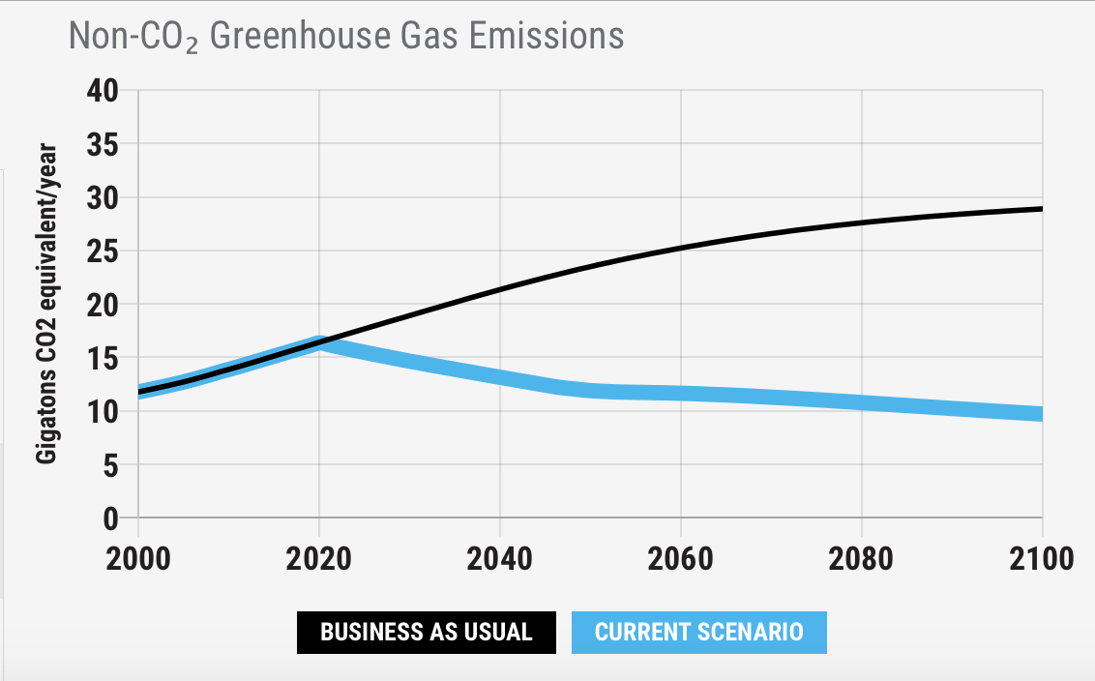

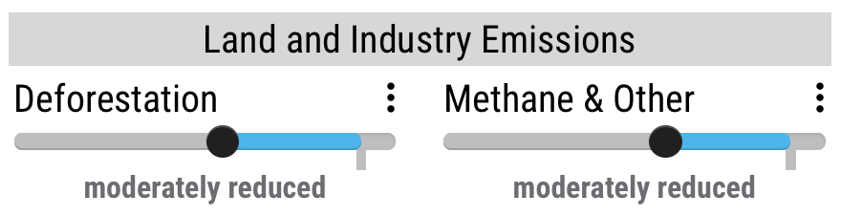
Jamaica
Source
Jamaica adopted an expanded and revised energy plan that emphasizes job creation and targets emission reductions in the country’s land and forestry sectors.
How can reducing deforestation/methane lower non-CO₂ GHG emissions?
Related
Co-benefits
Notes:
Copy and paste the link below to access the source:
https://phys.org/news/2020-07-jamaica-revamps-energy-policy-green.html

Slide 9
Equity considerations
If not crafted carefully, policies to reduce deforestation and land use emissions can compromise food security. How can land use reform protect rights of Indigenous people and preserve food sovereignty?

Slide 10
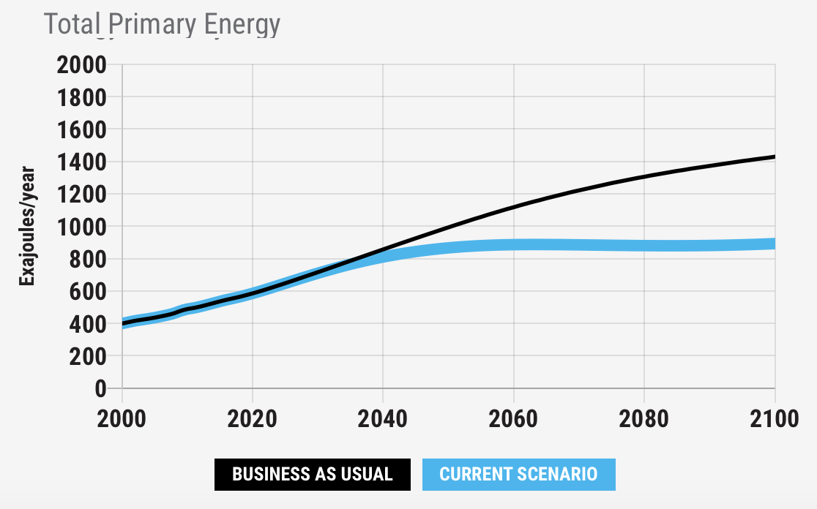
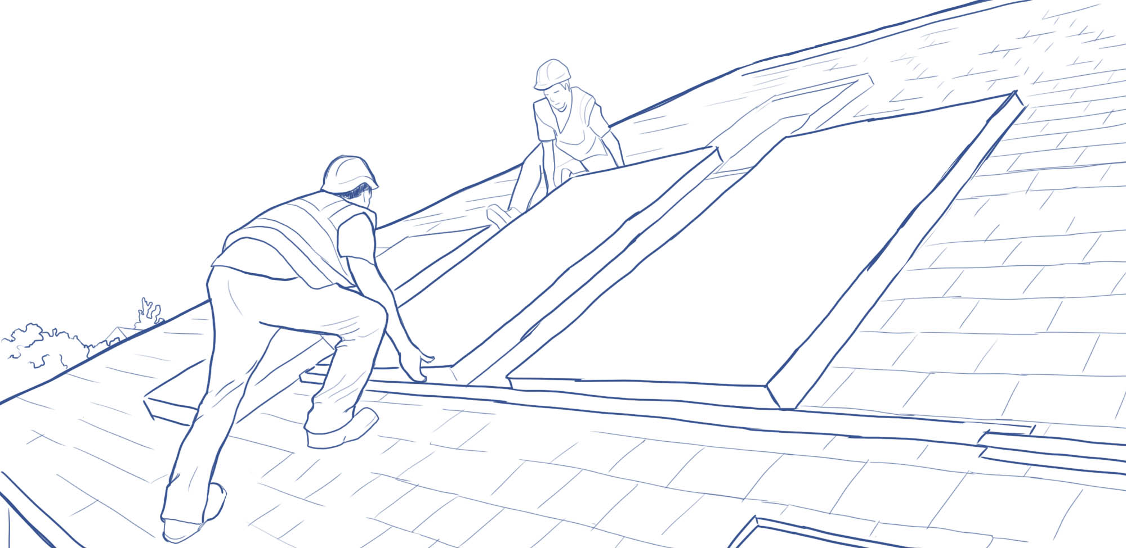
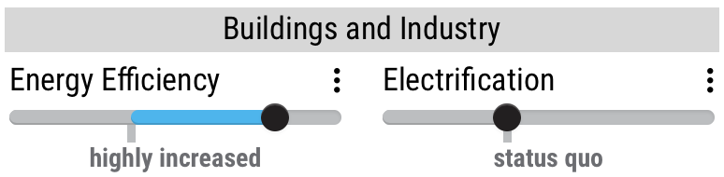
Ireland
Source
Ireland’s “July Jobs Stimulus” package includes initiatives for job creation and reskilling, transportation reform focused on active travel to improve health outcomes, as well as energy efficiency retrofits for homes and businesses.
How can retrofitting homes and businesses in Ireland lower total primary energy?
Related
Co-benefits
Notes:
Copy and paste the link below to access the source:
https://www.gov.ie/en/press-release/07aef-government-launches-74-billion-jobs-stimulus-to-help-businesses-re-open-get-people-back-to-work-and-promote-confidence/

Slide 11
Equity considerations
As energy consumption decreases, or switches from fossil fuels to renewables, many people can lose their jobs. How can policy measures to increase renewables provide workers with useful job reskilling as industries shift?

Slide 12
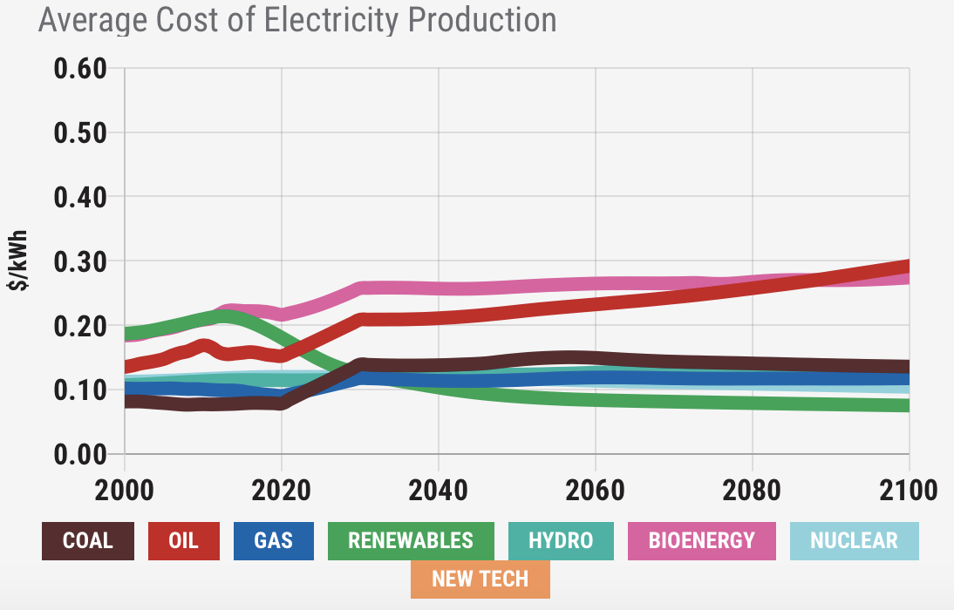
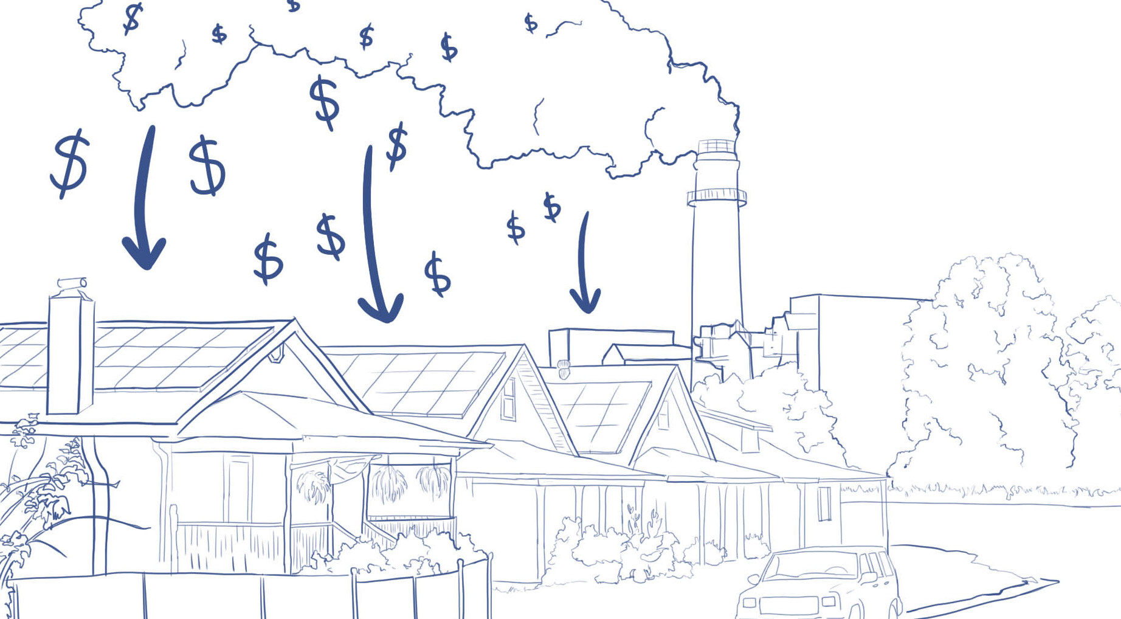
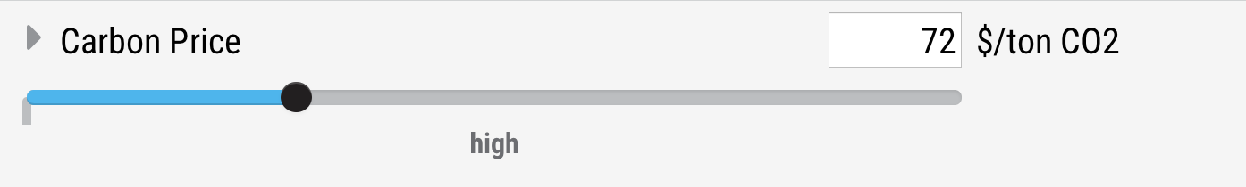
New Jersey, USA
Source
New Jersey state agencies are collaborating on a plan to direct proceeds from the Regional Greenhouse Gas Initiative (RGGI) towards programs that boost clean energy, create jobs, and promotes environmental justice.
How does a carbon price affect the cost of electricity from burning fossil fuels?
Related
Co-benefits
Notes:
Copy and paste the link below to access the source:
https://www.njeda.com/Press-Room/News-Articles/Press-Releases/Murphy-Administration-Releases-RGGI-Strategic-Fund

Slide 13
Equity considerations
Revenue from carbon taxes can be used in many different ways. What can governments do to ensure carbon price funds are reinvested into communities most in need?

