Slide 1
Coherence
Dr. Elizabeth Sawin
Confluence Philanthropy Practitioners Gathering
February 2020
Notes:
Good morning. So here we are approximately 2 months into the decisive decade. Literally going to shape how high the water is going to rise, what species are going to make it, just how many wars and refugees are going to be created. In no case will nothing be flooded, lost, displaced, extinct, right? That ship has sailed. But it could be so much better or so much worse depending on what we in this room do. And we sit out numbered,, underpowered, under-capitalized fighting for a livable future. I’ve got 15 minutes to offer you my best advice for these circumstances so here it is: Seek coherence.

Slide 2
Coherence
Alignment of capital, time, effort and attention with values
Notes:
the alignment of values, capital, time and attention

Slide 3
Notes:
This is a coherent pattern. Do you see how all parts - across scale from top to bottom and across domain from left to right - are following the same organizing princples?

Slide 4
Notes:
This a coherent pattern too – it looks different because it has different organizing principles but internally it is consistent and self similar. If we are going to survive I believe we need to reach for this sort of coherence. My organization, Climate Interactive has been building computer simulations of climate change like for over a decade, and I’m using a word like survival in that context.

Slide 5
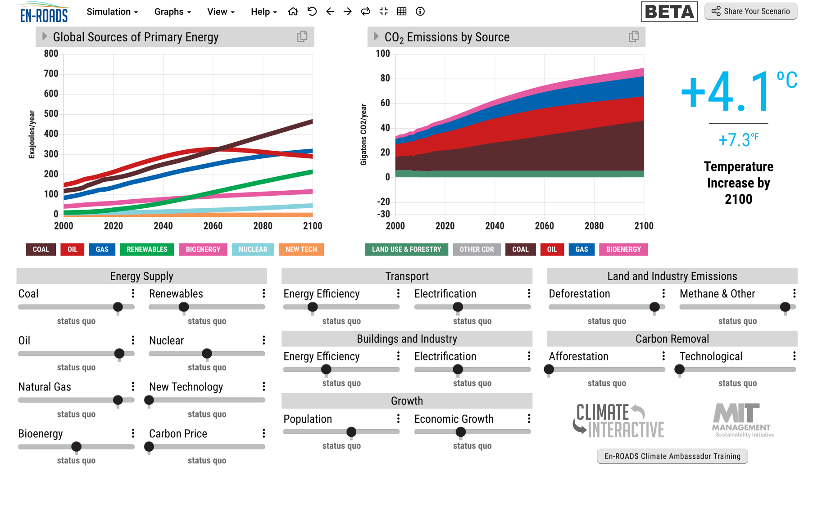
Notes:
This is an example of one of those computer models. It shows where we are headed without action on climate.

Slide 6
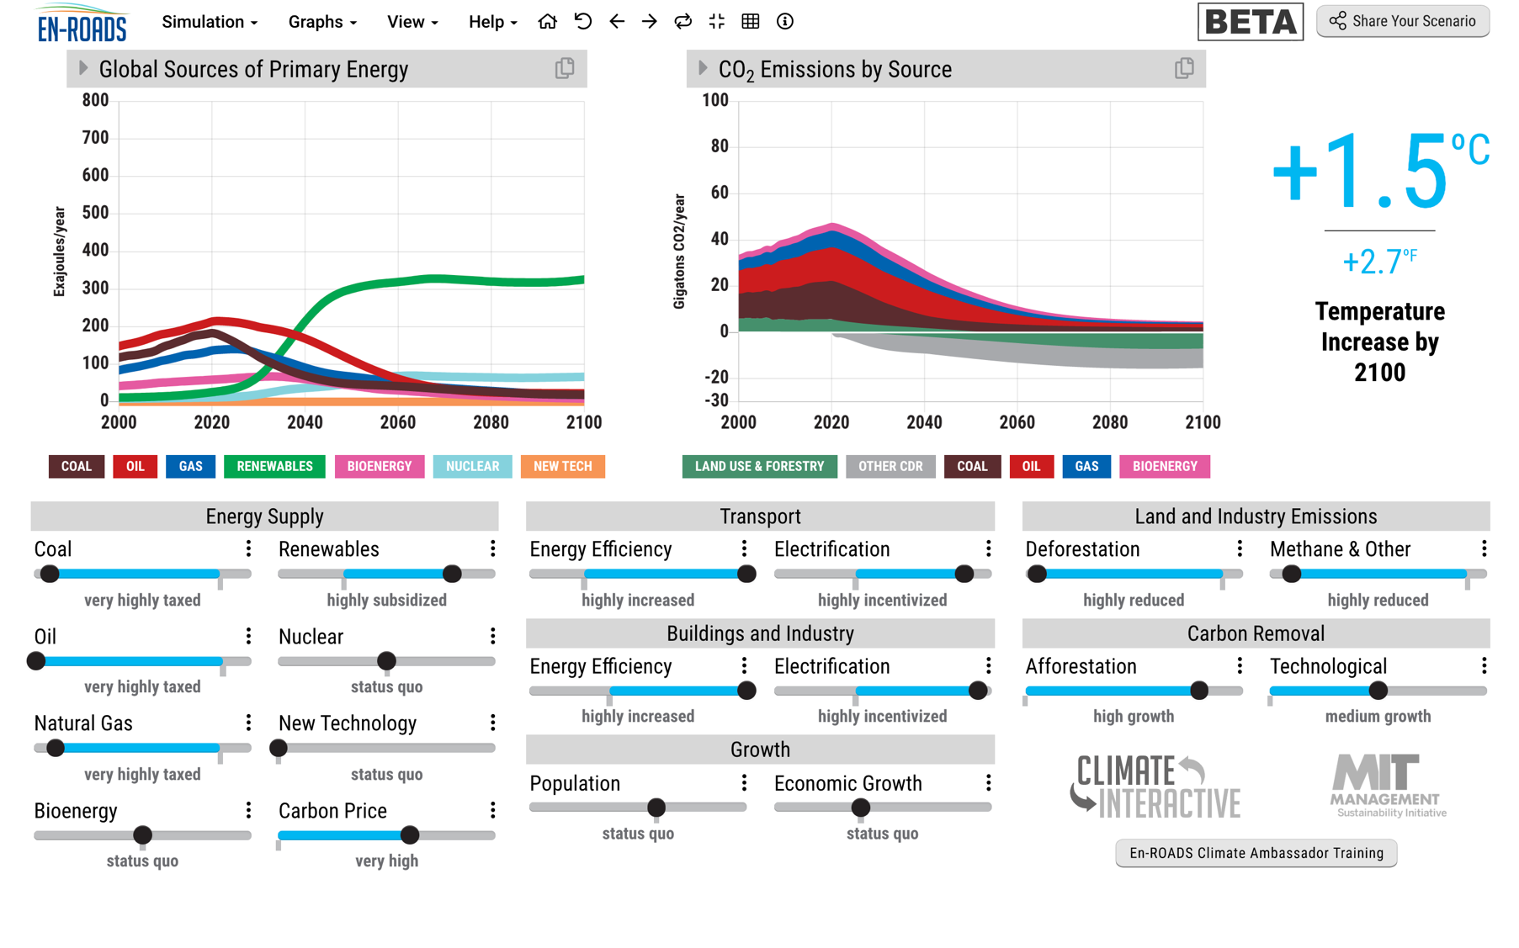
Notes:
It allows you to make scenarios, like this one, of ambitious global action. And the good news is En-ROADS and other models like it, show that there aren’t physical reasons why we can’t reach the goals of the Paris Agreement, to limit temperature increase to well below 2 degrees. But….here’s what I had to assume to create this scenario.

Slide 7
Everywhere
Notes:
I had to assume action happened everywhere

Slide 8
Starting now
Everywhere
Notes:
Starting now

Slide 9
Starting now
Everywhere
Across all sectors
Notes:
Across all sectors

Slide 10
Starting now
Close to perfectly
Everywhere
Across all sectors
Notes:
Implemented close to perfectly

Slide 11
Starting now
Close to perfectly
Everywhere
Across all sectors
Across all scales
Notes:
Across all scales, penetrating into every village and city block

Slide 12
Starting now
Close to perfectly
Everywhere
For decades to come
Across all sectors
Across all scales
Notes:
And sustained for decades to come.

Slide 13
With no one ‘in charge’
Notes:
On top of that there is no one in charge of this transformation that has to be almost perfect across scales sectors and domains. If the UN were going to lead us to safety we’d see signs of that by now.

Slide 14
All while coping with escalating impacts
Notes:
And on top of that you know we have to get it done while coping with escalating impacts. Dr Colon just gave us a first hand perspective on that.

Slide 15
Photo credit: Pixabay
Notes:
And who are we to get this done. Us – against the 70 trillion dollar global economy which is still mostly pushing in the wrong direction. What do I have to offer you up against this?

Slide 16
Photo credit: Pixabay
Notes:
I’ve got this.

Slide 17
Photo credit: Pixabay
Notes:
And this.

Slide 18
Photo credit: Pixabay
Notes:
Or this. These are all coherent patterns, created in nature. And the reason they interest me so much is that they line up so well with what I just told you is needed.

Slide 19
Notes:
I deeply interested in the force that creates pattern like this, because in the fidelity across sector, and scale, and over time (from primordial shoots to existing structures) I see a principle that seems to match what we need for the level of transformation we are holding out for.

Slide 20
Notes:
I’m interested in this force also because it is self-organizing – remember that part about no one being in charge? Remember that part about dirsuptions – command and control strategies break down under disruption, but self-organization carries on.

Slide 21
Coherence
Notes:
For all of those reasons – I’m urging you invest in coherence.

Slide 22
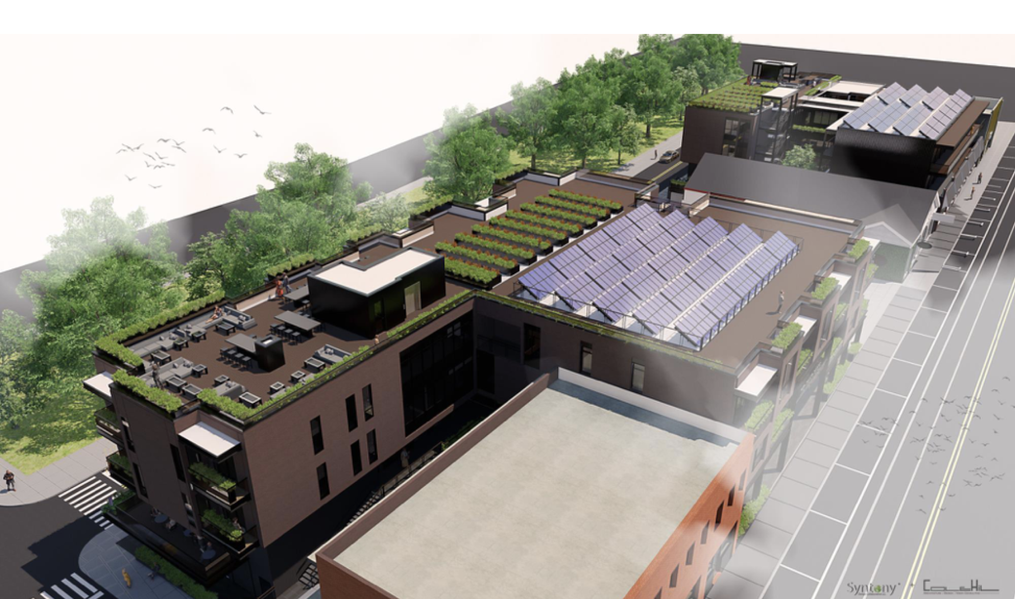
Historic District Development Corporation
Notes:
Here’s a coherent pattern – This is a project being brought to life by the Historic District Development Corporation in Atlanta a short walk from where Dr. King was born. It has coherence across domains – environmental sustainability with the solar panels and rooftop gardens and energy efficient design, economic and racial equity, community participation over time (from design to construction) The vision is that this project will set a pattern for a whole wave of development. And keep that in mind because coherent patterns spread – and part of what we need to tap into are strategies that spread.

Slide 23
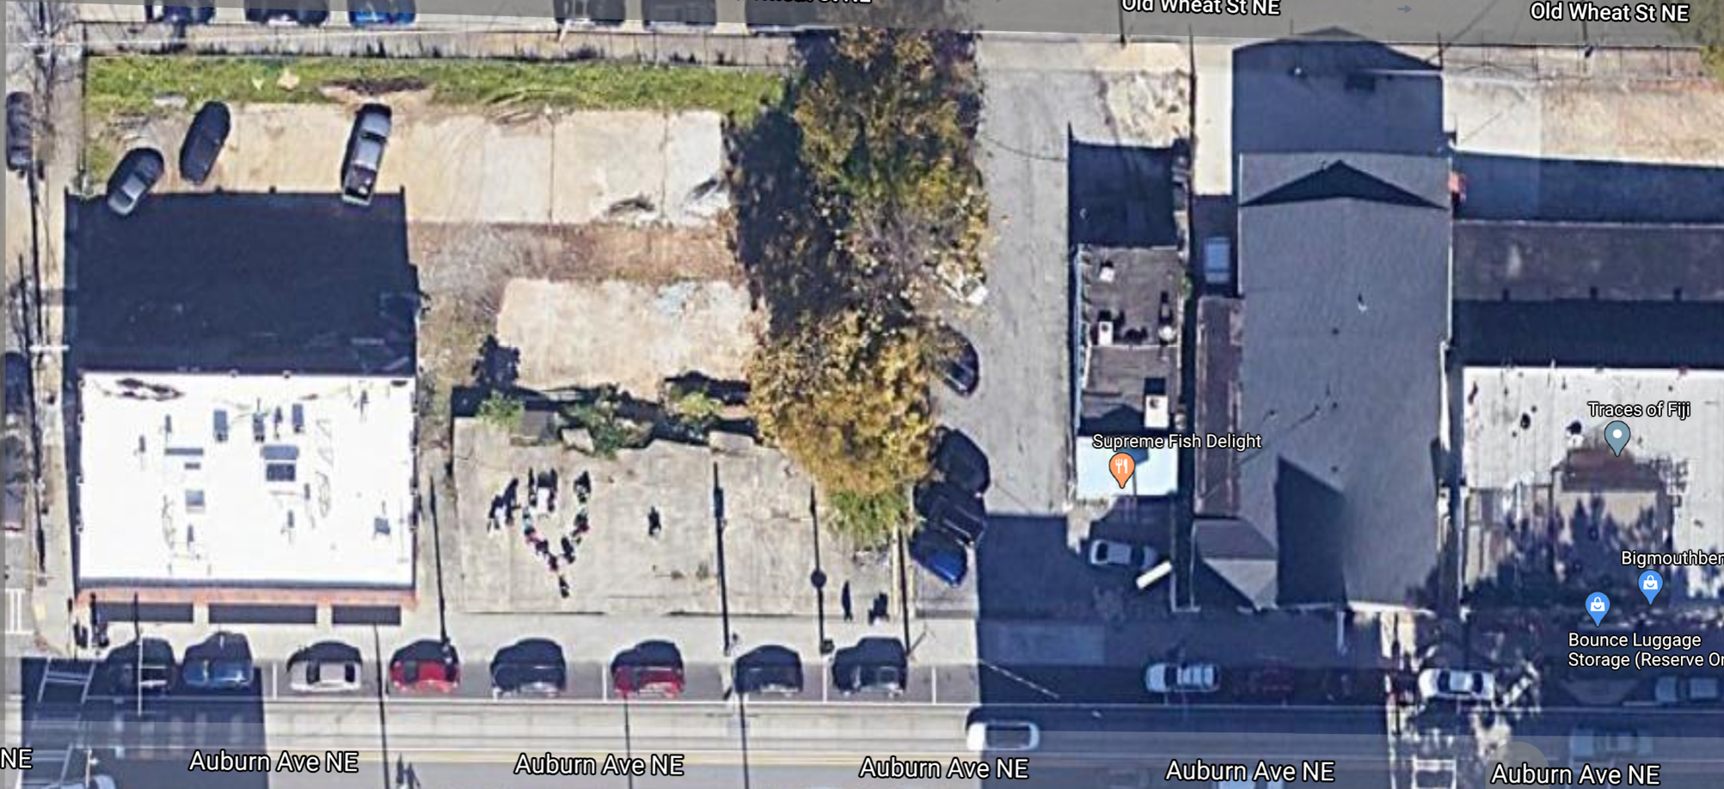
Google Maps
Notes:
But here’s a coherent pattern too. This is the google maps view of the site where the project on the previous slide is planned for. This is actually coherent around being less green, less sustainable, less invested in, than surrounding more affluent, more white communities.

Slide 24
Notes:
Here’s coherent pattern. Me To said the earth as 67 environmental regulations are reversed by trump. Do you see the same organizing principles across the domains of gender and nature?

Slide 25
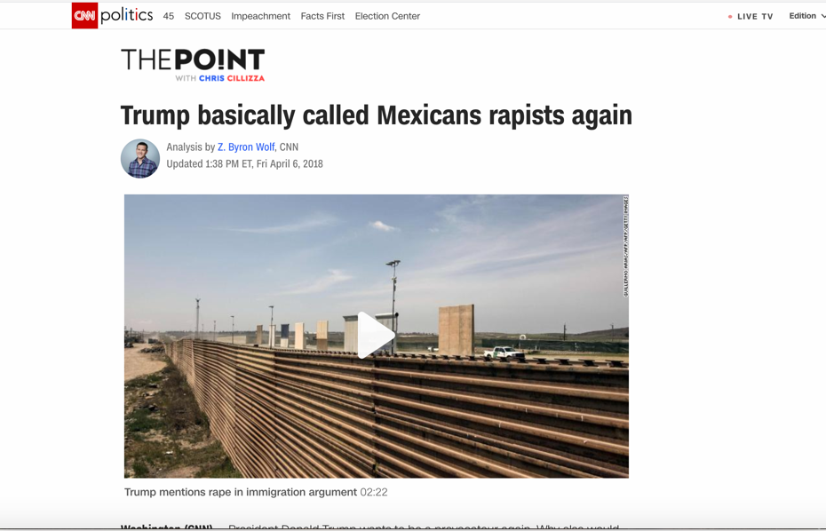
Notes:
In fact, the Trump administration is pretty darn coherent.

Slide 26
Not just any old kind of coherence
Notes:
So its not just any old kind of coherence that matters….

Slide 27
Domination
Partnership
White supremacy
Patriarchy
Earth as resource
Security found in accumulation
Racial equity
Gender equity
Earth as living web
Security found in a web of relationships
Notes:
I’d argue that there are two types of coherent patterns at play in our world right now. They have different names in different domains, but overall one is about domination, and one is about partnership.

Slide 28
Domination
Partnership
White supremacy
Patriarchy
Earth as resource
Security found in accumulation
Racial equity
Gender equity
Earth as living web
Security found in a web of relationships
Notes:
In the domain of race – white supremacy vs racial equity
In the domain of gender – patriarchy ves gender equity
In the domain of sustainability and climate earth as resource vs earth as alive
In the domain of security – is it found in accumulation or in a being embedded in a web of relationships?

Slide 29
Notes:
Both patterns may be coherent, but only one is consistent with how the earth actually works. Remember Dr. Kings inescapable network of mutuality. Partnership patterns are what survive on earth.

Slide 30
Notes:
Now in our daily lives none of us experience perfect coherence. Here’s an example of an incoherent system. This might be my first job in an environmental non-profit, where our global policy work was all about partnership, but where young women were subject to abuse. Addressing that pattern would have made that organization more coherent.

Slide 31
Notes:
Here’s another incoherent system. This is what your field might have looked like 15 or 20 years ago. Foundations giving grants in a partnership mindset, but with most of their asests caught up in an economy based mostly on values we’d call domination. In fact you could say that a big part of what motivates your movement is to bring greater coherence to all of your activities.
But why does coherence matter so much. Why am I saying that above almost everything else the quest for coherence should define your work this decade?

Slide 32
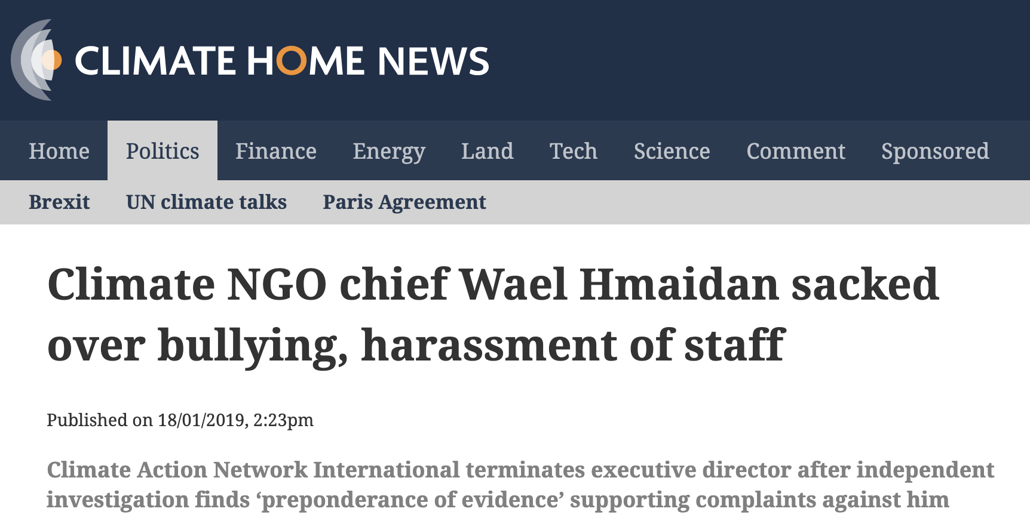
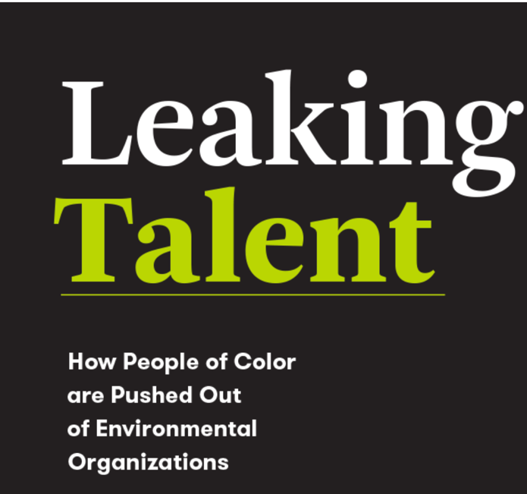
Incoherence weakens
Notes:
Well for one thing incoherence makes us weak, whether is state and federal levels pushing in opposite directions, or not being able to draw on the full brilliance of our communities, or weakening us with experiences of the violence that domination patterns create. Incoherence weakens, while….

Slide 33
Coherence attracts and energizes
Historic District Development Corporation
Notes:
Coherence attracts and energizes. I wish you could see people’s faces when they learn about this project.

Slide 34
Coherence opens up new spaces
Photo: Soulardarity
Notes:
Coherence opens up new spaces. This is photo a of a community owned solar streetlight put in place by a non-profit in highland park Michigan with 2 paid staff – soulardarity. After their electric utility removed streetlights because the city couldn’t pay it’s bills, in their community they developed a model this model – a foray into clean energy that also increased public safety. Their project ran into limits, in the insurance industry and public utility commission rulings. So they challenged and changed those rules. Meaning other communities in Michigan could do similar projects. Do you see how coherence means that patterns from a small scale can open up possibilities at larger scales that then ripple out laterally. Coherence opens up new spaces and allows patterns to spread.

Slide 35
Coherent patterns ripple outwards
Photo credit: Pixabay
Notes:
Coherent patterns ripple outwards, because the patterns it sets are sort of like a muscle memory.

Slide 36
Coherent patterns ripple outwards
Low stakes → High stakes
Notes:
You can build capacity in low stakes situations – say you cultivate a collaborative culture in your staff meeting – when your newest employee needs to go out and run a high stakes meeting, they’ll have that muscle memory of partnership to draw upon.

Slide 37
Coherent patterns ripple outwards
One sector→ Other sectors
Notes:
If two sectors are coherent then innovation from one sector can be transferred to another.

Slide 38
Coherent patterns ripple outwards
Familiar→ unfamiliar
Notes:
Coherent patterns provide the basis for improvisation. In novel situations people draw upon the patterns they know. Facing a period of increasing instability, we can’t predict everything we need to know – put we can put every effort into building strong partnership patterns, that will be there in novel situations. If we don’t establish stronger partnership patterns, guess what patterns are going to be drawn upon to meet that instability. We are already seen this right? Walls, camps, eco-fascism.

Slide 39
Photo credit: Pixabay
Notes:
You have a wonderful ecosystem here, with lots of those pockets of coherence. Your whole movement is about coherence. Imagine what might happen if you became even more mindful , disciplined and committed to that practice. I’m obviously not an expert on your sector, but here are a few thoughts about what that might look like.

Slide 40
Coherence is not for wimps
Photo credit: Pixabay
Notes:
First, let me say: coherence is not for wimps. You know this if you’ve ever stood up to a bully or stood up for a principle in a system where it was not accepted. Coherence around partnership values is going to take courage. But I think you all have what will be required.

Slide 41
Remove your resources (time, attention, capital) from patterns with domination elements.
Notes:
Remove your resources from patterns with domination elements. That’s what divestment is of course. But I’m talking across everything. Clean energy but it’s got a dirty secret in the supply chain? it’s not coherent. Great company but the founder is abusive? it’s not coherent. Your own staffing doesn’t reflect the demographics of the community you serve? It’s not coherent.

Slide 42
Redirect your resources (time, attention, capital) to patterns with partnership elements.
Notes:
The flip side: Redirect your resources (time, attention, capital) to patterns with partnership elements.

Slide 43
Measure, reward, and incentivize the coherence of patterns.
Notes:
Measure, reward, and incentivize the coherence of patterns. I’d love to talk to about what this might look like, ways to score coherence inner and outer, supply chains, process wise, all the dimensions. With partners in Atlanta we are experimenting with tools to help with this kind of analysis.

Slide 44
Work with coherence & design for it.
Find pockets of partnership & strengthen them and link them up.
Notes:
Work with coherence & design for it.
Find pockets of partnership & strengthen them and link them up.
Connect your grantees with your investing strategies
Line up your HR protocols with your investing strategies.
Bring together the coherent pattern across different sectors for learning and acceleration of innovation.

Slide 45
Photo credit: Pixabay
Notes:
The bottom line. Focus relentlessly, every day, in every interaction, in little small things and in the most consequential decisions on coherence. Don’t be distracted by chasing big sexy projects or long convoluted theories of change that will just fall apart under the coming disruptions anyway. Just focus on coherence.
And buckle up for a challenging, put possibly beautiful and powerful ride.

Slide 46
Thank you and let’s connect to improve this thinking! esawin@ClimateInteractive.org
Notes:
Thank you.

