Slide 1




Climate Action Simulation
Notes:
Dear Facilitator, these slides can support your facilitation of the Climate Action Simulation roleplaying game, which complements the En-Roads simulation model. You may pick and choose from these slides and adjust them to suit your audience and setting.
Script: Welcome everyone! I am [introduce yourself] and I’ll be facilitating the Climate Action Simulation today.
These slides were last updated in May 2022.

Slide 2



Developed by:
Notes:
Script: We’ll be using an interactive tool called En-ROADS which is developed by Climate Interactive, a leading nonprofit climate & energy think tank, in partnership with the MIT Sloan Sustainability Initiative and UMass Lowell’s Climate Change Initiative.

Slide 3
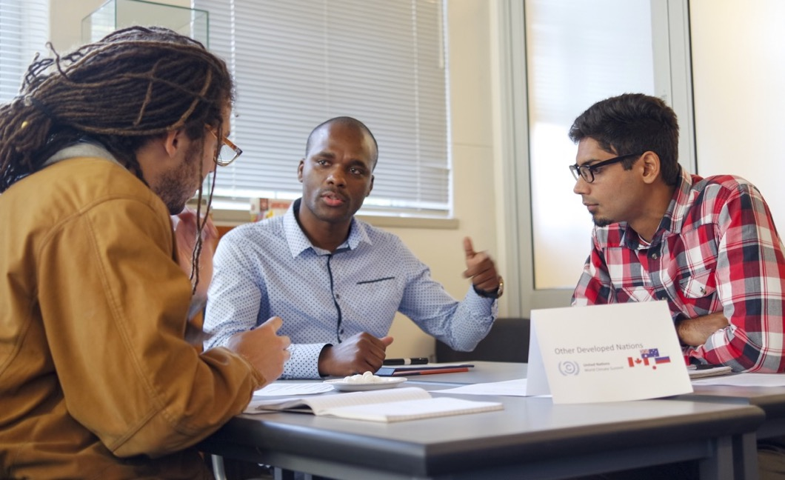

Agenda:
Introduction
Welcome to the Summit
Plenary Rounds
Debrief

Slide 4
Introduction

Slide 5



The Climate Action Simulation is a group roleplaying game to explore solutions for mitigating climate change.
Real data
Computer Simulator
Mock UN summit
Notes:
Script: Today you will experience the Climate Action Simulation, which is an interactive group roleplaying game that helps you learn about the solutions for mitigating climate change. You will engage with:
the latest research on climate science and solutions
brought together into one powerful and dynamic computer simulator model called En-ROADS abbreviated for “Energy Rapid Overview and Decision Support”
and you will be roleplaying a mock United Nations climate summit

Slide 6
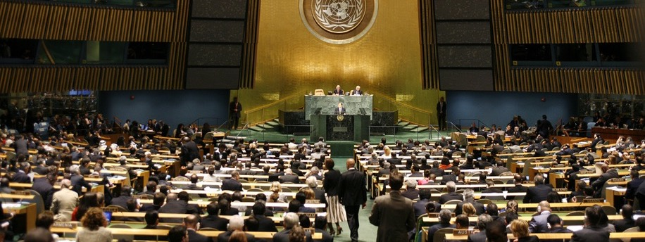
How the Climate Action Simulation game works…
“Global leaders” from sectors across business, government, and civil society gather to negotiate a climate solutions plan to limit global warming to less than 2ºC and ideally 1.5ºC above pre-industrial levels.
Notes:
Script: You will all act as global leaders from different sectors across business, government, and civil society. Our goal will be to negotiate a climate solutions plan to limit global warming to less than 2ºC (3.6ºF) and ideally 1.5ºC (2.7ºF) above pre-industrial levels.

Slide 7
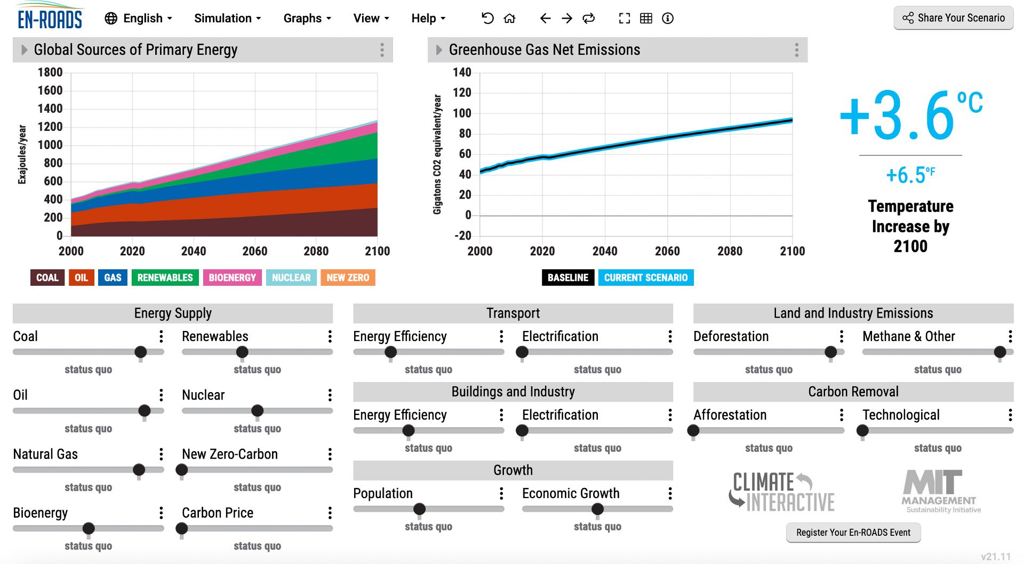
Backed by data…
We will use En-ROADS, a cutting-edge simulation model, to test climate solutions and generate climate scenarios for the future.
Notes:
Updated: December 2021

Slide 8
Let’s briefly review the science and what’s at stake….

Slide 9
Atmospheric CO₂ is higher than any time in that last 800,000 years, and levels are increasing faster than any time in millions of years.
Source: NASA
Notes:
Script: Atmospheric CO2 is higher than at any time in the last 800,000 years, and levels are increasing faster than at any time in millions of years.
Sources: NASA Jet Propulsion Laboratory https://climate.nasa.gov/
Updated: October 2020

Slide 10

Global Temperature Change from Preindustrial (°C)
°F
2.7
1.8
Historical Dataset:
0.9
0
-0.9
Source: C-ROADS
Notes:
Script: This graph shows a closer look at the last 170 years. Measuring from 1850, which is often used to approximate temperature in pre-industrial times, surface temperature has increased approximately 1 degree C, or 1.8 degrees F.
Sources: C-ROADS, using data from NASA GISS Surface Temperature Analysis (GISTEMP v4, 2020) and Met Office Hadley Centre HadCRUT5 (2020)
Updated: March 2022

Slide 11
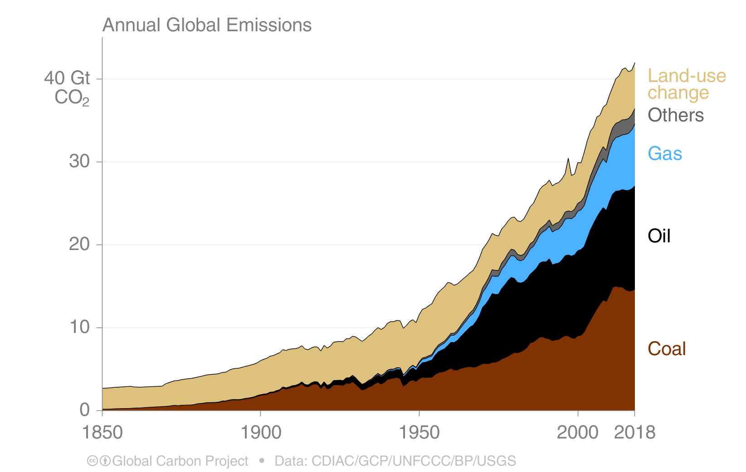
CO₂ Emissions by Source
CO₂ Emissions (Gtons CO₂/year)
Source: Carbon Dioxide
Information Analysis Center (CDIAC)
Other: Emissions from cement production and gas flaring
Notes:
Script: But where does all the CO2 come from? Any ideas? This graph shows the sources of CO2 from the year 1850 to 2018. The primary contributor to CO2 emissions are the fossil fuels: coal (which you see in brown), oil (in black), and gas (in blue). You can see that there has been lots of growth in coal, oil and gas over the last 100 years. Comparatively, land-use change emissions, which are primarily from deforestation, have not grown as substantially and may even be declining. Other emissions primarily consist of lime calcination for concrete production.
Sources: CDIAC (https://www.globalcarbonproject.org/carbonbudget/19/presentation.htm), drawing from Houghton and Nassikas 2017; Hansis et al. 2015; Friedlingstein et al. 2019; Global Carbon Budget 2019
Updated: October 2020

Slide 12
Total Annual Global Greenhouse Gas Emissions by Gas
Source: C-ROADS
Notes:
Script: Carbon dioxide is not the only thing that is contributing to climate change. There are also several other greenhouse gases. Here you see the relative contribution from different gases. In black and green you can see the contribution that CO2 makes from fossil fuels and land use, then in light blue is methane (CH4), then nitrous oxide (N2O), and the F-gases (fluorinated gases). Agriculture contributes 50% of global methane (CH4) emissions and 60% of global nitrous oxide (N2O) emissions. Heavy industry and manufacturing, as well as consumer goods, are sources of N2O and F-gases.
Sources: C-ROADS (Climate Interactive)
Updated: September 2020

Slide 13
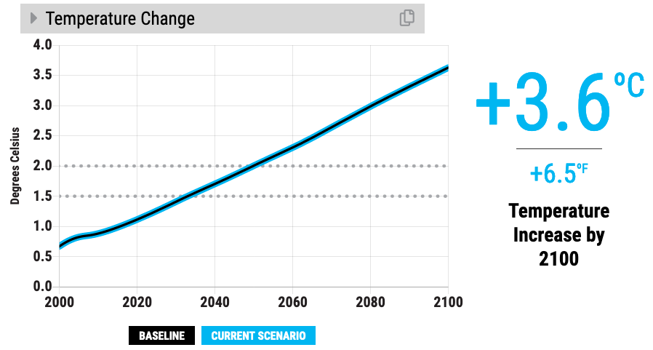

Baseline scenario
Our climate goals (1.5ºC to 2ºC)
Notes:
Script: If we continue business as usual, we estimate that temperature change will reach 3.6 degrees Celsius by 2100. That’s 6.5 degrees Fahrenheit. Compare the bold line to the dotted lines where our climate goals (2 degrees C and 1.5 degrees C) are on the graph.
Updated: November 2020

Slide 14
What would 3+ °C (or 5.4+ °F) of warming mean?
Arctic sea ice is gone in 2 out of every 3 summers¹
50% of insect species lose >50% of their habitat range²
Drought: 11 months longer
Increase in average drought length³
Area burned by summer wildfires in Mediterranean doubles⁴
^{Compared to today}
See the impacts of your scenario in the Impacts graph section of En-ROADS
Notes:
Script: However, I want to be clear. A 3-4 degree future is still very bleak – especially for the world’s most vulnerable nations and communities who experience the impacts of climate change disproportionately. We need to do better. Far better. Here’s what a 3 degree future means for our world: [Read bullets from the slide].
Notes:
Arctic sea ice: Melting of Arctic sea ice has a positive feedback effect on global warming, as ice and snow reflect energy from the sun back into space. Without sea ice, more of the energy is absorbed, contributing to further warming. A warming Arctic and lessening sea ice are linked to extreme weather effects in other parts of world, as a result of the global atmospheric circulation. For more on this topic, see https://www.carbonbrief.org/qa-how-is-arctic-warming-linked-to-polar-vortext-other-extreme-weather
Insects: Insects are important as pollinators, for nutrient cycling, and for breaking down waste, among other services. They are the major or sole food source for many amphibian, reptile, bird, and mammal species.⁵
Updated: September 2020
Sourcess:
1. Sigmond, M., Fyfe, J.C. & Swart, N.C. Ice-free Arctic projections under the Paris Agreement. Nature Clim Change 8, 404–408 (2018). https://doi.org/10.1038/s41558-018-0124-y
2. Warren, R., et al. "The projected effect on insects, vertebrates, and plants of limiting global warming to 1.5 C rather than 2 C." Science 360.6390 (2018): 791-79
3. Naumann, G. et al. (2018) Global Changes in Drought Conditions Under Different Levels of Warming, Geophysical Research Letters
4. Turco, M. et al. (2018) Exacerbated fires in Mediterranean Europe due to anthropogenic warming projected with nonstationary climate-fire models, Nature Communications. https://www.nature.com/articles/s41467-018-06358-z
5. https://www.si.edu/spotlight/buginfo/benefits
Photos:
Arctic: https://pixabay.com/images/id-1913559/
Trees: https://pixabay.com/images/id-947331/
Bee: https://pixabay.com/images/id-4243850/
Wildfire: https://www.flickr.com/photos/slworking/29034137667

Slide 15
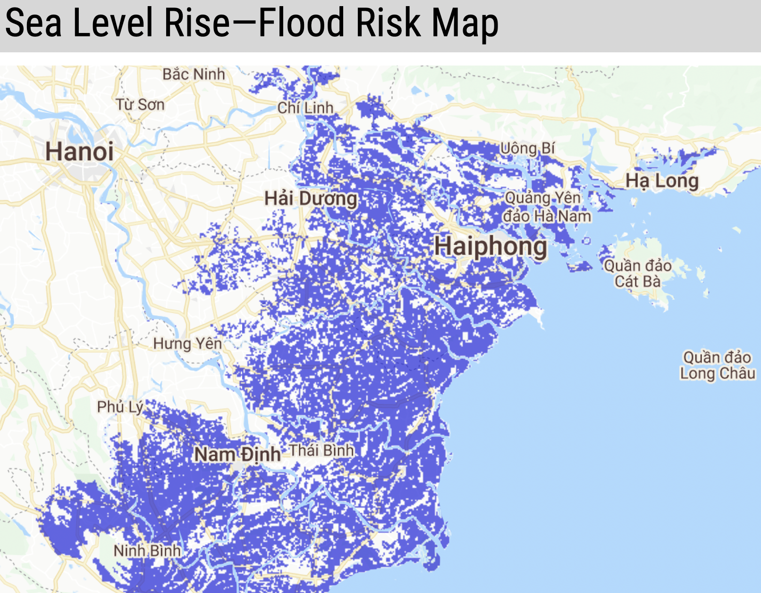
Hanoi, Vietnam: 3.6°C
Flood risk from sea level rise by 2100
Source: En-ROADS & Climate Central
Notes:
Note: The sea level rise flood risk shown here is a projection of sea level rise by 2100. The sooner we cut carbon emissions, the lower the eventual sea level rise. Use the Sea Level Rise—Flood Risk Map in En-ROADS under “Impacts” in the Graphs menu to search for a location and see the effect of lowering temperature in your scenario.
Source: En-ROADS in collaboration with Climate Central using the Climate Central Coastal Risk Screening Tool https://coastal.climatecentral.org/
Updated: March 2022

Slide 16
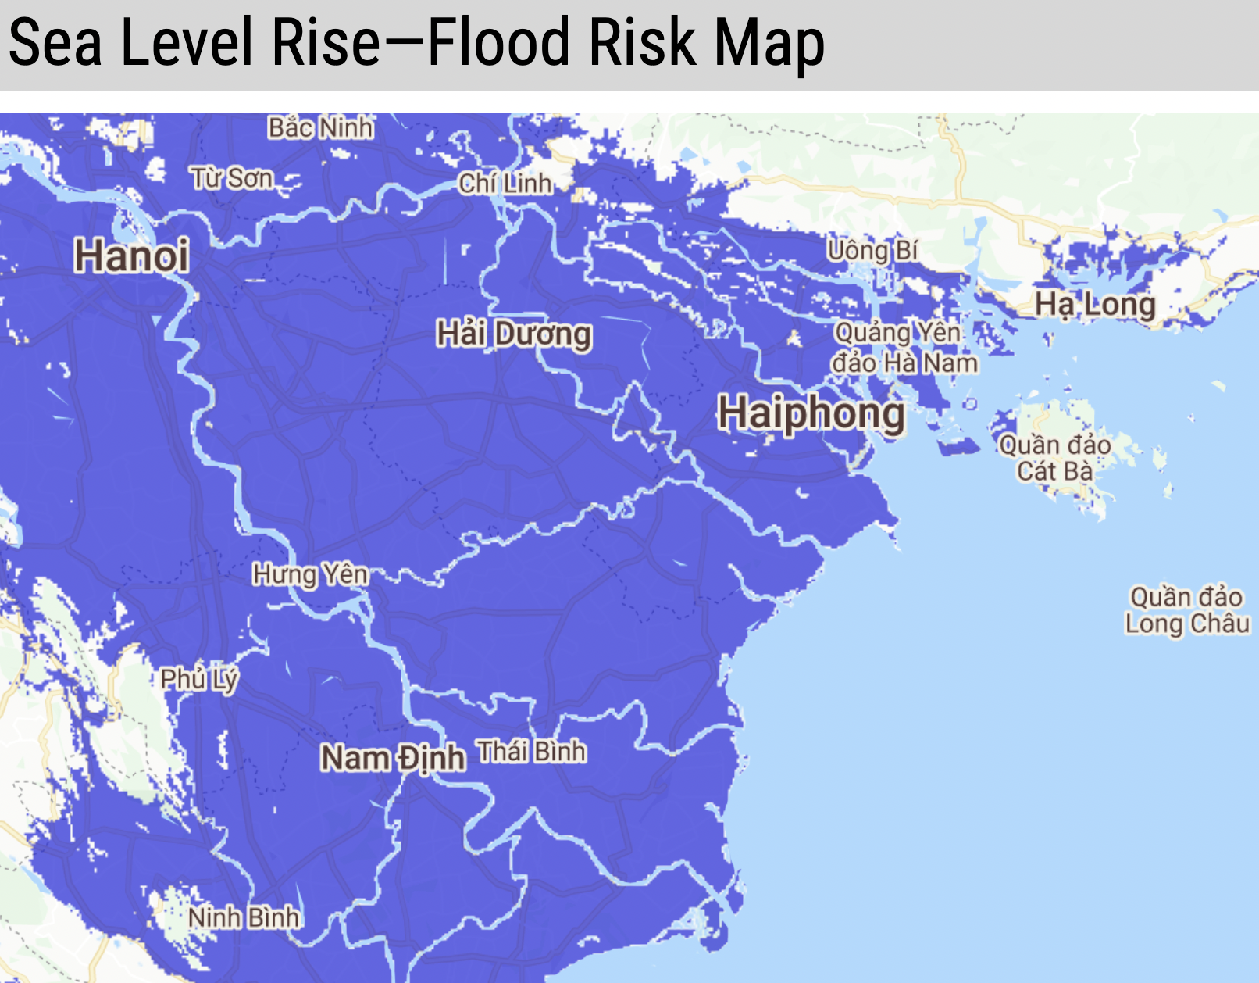
Hanoi, Vietnam: 3.6°C
Flood risk from sea level rise over next few centuries
Use En-ROADS to create a scenario that lowers this sea level rise. View the map under “Impacts” in the Graphs menu.
Source: En-ROADS & Climate Central
Notes:
Note: The sea level rise flood risk shown here is a projection of long-term (over centuries) sea level rise due to sea levels locked in by different amounts of carbon pollution. This is “committed” sea level rise – it will continue even if carbon emissions are cut. The sooner we cut carbon emissions, the lower the eventual sea level rise. Use the Sea Level Rise—Flood Risk Map in En-ROADS under “Impacts” in the Graphs menu to search for a location and see the effect of lowering temperature in your scenario.
Source: En-ROADS in collaboration with Climate Central using the Climate Central Coastal Risk Screening Tool https://coastal.climatecentral.org/
Updated: March 2022

Slide 17
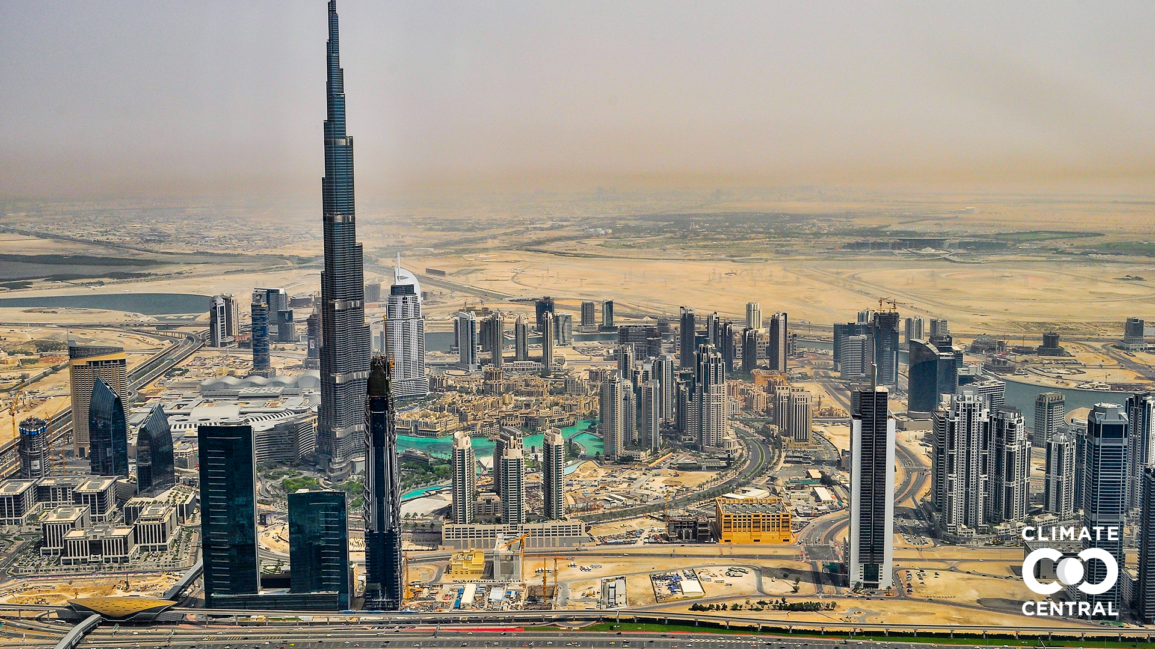
Dubai today
Notes:
Script: Here is what Burj Khalifa (the tallest skyscraper in the world) in Dubai, United Arab Emirates looks like today…
Source:
Climate Central. (2021). Picturing Our Future. https://picturing.climatecentral.org/
Benjamin H Strauss et al. (2021). Unprecedented threats to cities from multi-century sea level rise. Environ. Res. Lett. 16 114015. https://doi.org/10.1088/1748-9326/ac2e6b

Slide 18
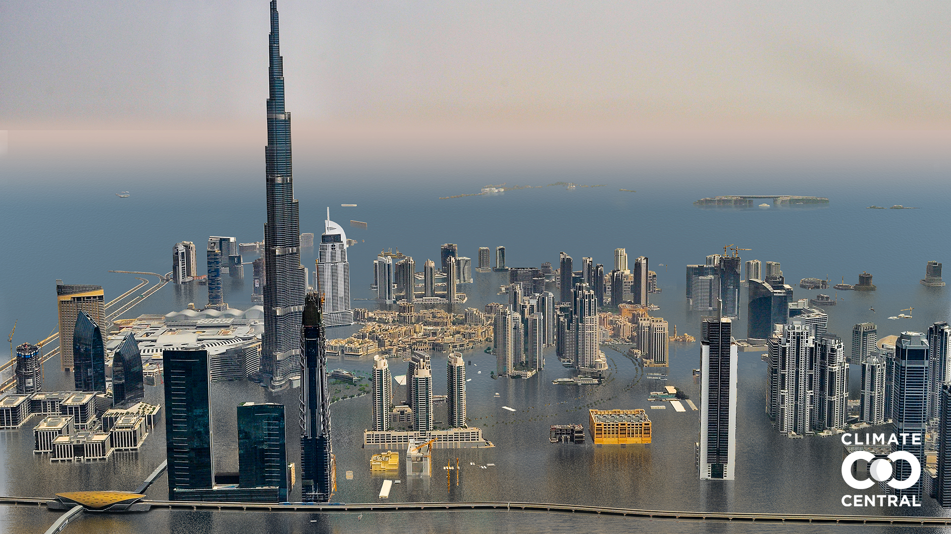
…and with 3°C of warming
Dubai today
Source: Climate Central
Notes:
…and with long-term sea level rise due to 3°C of warming.
Source:
Climate Central. (2021). Picturing Our Future. https://picturing.climatecentral.org/
Benjamin H Strauss et al. (2021). Unprecedented threats to cities from multi-century sea level rise. Environ. Res. Lett. 16 114015. https://doi.org/10.1088/1748-9326/ac2e6b

Slide 19
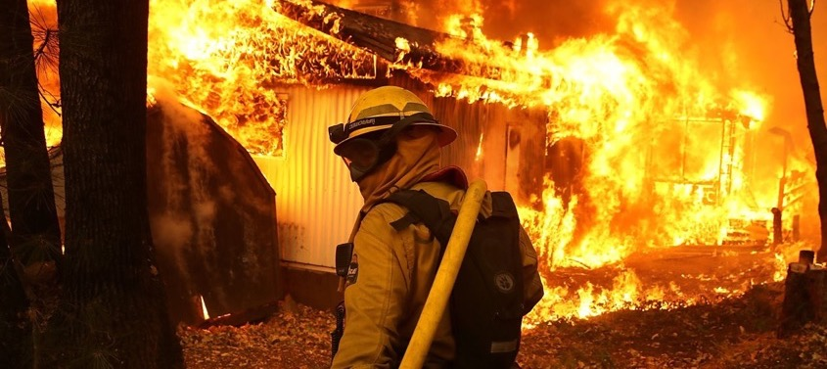
Climate-related disasters cost the world $650 billion between 2016 and 2018. Damages associated with global warming could total over $54 trillion by the time we reach 1.5°C.
Source: Morgan Stanley, IPCC, CNBC
Notes:
Sources:
Morgan Stanley. “Five Sectors that Cannot Escape Climate Change.” March 23, 2020. https://www.morganstanley.com/im/en-us/individual-investor/insights/articles/five-sectors-that-cannot-escape-climate-change.html
IPCC, 2018: Global warming of 1.5°C. An IPCC Special Report on the impacts of global warming of 1.5°C above pre-industrial levels and related global greenhouse gas emission pathways, in the context of strengthening the global response to the threat of climate change, sustainable development, and efforts to eradicate poverty [V. Masson-Delmotte, P. Zhai, H. O. Pörtner, D. Roberts, J. Skea, P.R.Shukla,A. Pirani, W. Moufouma-Okia, C.Péan, R. Pidcock, S. Connors, J. B. R. Matthews, Y. Chen, X. Zhou, M. I. Gomis, E. Lonnoy, T. Maycock, M. Tignor, T. Waterfield(eds.)]. https://www.ipcc.ch/site/assets/uploads/sites/2/2019/06/SR15_Full_Report_Low_Res.pdf
Photo: https://www.cnbc.com/2019/02/14/climate-disasters-cost-650-billion-over-3-years-morgan-stanley.html

Slide 20
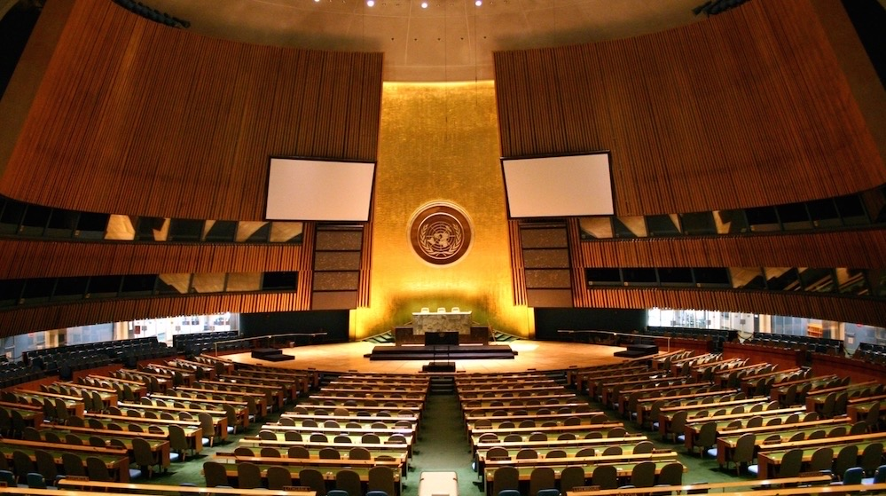
Welcome to the
UN Climate Action Summit
Notes:
Note - Open the roleplaying period. Enter the room as the UN Secretary General, and deliver your opening speech! (example speech from UN Secretary General Antonio Guterres: https://youtu.be/P8M-2gSm3bs)

Slide 21

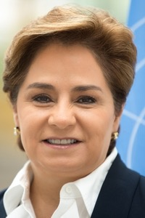

Opening Remarks by UN Secretary-General
UN Secretary-General
António Guterres
UNFCCC Executive Secretary
Patricia Espinosa
Notes:
Note – Insert your own professional headshots above. Depending on your co-facilitator’s skillset and role, you may choose to replace the second role e.g., IPCC Science Specialist, UN Policy Specialist, etc.
Sources:
https://www.un.org/sg/en/content/sg/biography
https://unfccc.int/about-us/the-executive-secretary
Updated: October 2020

Slide 22
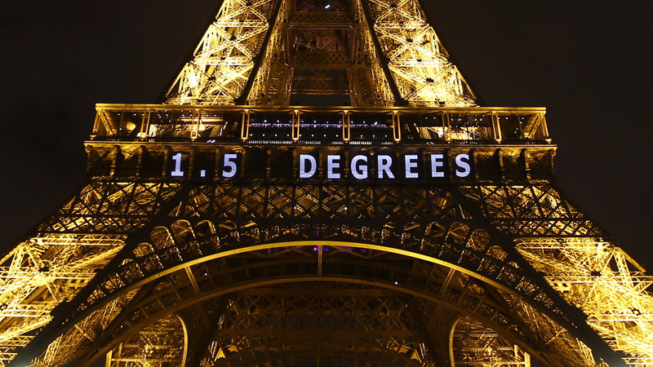
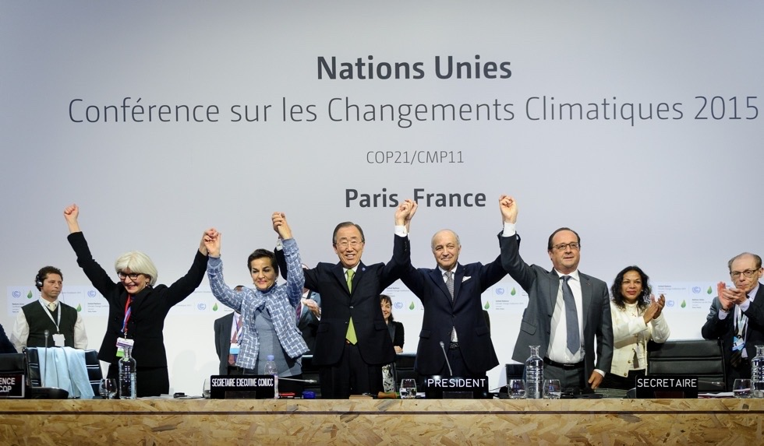
Our Goal Today
Limit global warming to less than 2ºC, and as close to 1.5ºC as possible, above pre-industrial levels.
Notes:
Sources:
https://www.npr.org/sections/thetwo-way/2015/12/12/459502597/2-degrees-100-billion-the-world-climate-agreement-by-the-numbers
https://www.nature.com/articles/d41586-020-00834-7

Slide 23
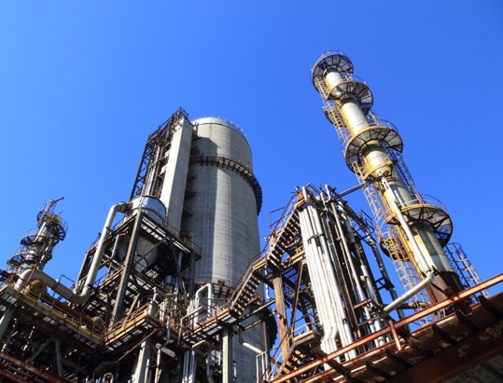
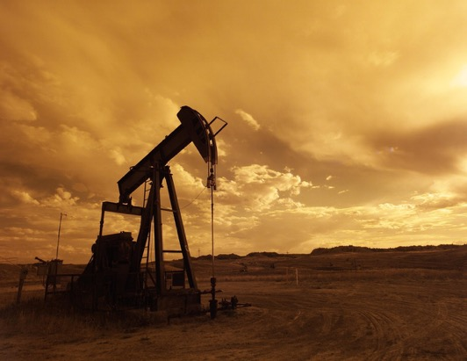



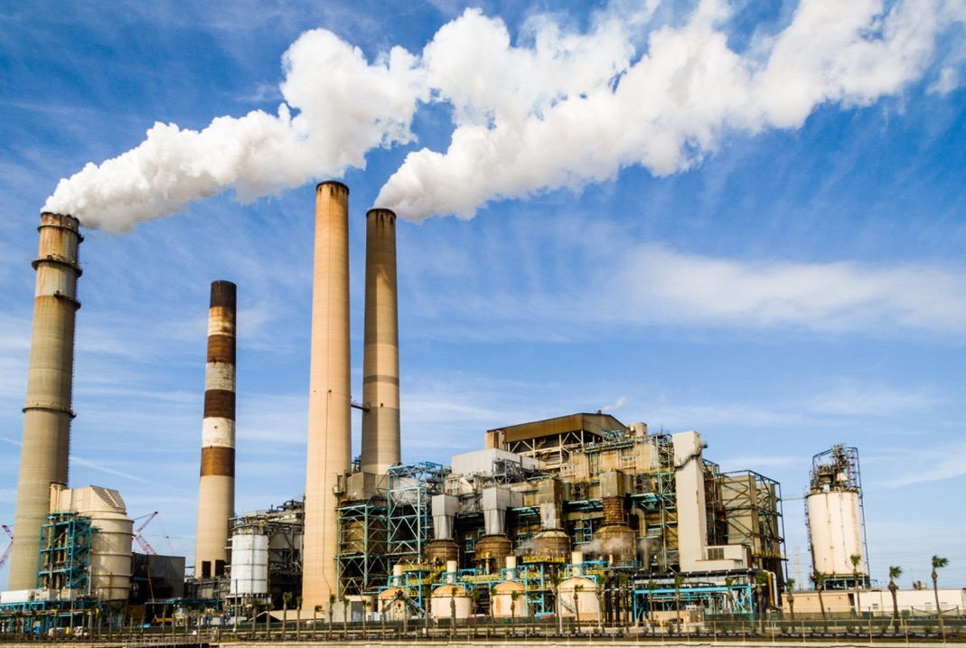
Conventional Energy
Largest energy suppliers in the world:
  Coal
  Oil
  Gas
  Nuclear
  Electric Utilities
Notes:
Note - Introduce the groups in the room.

Slide 24
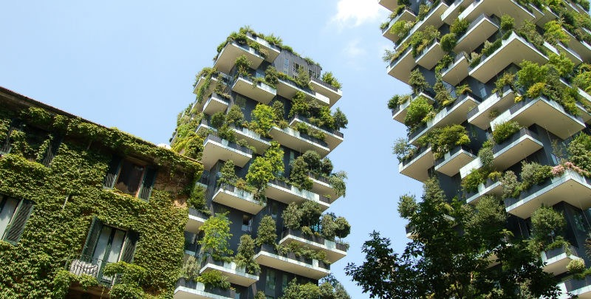



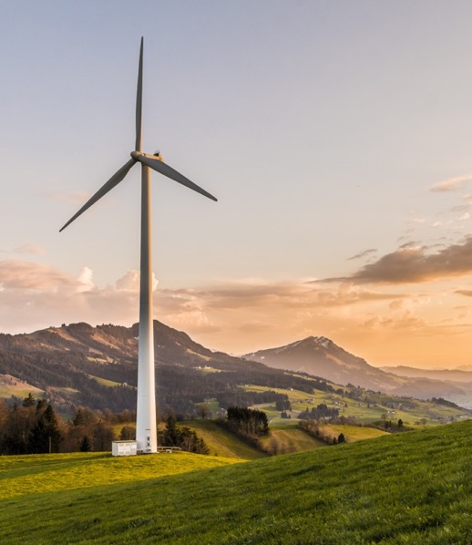
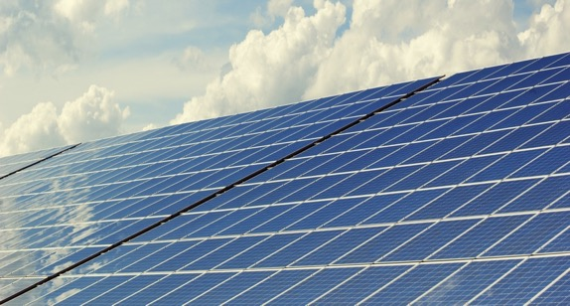
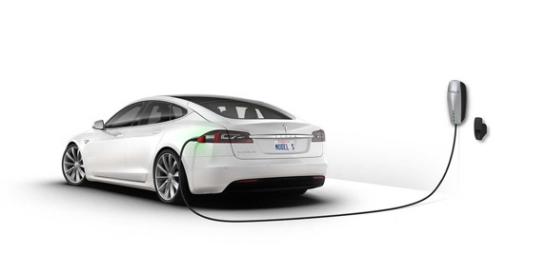
Clean Tech
Global leaders in clean tech:
  Wind, Solar, and other renewable energy sources
  Energy storage, electric vehicles
  Energy efficiency, green buildings
  Technological carbon removal
  New energy for the future

Slide 25
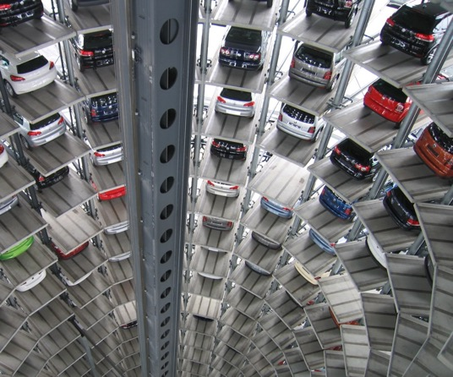
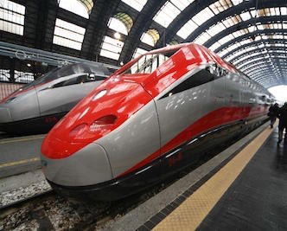


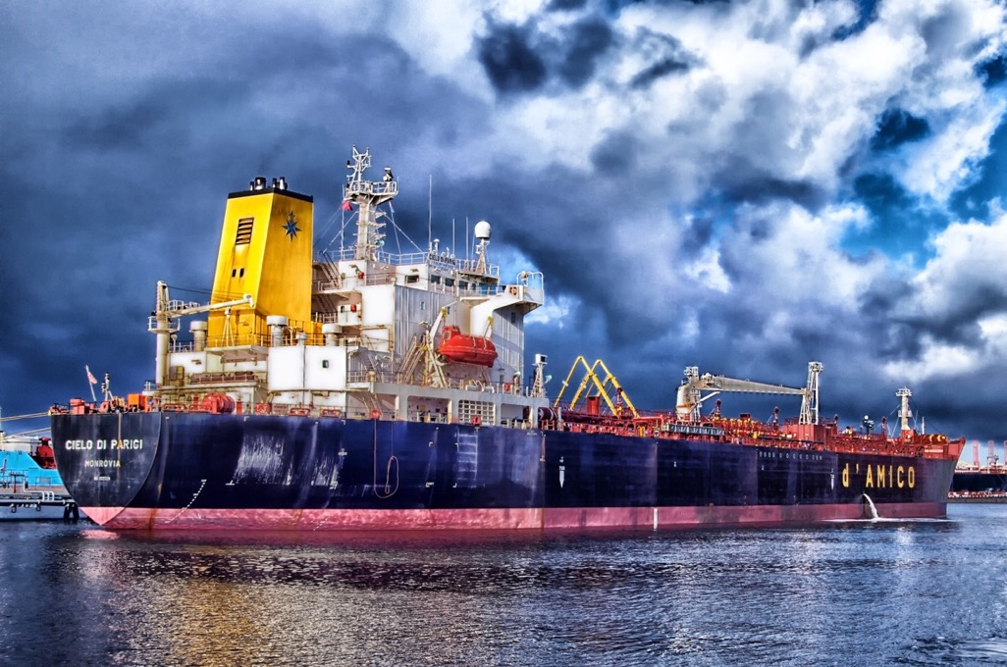
Industry & Commerce
Largest energy consuming corporations:
  Automakers, Airlines, Shipping & Freight, Other Transport
  Construction
  Industrial machinery
  Manufacturing
  Consumer products
  High tech

Slide 26
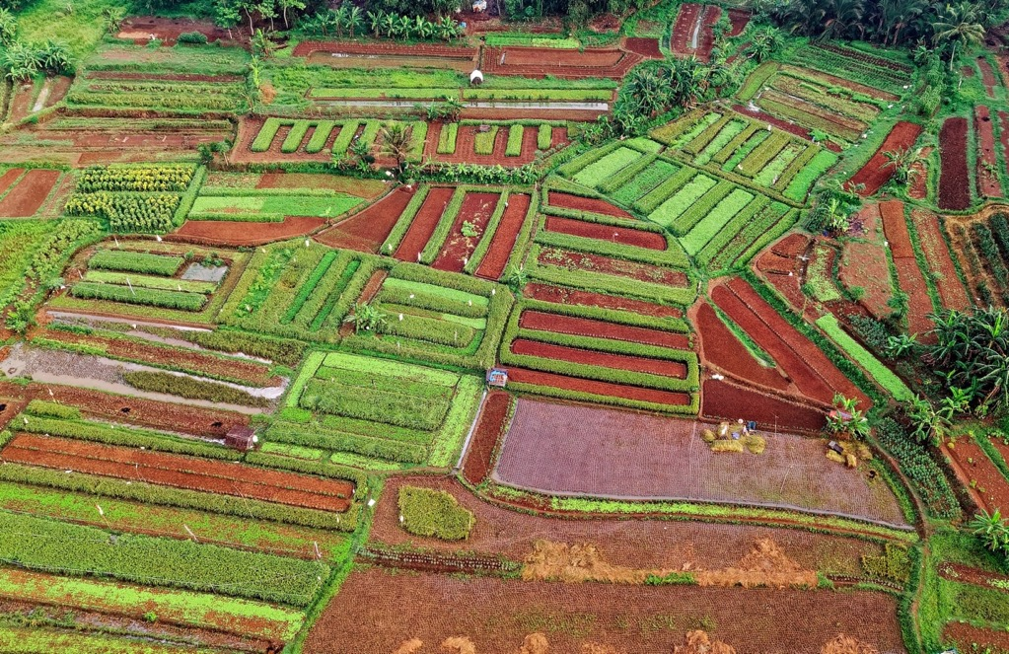



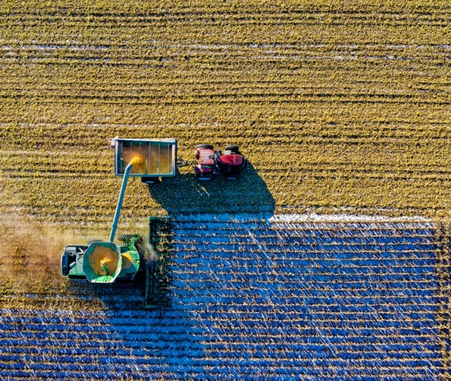
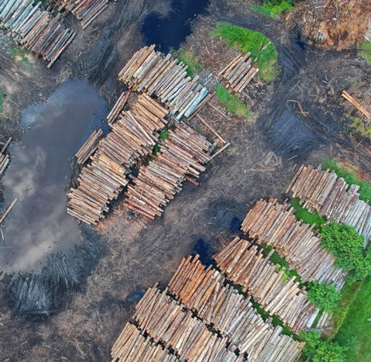
Land, Agriculture, & Forestry
Global alliance of:
  Food & agriculture companies
  Large landowners and farmer advocacy groups
  Logging companies
  Land conservation groups

Slide 27
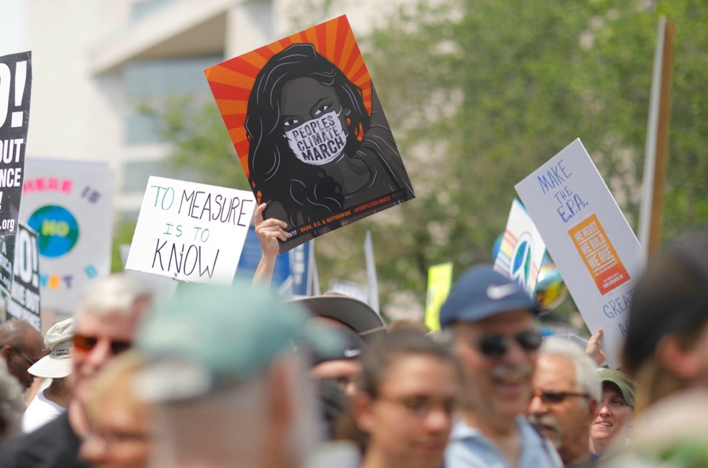



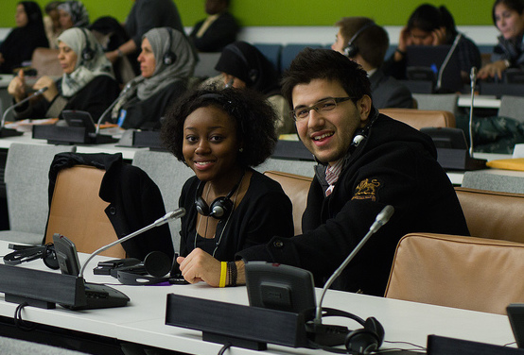
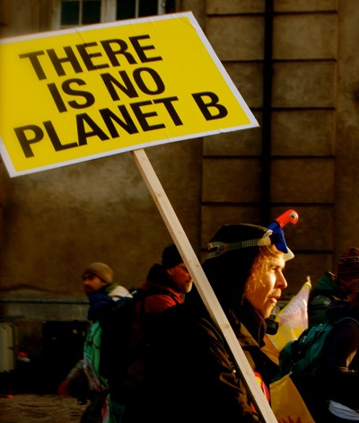
Climate Justice Hawks
Leading environmental nonprofits
Climate justice organizations
Grassroots & youth movements
Global citizens from communities harmed by climate change

Slide 28




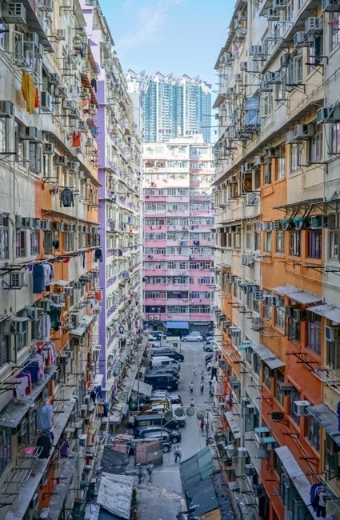
World Governments
Government leaders from around the world representing:
  Developed countries – EU, USA, Canada, etc.
  Rapidly developing countries – China, India, etc.
  Small island nations

Slide 29
Plenary Rounds
Notes:
Note – The following slides will help guide the group through the stages of the game. They may be projected as a helpful reminder in the background, although the focus of the room should be on the interactive roleplaying, with each other and the model. You may alternate between the Slides and the En-ROADS model on the projected screen.

Slide 30
Process
Each team may propose one action per round. You may propose to:
Add a new solution to the plan by choosing to change one of the 18 levers in En-ROADS
Or reverse a previous action that another group proposed.
We will review the impact of your proposed actions in En-ROADS.

Slide 31
Multisolving Lens
Consider:
A near-term co-benefit from your proposal. How can you address more than one problem with one action?
How might you ensure that marginalized communities are not disproportionately burdened and/or left out of opportunities to address and act on climate change?

Slide 32
Notes:
Note – Use the En-ROADS control panel guide to help orient participants to their decision variables e.g., 18 levers. Use this time to also briefly orient people to the actual En-ROADS simulator, and show how this Guide relates to the En-ROADS simulator.

Slide 33
Overall Process
Break for round 1 team meetings
Each team will send up a delegate to make a 2-minute speech to propose one action per round. You may propose to:
    Add a new solution – OR –
    Reverse a previous action
We will input each action into En-ROADS and evaluate the results together. This round closes when every team has offered one solution.
Plenary rounds end when we achieve our climate goals or run out of time.

Slide 34
Guidelines for Respectful Roleplay
Please be respectful to your fellow participants and the group you are representing. In particular, please follow these guidelines:
Accents
Do not pretend to have an accent or similar speech characteristics of the group of people you are portraying. This could be offensive to other participants or observers and detracts from the goals of the game.
Clothing & head coverings
Do not wear the traditional or religious clothing or head coverings of any nation or culture as part of your role, unless you yourself are of that culture or religion and it is a part of your personal practice.
Adapted from the American Model UN guidance

Slide 35
Round 1 Team Meeting
(10-15 minutes)
Start by looking over the En-ROADS control panel. Try circling the
2-3 actions you most strongly support vs. oppose
    An “action” is any change one of the 18 levers in En-ROADS
2. Talk with your team to form your overall strategy
3. Discuss with your team to reach an agreement on your first action, including details – e.g., level of change, start year
4. Select your delegate and prepare a 2-minute speech
Notes:
Note - Change the (time) for each of the sections in the following slides per your game timing

Slide 36
Round 1 Team Meeting
(10-15 minutes)
For each proposal, consider these questions:
    What are your vital interests?
    What is politically feasible?
    What do you need from the other groups?
    What can you offer them?
    What is a near-term co-benefit from your proposal?
    How can you solve more than one problem with one solution?
    How do you ensure that vulnerable communities are not disproportionately affected by your proposal?

Slide 37
Round 1
Plenary Presentations
(10-15 minutes)

Slide 38

2nd Team Meeting & Negotiations
(15-20 minutes)
Discuss follow-up actions as a team
Negotiate with other groups and lobby them to change their position if necessary

Slide 39
Round 2
Plenary Presentations
(10-15 minutes)

Slide 40
2nd Plenary Presentations
(20 minutes)
Teams continue proposing actions as before, with each team proposing one action per turn
The summit will close when we collectively achieve our climate goals or run out of time

Slide 41
Debrief

Slide 42
Reflection
Think of something you would love about being part of this sort of future.
Take one minute of silence to reflect on your experience.

Slide 43
How are you feeling?

Slide 44
Debriefing Discussion
What surprised you?
What were your key insights?
What will you take away from today, and how can you apply what you learned to the real world?
Notes:
Note – These are the three basic guiding questions to lead the debriefing discussion. You may choose your own and follow up with more detailed questions. We provide some options for Additional Discussion Questions in the Facilitator’s Guide.

Slide 45
Looking ahead
We have the tools
Solar and wind are growing and getting cheaper
Corporations are investing in clean tech
Countries and states are stepping up
The general public is becoming more educated and engaged

Slide 46

Companies are starting to take action
Clothing brand H&M has promised to double its energy efficiency
by 2030
Over 260 of the world’s largest companies have committed to using 100% renewable electricity by 2050, with an average target date of 2028
Microsoft has pledged to be carbon negative by 2030, removing more carbon than it emits
Notes:
Sources:
https://blogs.microsoft.com/blog/2020/01/16/microsoft-will-be-carbon-negative-by-2030/
https://www.there100.org/technical-guidance
https://hmgroup.com/media/news/general-2017/h-m-joins-international-initiative-to-enhance-energy-productivit.html
Photos:
https://unsplash.com/photos/PQmXUxmfR44
https://unsplash.com/photos/_h0xG4s6NFg
https://pixabay.com/images/id-1712699/
https://unsplash.com/photos/_h0xG4s6NFg
Updated: October 2020

Slide 47
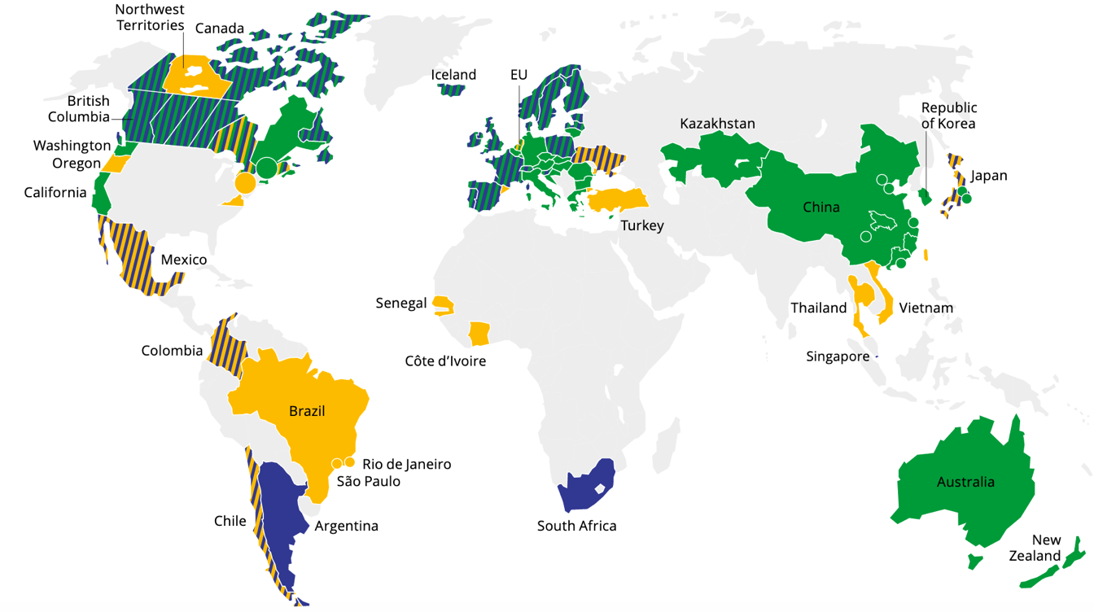
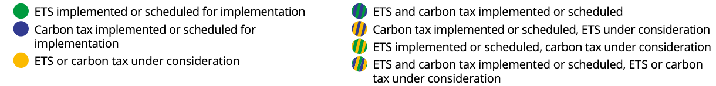

Carbon prices are being enacted around the world
Current or planned carbon pricing covers 22% of global emissions
80+ jurisdictions (regional, national or sub-national) have implemented or are considering carbon prices
Source: World Bank, 2020
Notes:
Sources:
https://carbonpricingdashboard.worldbank.org/map_data and World Bank Group. (2019). State and Trends of Carbon Pricing 2019. Washington, DC: World Bank. https://openknowledge.worldbank.org/handle/10986/31755
Notes:
ETS = Emissions Trading System
Notes from World Bank’s “State and Trends of Carbon Pricing 2019”: “The large circles represent cooperation initiatives on carbon pricing between subnational jurisdictions. The small circles represent carbon pricing initiatives in cities. Note: Carbon pricing initiatives are considered “scheduled for implementation” once they have been formally adopted through legislation and have an official, planned start date. Carbon pricing initiatives are considered “under consideration” if the government has announced its intention to work towards the implementation of a carbon pricing initiative and this has been formally confirmed by official government sources. The carbon pricing initiatives have been classified in ETSs and carbon taxes according to how they operate technically. ETS not only refers to cap-and-trade systems, but also baseline-and-credit systems as seen in British Columbia and baseline-and-offset systems as seen in Australia. The authors recognize that other classifications are possible."
Updated: September 2020

Slide 48
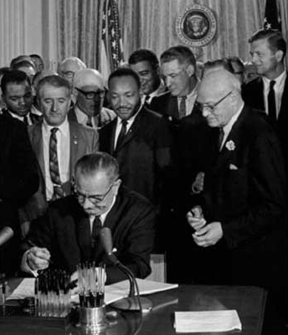

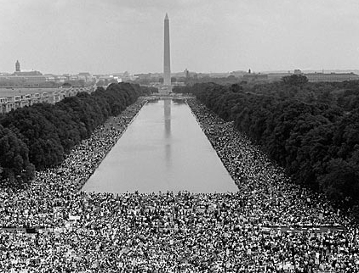
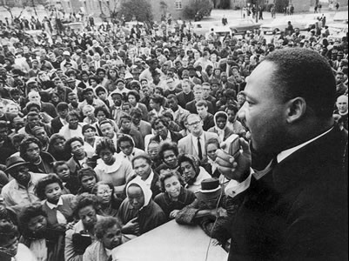
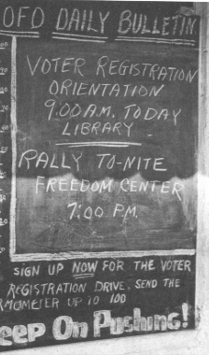
“The world as we have created it is a process of our thinking. It cannot be changed without changing our thinking.”
- Albert Einstein
“Never doubt that a small group of thoughtful, committed citizens can change the world. Indeed, it is the only thing that ever has.”
- Margaret Mead

Slide 49
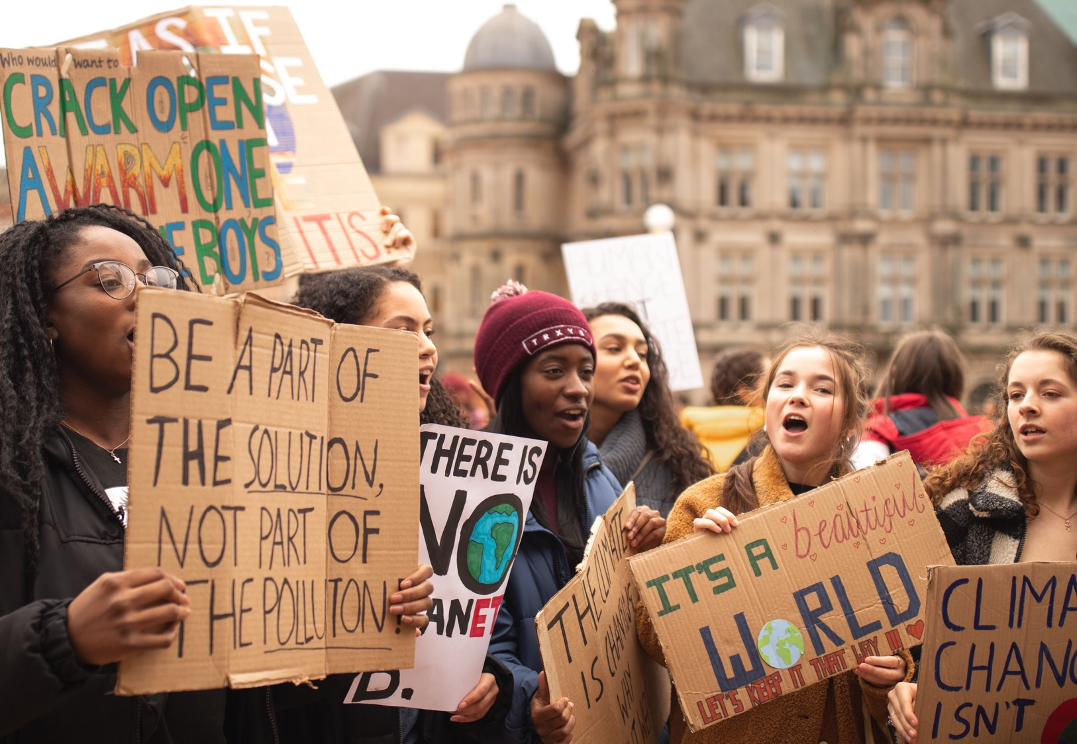

September 2019: Over 7 million people in 185 countries
Global Climate Strikes
Notes:
Sources:
https://unsplash.com/photos/7SE389kUVGw
https://350.org/7-million-people-demand-action-after-week-of-climate-strikes/

Slide 50
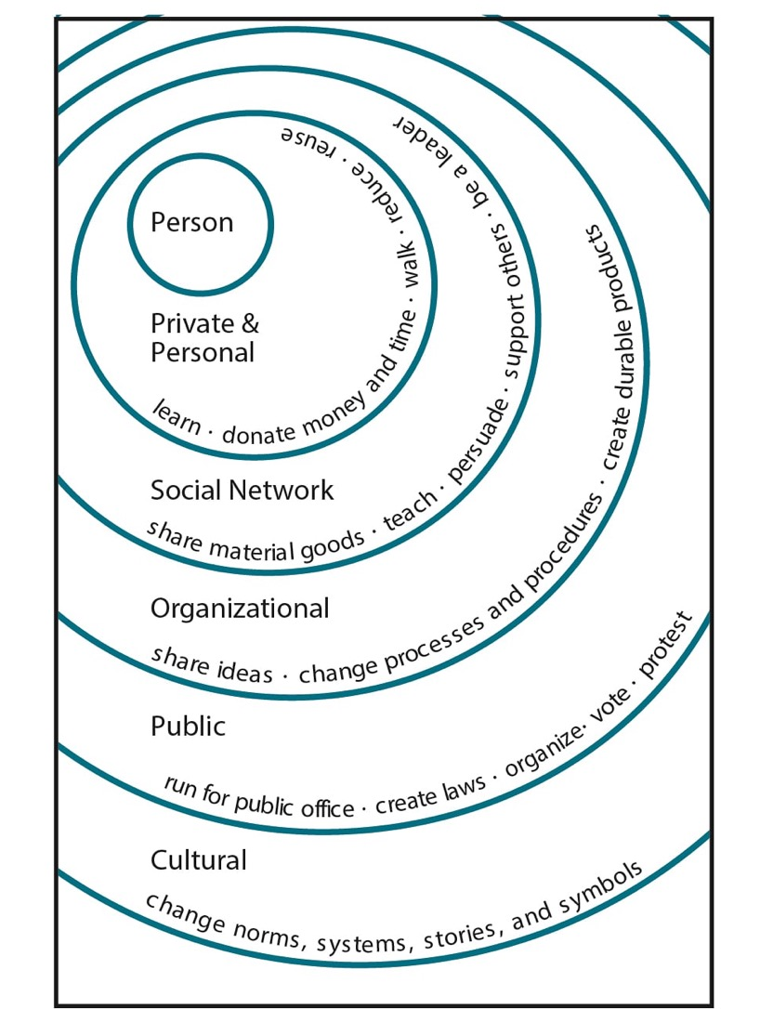
What can you do?
Illustration by Elise Amel
Notes:
Source: https://www.theguardian.com/environment/climate-consensus-97-per-cent/2017/may/19/study-inspiring-action-on-climate-change-is-more-complex-than-you-might-think

Slide 51
Treaty Signing
We, the members of the Climate Solutions Summit, having led the negotiations occurred in (insert your location) on (insert the date), and signed on behalf of each representative, do hereby accept the responsibility to work together and apply our best efforts to enact this plan, in order to limit our planet’s global warming to under 2 degrees Celsius above pre-industrial levels, as accorded by the guiding principles of the Paris Climate Agreement.

Slide 52
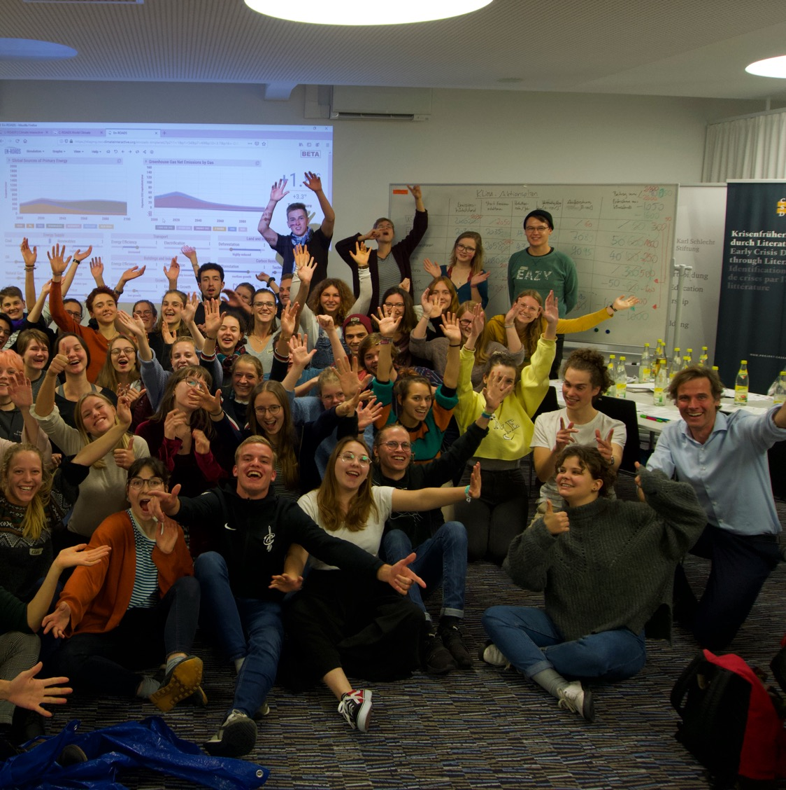
Thank You!
Visit: climateinteractive.org

Slide 53
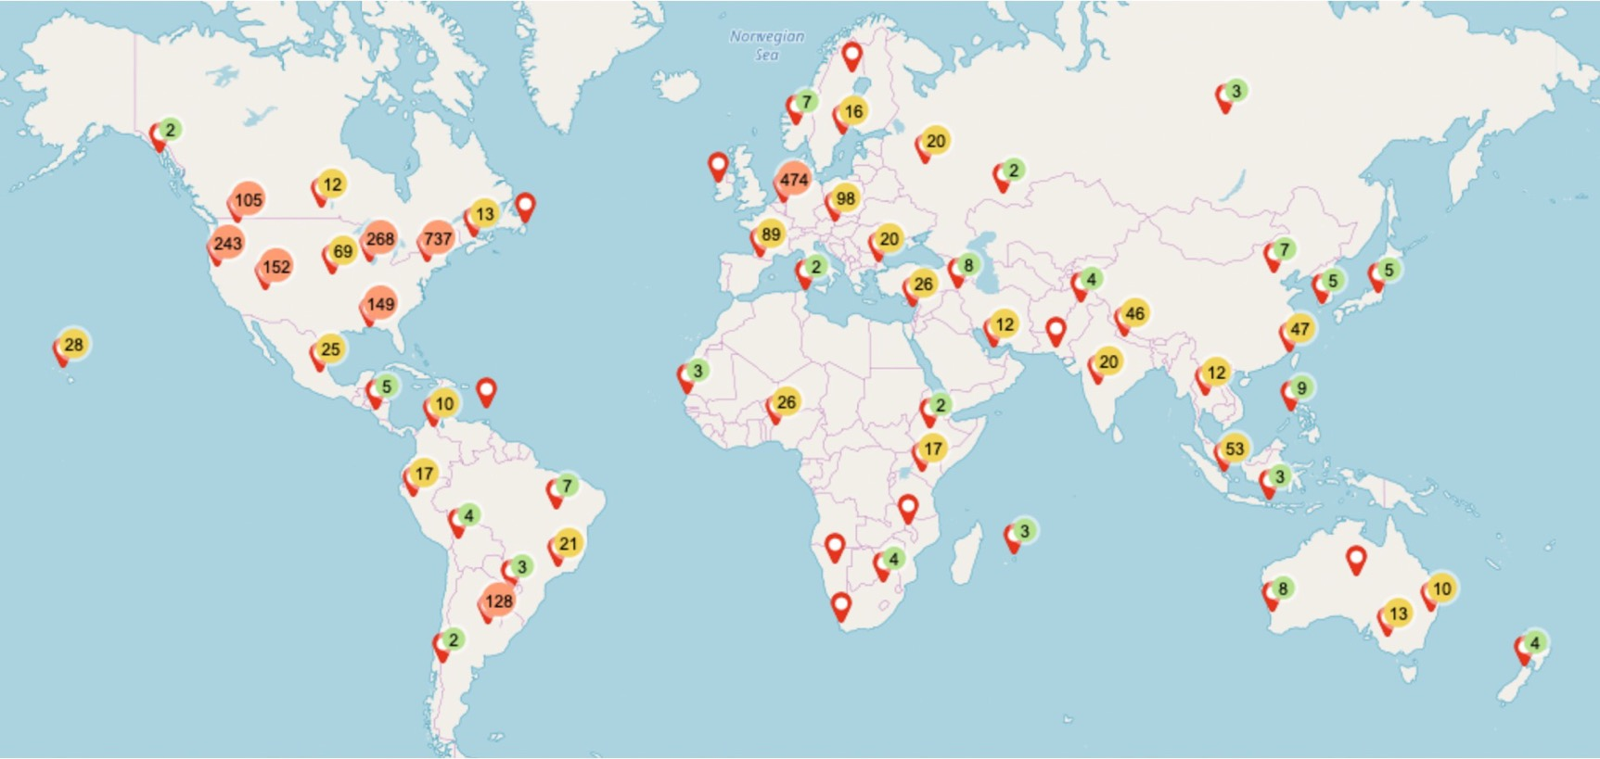
En-ROADS simulations:
Over 80,000 participants in 86 countries
As of November 2021
Notes:
Script: You are part of a global movement to become more knowledgeable about and equipped to solve climate change by experiencing this interactive workshop.
Updated: November 2021

Slide 54
Appendix

Slide 55
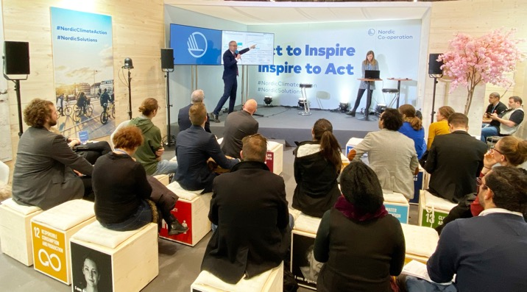
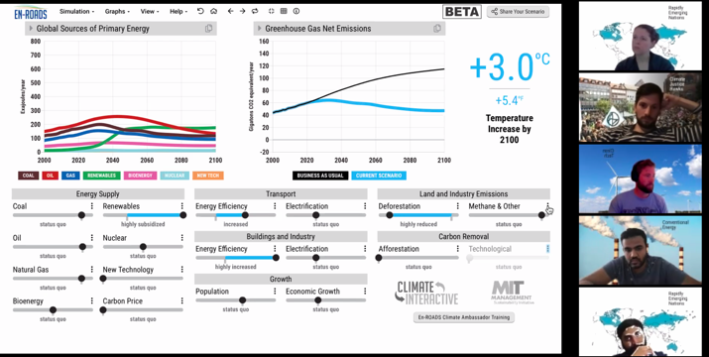
The En-ROADS Training Program
Join this free, self-paced online course to…
Learn more about the En-ROADS simulator
Facilitate engaging events to spark climate action – both online and in-person
Gain valuable insights on systems thinking, multisolving, advanced facilitation tips, and more
Begin your journey as an En-ROADS Climate Ambassador
  So far, we have over 400 En-ROADS Climate Ambassadors from more than 50 different countries!
Register at: https://learn.climateinteractive.org

Slide 56

The En-ROADS Climate Ambassador Program
The En-ROADS Climate Ambassador Program is a unique leadership opportunity to become a climate leader in your field for those who complete the En-ROADS training.
500+
En-ROADS Climate Ambassadors
70+
Countries
34+
Languages
from all walks of life: professors, business leaders, entrepreneurs, artists, activists, engineers, scientists, students, lawyers, & beyond
As of May 2022
Notes:
Updated May 2022

Slide 57
Insights from En-ROADS
A combination of solutions is needed to address climate change: “It takes more than one seed to plant a garden”:
Keeping climate change to well below 2°C, and limiting it to 1.5°C, is possible.
      We can still avoid the worst-case scenarios – it is still physically and technologically possible.
All successful scenarios significantly cut burning of coal, oil, and gas in the next 10-20 years
There are many lower-leverage actions that help address climate change globally but which are not as high of a priority as reducing fossil fuel use.
There are many opportunities to increase equity as we take these actions.

Slide 58
Additional En-ROADS Insights
The transition from high-carbon to low-carbon takes decades due to the long lifetime of fossil fuel capital infrastructure.
A brand-new energy source takes too long to scale up to contribute much on its own.
Even when low-carbon energy sources are encouraged, we still burn fossil fuels unless they are actively discouraged.
Reducing other greenhouse gas emissions (methane, N₂O, F-gases) reduces temperature quite a bit.
A carbon price is high leverage because it changes the fuel mix and reduces energy demand.
New technologies grow via reinforcing “learning” feedback loops.
When energy becomes inexpensive, energy demand increases modestly.
Accelerated growth in natural gas (e.g., via subsidy), without a carbon price, competes with renewables and does not reduce greenhouse gas emissions.
In a scenario in which many actions that limit fossil fuel demand have already been taken, more nuclear/new zero-carbon energy/renewables just displaces the other low-carbon sources (a dynamic known as “crowding out”).
Reducing deforestation is lower leverage in the long term than many expect, because its impact is overshadowed by the amount of greenhouse gas emissions that come from burning fossil fuels.

Slide 59
System Dynamics In En-ROADS
Capital Stock Turnover – Changes to infrastructure take time
Price-Demand Feedback – Price, demand, and supply are linked
Crowding Out – Low-carbon supplies compete for long-term market share
Squeezing the Balloon – Fossil fuel supplies experience compensating feedback
Economies of Scale and Learning – Success builds success via Progress Ratio
Drivers of Growth – Population and GDP growth drives emissions
Bathtub Dynamics – CO₂ emissions must be lower than removals for CO₂ concentration and temperature to stop rising

Slide 60
Features of En-ROADS
Transparent
  All equations and structure are available in the online Reference Guide
Flexible
  Assumptions are adjustable
Globally aggregated to be fast
  Complementing, not supplanting, the integrated assessment models used by the IPCC
Supports grounding discussions to learn and strategize, backed with real data & science
  However, not to serve as predictions for the future, which is dependent on too many behavioral variables

Slide 61
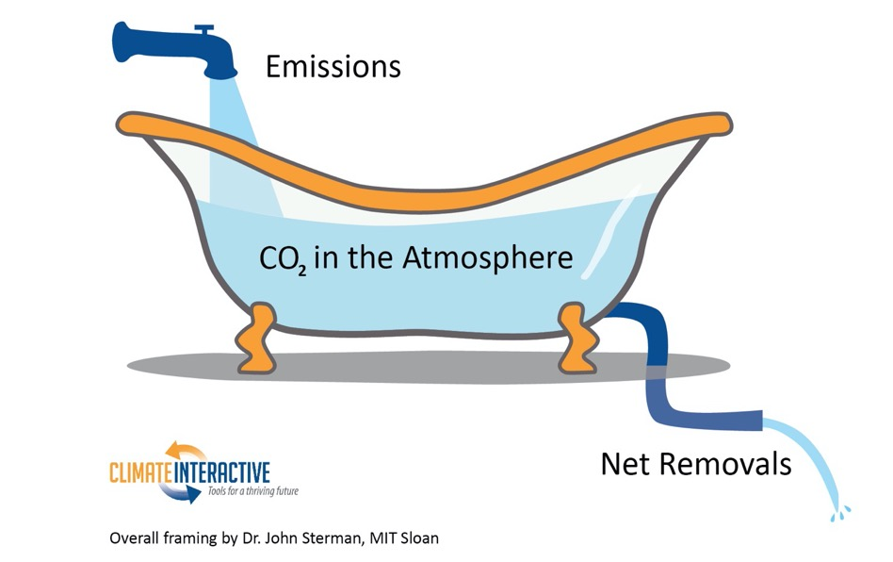
Bathtub Dynamics
Notes:
Note: The metaphor of a bathtub helps explain the dynamics of rising CO₂ concentration in the atmosphere. If more CO₂ enters the atmosphere (like water flowing into a tub) than is removed (like water draining from the tub), then the amount of CO₂ in the atmosphere (the amount of water in the tub) will continue to increase. To flatten CO₂ concentration, we need to bring CO₂ emissions down to equal removals. If your bathtub is overflowing, you turn off the tap before you go get a mop and bucket.
To understand more about stocks, flows, and the bathtub framing below, watch our video as part of our Climate Leader learning series.

Slide 62
En-ROADS Core Structure
Temperature
Impacts
Total greenhouse gases (GHGs)
Energy CO₂ emissions
Land use CO₂ emissions
CO₂ removal
Other greenhouse gases
(N₂O, methane,
f-gases)
Population
Consumption
Energy Intensity
Carbon Intensity
Notes:
*This slide is animated.

Slide 63
Multisolving

Slide 64
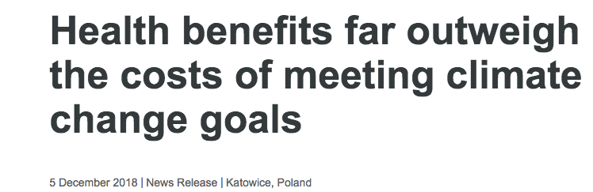
“The health burden of polluting energy Sourcess is now so high, that moving to cleaner and more sustainable choices for energy supply, transport and food systems effectively pays for itself,” says Dr Maria Neira, WHO Director of Public Health, Environmental and Social Determinants of Health.
“When health is taken into account, climate change mitigation is an opportunity, not a cost.”
Notes:
Sources: https://www.who.int/news-room/detail/05-12-2018-health-benefits-far-outweigh-the-costs-of-meeting-climate-change-goals

Slide 65
Clean Energy & Health
Health benefits from wind and solar power in the United States from 2007 to 2015 were even greater than their climate benefits.
Source: Millstein, et al (2017)
Notes:
Sources: Millstein, et al (2017). The climate and air-quality benefits of wind and solar power in the United States. NATURE ENERGY 2, 17134. DOI: 10.1038/nenergy.2017.134. http://rdcu.be/uZwc
These figures specifically come from Table 3: Cumulative and 2015 benefits from avoided air pollution and avoided GHG emissions. 2015 US dollars.

Slide 66
Clean Energy & Jobs
If $200 billion was invested every year in energy efficiency and clean energy in the US, 4.2 million jobs would be created by 2030, and the 2030 unemployment rate would be reduced by 1.5%.
Source: Pollin, et al (2014)
Notes:
Sources: Pollin et al (2014). Green Growth: A U.S. Program for Controlling Climate Change and Expanding Job Opportunities. Center for American Progress & Political Economy Research Institute. https://www.americanprogress.org/issues/green/reports/2014/09/18/96404/green-growth/

Slide 67
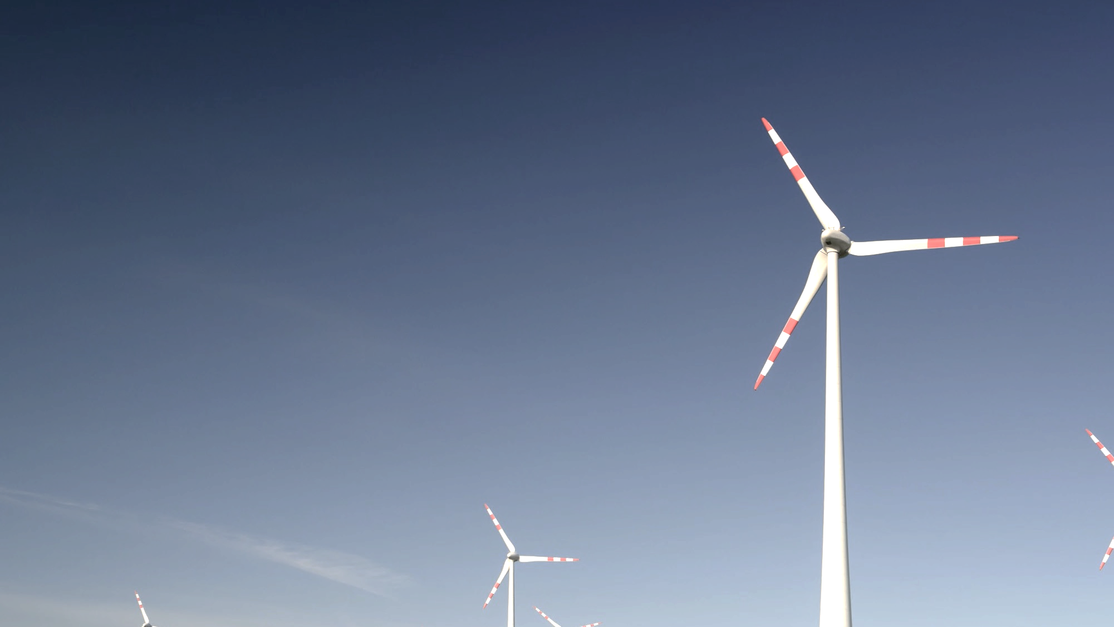
Health Benefits of Climate Action: Global
Limiting warming to 1.5-2°C by cutting fossil fuel emissions would:
Prevent ~153 million premature deaths from air pollution by 2100¹
Save ~$800 Billion per year due to health benefits from clean power and $400 Billion per year from clean transportation
  ~$1.2 Trillion per year total²
Source: Shindell et al., 2018; Shindell et al., 2016
Notes:
Sources:
1. Shindell, D., Faluvegi, G., Seltzer, K. et al. Quantified, localized health benefits of accelerated carbon dioxide emissions reductions. Nature Clim Change 8, 291–295 (2018). https://doi.org/10.1038/s41558-018-0108-y
2. Shindell, Drew T., Yunha Lee, and Greg Faluvegi. "Climate and Health Impacts of US Emissions Reductions Consistent with 2 °C." Nature Climate Change Nature Climate Change 6.5 (2016): 503-507.
Photo: https://unsplash.com/photos/4NhqyQeErP8

Slide 68
Health Benefits of Climate Action: U.S.
The U.S. would save billions in health care costs by 2030²
Prevent ~295,000 premature deaths by 2030 from air pollution caused by fossil fuel use
Prevent ~29,000 Emergency Room visits/year for childhood asthma
Prevent 15 million adult work hours lost/year
Source: Shindell et al., 2016
Notes:
Sources:
1. Shindell, D., Faluvegi, G., Seltzer, K. et al. Quantified, localized health benefits of accelerated carbon dioxide emissions reductions. Nature Clim Change 8, 291–295 (2018). https://doi.org/10.1038/s41558-018-0108-y
2. Shindell, Drew T., Yunha Lee, and Greg Faluvegi. "Climate and Health Impacts of US Emissions Reductions Consistent with 2 °C." Nature Climate Change Nature Climate Change 6.5 (2016): 503-507.
Photos:
Power station: https://pixabay.com/images/id-374097/
Emergency room: https://pixabay.com/images/id-3323451/
Clock: https://pixabay.com/images/id-650753/

Slide 69
Impacts at different levels of warming

Slide 70
1.5ºC of warming (or 2.7ºF)
Increase of 3.0 - 4.5°C (5.4 - 8.1°F) in extreme temperatures
in some regions¹
70% of coral reefs bleached²
Drought: 2 months longer
Increase in average drought length³
13% of people face severe heat waves at least every 5 years⁴
Notes:
Script: By limiting warming to 1.5ºC, you have achieved our collective goal! This is no small feat and something we should all be proud of.
Congratulations!!! We have arrived at a set of policies that will avert the worst impacts of climate change, especially for the world’s most vulnerable.
While there are still impacts that we will need to adapt to, look at how significantly the impacts were reduced compared to a 4ºC scenario of warming:
[Review bullets on the slide]
Notes:
Increase in temperature extremes: The overall message is that there is no single 1.5-degree world; many regions will experience much greater warming than 1.5 degrees. During the summer in mid-latitudes, increases of up to 3 degrees C in extreme temperature may occur, with the strongest warming happening in central and eastern North America, central and southern Europe, the Mediterranean, western and central Asia, and southern Africa. During the winter in high-latitudes, increases of up to 4.5 degrees C may occur.
Coral bleaching: Many societies depend on coral reefs for fisheries and tourism. Reefs protect the shoreline from storm surge and erosion, among other benefits.
Severe heat waves: defined as having a Heat Wave Magnitude Index daily greater than 20. The Heat Wave Magnitude Index takes into account both heat wave duration and intensity
Updated: September 2020
Sources:
1. IPCC, 2018: Summary for Policymakers. In: Global Warming of 1.5°C. An IPCC Special Report on the impacts of global warming of 1.5°C above pre-industrial levels and related global greenhouse gas emission pathways, in the context of strengthening the global response to the threat of climate change, sustainable development, and efforts to eradicate poverty [Masson-Delmotte, V., P. Zhai, H.-O. Pörtner, D. Roberts, J. Skea, P.R. Shukla, A. Pirani, W. Moufouma-Okia, C. Péan, R. Pidcock, S. Connors, J.B.R. Matthews, Y. Chen, X. Zhou, M.I. Gomis, E. Lonnoy, T. Maycock, M. Tignor, and T. Waterfield (eds.)]. World Meteorological Organization, Geneva, Switzerland, 32 pp.
2. Schleussner, C.-F., Lissner, T. K., Fischer, E. M., Wohland, J., Perrette, M., Golly, A., Rogelj, J., Childers, K., Schewe, J., Frieler, K., Mengel, M., Hare, W., and Schaeffer, M.: Differential climate impacts for policy-relevant limits to global warming: the case of 1.5 °C and 2 °C, Earth Syst. Dynam., 7, 327–351, https://doi.org/10.5194/esd-7-327-2016, 2016.
3. Naumann, G. et al. (2018) Global Changes in Drought Conditions Under Different Levels of Warming, Geophysical Research Letters
4. Dosio, A., L. Mentaschi, E.M. Fischer, and K. Wyser, 2018: Extreme heat waves under 1.5°C and 2°C global warming. Environmental Research Letters, 13(5), 054006, doi:10.1088/1748-9326/aab827.
Photos:
Fan: https://pixabay.com/images/id-3571028/
Thermometer: https://pixabay.com/images/id-4767444/
Trees: https://pixabay.com/images/id-947331/
Dead coral: https://unsplash.com/photos/l77WKwkDpWQ
Live coral: https://unsplash.com/photos/0G01UI1MQhg

Slide 71
2ºC of warming (or 3.6ºF)
Risk of river flooding more than doubles¹
Average 170% increase in river flooding, with highest risk in U.S., Asia, and Europe
90% of coral reefs bleached²
Drought: 4 months longer
Increase in average drought length³
Over 50% of world’s population exposed to lethal heat
for more than 20 days per year⁴
Notes:
Script: By limiting warming to 2ºC, you have come very close to our stated goal and should be very proud of the progress you have made! While there are still some serious impacts that the world will need to adapt to and prepare for, the impacts are FAR less severe than we would have seen under a baseline scenario.
Let’s take a look at the impacts we would expect to see in a 2ºC world: [Read bullets on the slide]
Notes:
Flooding: This does not include impacts from flash floods, pluvial floods (when extreme rainfall means that the ground cannot absorb the water), and coastal floods.
Coral bleaching: Many societies depend on coral reefs for fisheries and tourism. Reefs protect the shoreline from storm surge and erosion, among other benefits.
Updated: September 2020
Sourcess:
1. Alfieri, L., Bisselink, B., Dottori, F., Naumann, G., de Roo, A., Salamon, P., Wyser, K. and Feyen, L. (2017), Global projections of river flood risk in a warmer world. Earth's Future, 5: 171-182. doi:10.1002/2016EF000485
2. Schleussner, C.-F., Lissner, T. K., Fischer, E. M., Wohland, J., Perrette, M., Golly, A., Rogelj, J., Childers, K., Schewe, J., Frieler, K., Mengel, M., Hare, W., and Schaeffer, M.: Differential climate impacts for policy-relevant limits to global warming: the case of 1.5 °C and 2 °C, Earth Syst. Dynam., 7, 327–351, https://doi.org/10.5194/esd-7-327-2016, 2016.
3. Naumann, G. et al. (2018) Global Changes in Drought Conditions Under Different Levels of Warming, Geophysical Research Letters
4. Mora, C., Dousset, B., Caldwell, I. et al. Global risk of deadly heat. Nature Clim Change 7, 501–506 (2017). https://doi.org/10.1038/nclimate3322
Photos:
Flood: https://unsplash.com/photos/_whs7FPfkwQ
Thermometer: https://pixabay.com/images/id-4767444/
Trees: https://pixabay.com/images/id-947331/
Dead coral: https://unsplash.com/photos/l77WKwkDpWQ
Live coral: https://unsplash.com/photos/0G01UI1MQhg

Slide 72
3ºC of warming (or 5.4ºF)
Arctic sea ice is gone in 2 out of every 3 summers¹
50% of insect species lose >50% of their habitat range²
Drought: 11 months longer
Increase in average drought length³
Area burned by summer wildfires in Mediterranean doubles⁴
^{Compared to today}
Notes:
Script: However, I want to be clear. A 3-4 degree future is still very bleak – especially for the world’s most vulnerable nations and communities who experience the impacts of climate change disproportionately. We need to do better. Far better. Here’s what a 3 degree future means for our world: [Read bullets from the slide].
Notes:
Arctic sea ice: Melting of Arctic sea ice has a positive feedback effect on global warming, as ice and snow reflect energy from the sun back into space. Without sea ice, more of the energy is absorbed, contributing to further warming. A warming Arctic and lessening sea ice are linked to extreme weather effects in other parts of world, as a result of the global atmospheric circulation. For more on this topic, see https://www.carbonbrief.org/qa-how-is-arctic-warming-linked-to-polar-vortext-other-extreme-weather
Insects: Insects are important as pollinators, for nutrient cycling, and for breaking down waste, among other services. They are the major or sole food source for many amphibian, reptile, bird, and mammal species.⁵
Updated: September 2020
Sourcess:
1. Sigmond, M., Fyfe, J.C. & Swart, N.C. Ice-free Arctic projections under the Paris Agreement. Nature Clim Change 8, 404–408 (2018). https://doi.org/10.1038/s41558-018-0124-y
2. Warren, R., et al. "The projected effect on insects, vertebrates, and plants of limiting global warming to 1.5 C rather than 2 C." Science 360.6390 (2018): 791-79
3. Naumann, G. et al. (2018) Global Changes in Drought Conditions Under Different Levels of Warming, Geophysical Research Letters
4. Turco, M. et al. (2018) Exacerbated fires in Mediterranean Europe due to anthropogenic warming projected with nonstationary climate-fire models, Nature Communications. https://www.nature.com/articles/s41467-018-06358-z
5. https://www.si.edu/spotlight/buginfo/benefits
Photos:
Arctic: https://pixabay.com/images/id-1913559/
Trees: https://pixabay.com/images/id-947331/
Bee: https://pixabay.com/images/id-4243850/
Wildfire: https://www.flickr.com/photos/slworking/29034137667

Slide 73
4+ºC of warming (or 7.2+ºF)
Sea level rise this century: ~1.2 meters (~4 feet)¹
More than two thirds of glaciers in the
Himalaya Mountains melted²
One in six species could go extinct³
Three-quarters of world population exposed to lethal
heat for >20 days/year⁴
Notes:
Script: If we do not take to reduce our fossil fuel use, we could see severe impacts by the end of the century. For example…
Notes:
Glaciers: The Hindu Kush Himalaya mountains provide water for two billion people. Water from Himalayan glaciers accounts for a significant part of the water in major rivers, including the Indus and Ganges. Estimates for the contribution of glacial melt to the Indus, for example, range from 21% to 80% based on different studies.²
Lethal heat: Populations in tropical areas will be exposed to much more lethal heat. “By 2100, mid-latitudes (for example, 40° N or S) will be exposed to ∼60 deadly days per year compared to almost the entire year in humid tropical areas under RCP 8.5.”⁴
Updated: September 2020
Sources:
1. Vermeer, M. & Rahmstorf, S. (2009). Global sea level linked to global temperature. Proceedings of the National Academy of Sciences. 106(51) 21527-21532. https://www.pnas.org/content/106/51/21527
2. P. Wester, A. Mishra, A. Mukherji, A. B. Shrestha (eds) (2019) The Hindu Kush Himalaya Assessment—Mountains, Climate Change, Sustainability and People. Springer Nature Switzerland AG, Cham.
3. Urban, M. Accelerating extinction risk from climate change. Science.348.6234 (2015), 571-573. https://science.sciencemag.org/content/348/6234/571
4. Mora, C., Dousset, B., Caldwell, I. et al. Global risk of deadly heat. Nature Clim Change 7, 501–506 (2017). https://doi.org/10.1038/nclimate3322
Photos:
Wave: https://pixabay.com/images/id-1913559/
Glacier: https://pixabay.com/images/id-276995/
Thermometer: https://pixabay.com/images/id-4767444/
Skeleton: https://pixabay.com/images/id-433340/

Slide 74
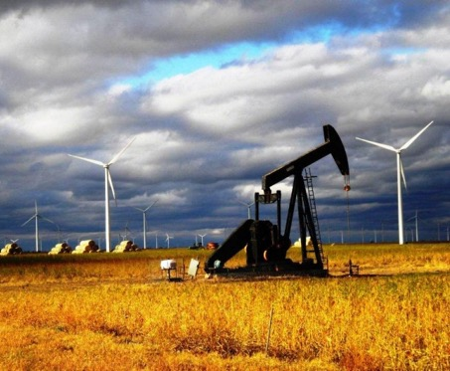
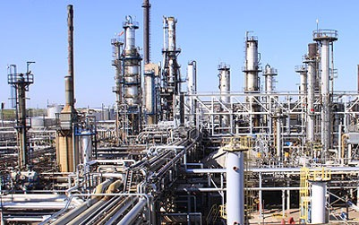
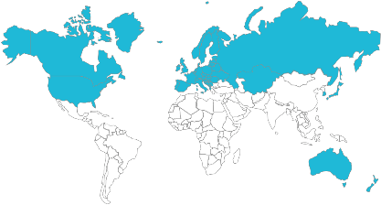
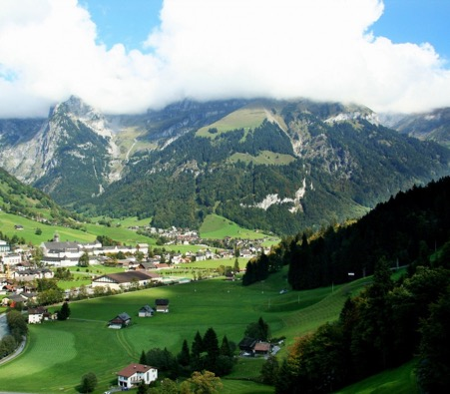



Developed Nations
Leaders of:
  Australia
  Canada
  European Union
  Japan
  New Zealand
  Russia & Former Soviet Republics
  South Korea
  USA

Slide 75






Rapidly Emerging Nations
Leaders of:
  China
  India
  Indonesia
  Brazil
  Mexico
  South Africa

Slide 76





Developing Nations
Leaders of over 100 nations in
  Africa
  Central and Latin America
  South and Southeast Asia
  Middle East
  Small Island States

