Slide 1
AFRICA SLIDES
Notes:
These slides are best used as talking points for WC facilitators in Africa covering:
Impacts of climate change in Africa
Good News features - Mitigation and Adaptation initiatives across the continent.

Slide 2
IMPACTS
Notes:
These slides provide talking points for WC facilitators in Africa covering:
Impacts of climate change in Africa
Good News features - Mitigation and Adaptation initiatives

Slide 3
Key Impacts Identified in IPCC AR5
Shifts in biome distribution: impacts on wildlife and extinction
Increased stress on water resources
Degradation of coral reefs: loss of ecosystems and fish stocks
Reduced crop productivity, increased pests and flood damage
Changes in distribution of vector and water borne diseases
Under-nutrition
Increased migration
Sea level rise and extreme events: disrupted infrastructure etc.
Notes:
Source: IPCC AR5 Chapter 22
These impacts interact and exacerbate each other:-
Affecting land use and biomass- Forestry, Agriculture, Biodiversity, Human settlement, Energy, Food Security
Affecting Agriculture, Food Security, Human Health & Sanitation
Affecting Ocean Colour, as an indicator of ocean productivity (Fisheries, Food security, Human Health); and Ocean acidity (Fish stocks, biodiversity)
Affecting Temperature, Wind, Humidity (floods, drought, disaster risk reduction)
8. Sea Level Rise (infrastructure, freshwater availability, tourism)

Slide 4
Ndaka-ini Dam, Kenya
2013
2018
Notes:
Major water source for Nairobi
Hope, luck is the language, but is it what we should be doing
Drop by 17 M between 2016 and 2017 resulting in a decline from 70M litres to 32M litres
Protests about water- communities demanding water – and saying they don’t know where the water comes from

Slide 5
Climate change and climate variability have the potential to exacerbate existing threats to human security including food, health, and economic insecurity, all being of particular concern for Africa

Slide 6
A 2°C temperature rise above the pre-industrial levels will permanently reduce up to 5% of annual per capital consumption in Africa

Slide 7
Climate change increases the burden of a range of human health outcomes
Malaria will put 90 million more people at risk in Sub-Saharan Africa

Slide 8
Cost of adaptation:
At least 5 to 10% of GDP
Notes:
Source: IPCC, 2007, Chapter 11- Regional Climate Projections.

Slide 9
By 2020:
75-250 million Africans are projected to be exposed to increased water stress due to climate change.
Yields from rain-fed agriculture could be reduced by up to 50%.
Notes:
Source: IPCC, 2007, Chapter 11- Regional Climate Projections.

Slide 10
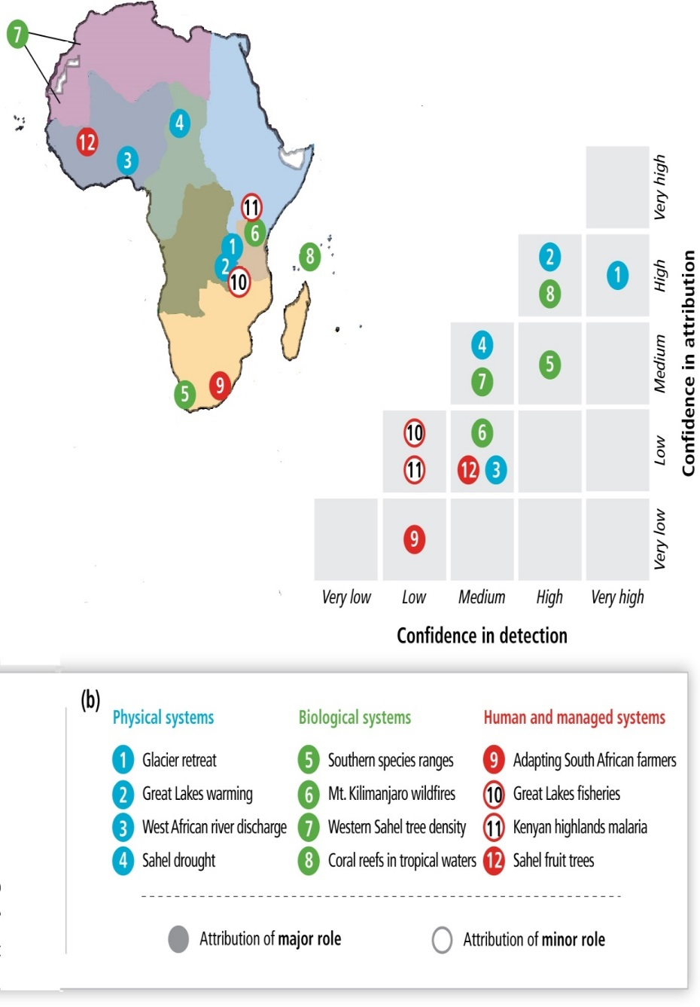
Observed impacts of climate change in Africa
Attribution
« How much the observed change is due to climate change »
(IPCC AR5, 18.2.1)
Detection
« An impact of climate change has or has not been detected »
(IPCC AR5, 18.2.1)
Source: IPCC AR5, Chapter 22

Slide 11
1. Temperature
Without action, by 2050, average temperatures in Africa are predicted to increase by 1.5 to 3°C, and will continue further upwards beyond this time.
Warming is very likely to be larger than the global annual mean warming throughout the continent and in all seasons, with drier subtropical regions warming more than the moister tropics.
Notes:
Source: IPCC, 2007, Chapter 11- Regional Climate Projections

Slide 12
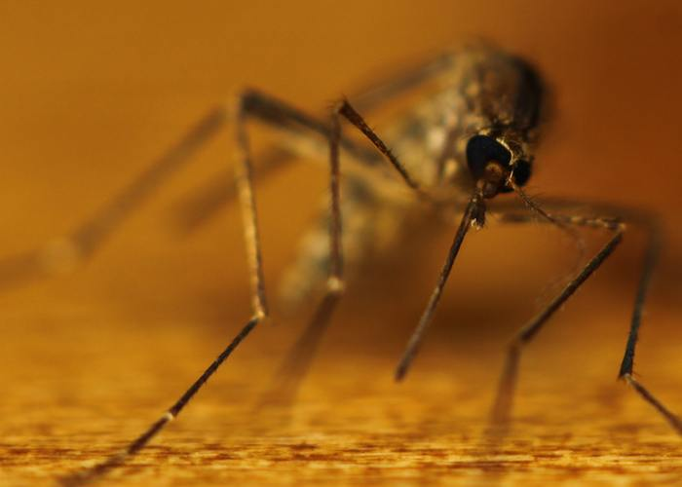
219 million people affected in 2010 globally, the vast majority in sub-Saharan Africa. 90 million to be affected in Sub-Saharan Africa alone.
Malaria

Slide 13
2. Ecosystems
25-40% of mammals in national parks in sub-Saharan Africa will become endangered.
Melting glaciers on Mt. Kenya & Kilimanjaro will harm biodiversity there.
Decline in fisheries in East African lakes.
Notes:
Ecosystems are critical in Africa, contributing significantly to biodiversity and human well-being.
Source: IPCC, 2007, Chapter 11- Regional Climate Projections
http://know.climateofconcern.org/index.php?option=com_content&task=article&id=105

Slide 14
Notes:
Source: 350.org http://350africa.org/2014/12/12/8-ways-climate-change-is-already-affecting-africa/
The glaciers act as a water tower and several rivers are now drying up. It is estimated that 82% of the ice that capped the mountain, when it was first recorded in 1912, is now gone. (IPCC, 2001)

Slide 15
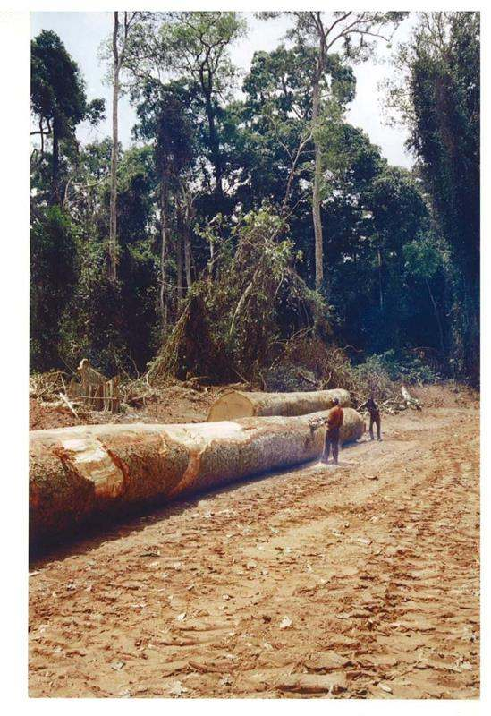
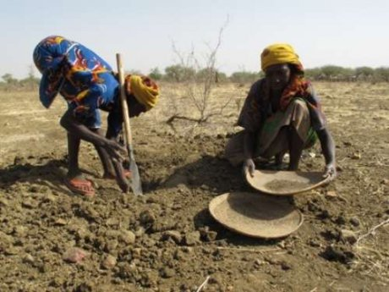
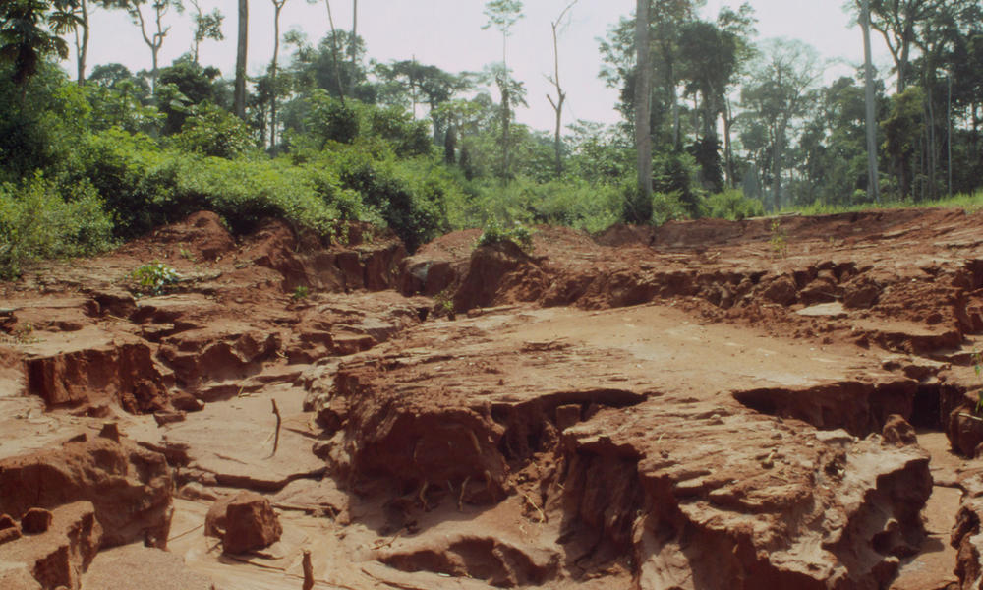
Congo Basin: Déforestation
2°C - 4°C warming
Droughts
Soil erosion
(RFUK)
Loss of biodiversity
WWF (CAR)

Slide 16
3. Rainfall
Annual rainfall is likely to decrease in much of Mediterranean Africa and the northern Sahara.
Rainfall in southern Africa is likely to decrease in much of the winter rainfall region and western margins.
There is likely to be an increase in annual mean rainfall in East Africa.
Already: In the tropical rainforest zone, declines in mean annual precipitation of around 4% in West Africa, 3% in North Congo and 2% in South Congo for the period 1960 to 1998 have already been noted.
Notes:
It is unclear how rainfall in the Sahel, the Guinean Coast and the southern Sahara will evolve.

Slide 17
Floods in Nigeria
Notes:
Source: 2012- Reuters: http://www.reuters.com/article/us-nigeria-flood-idUSBRE88Q12U20120927
2015: Relief Web: http://reliefweb.int/report/nigeria/37610-hectares-farmland-5495-houses-25950-people-affected-flood-kebbi-state
Inability of governments and communities to cope with climate-related disasters
70% affected are farmers, meaning they will be food insecure, but also agricultural production declines with flooding in these regions (think interconnections and multisolving here)

Slide 18
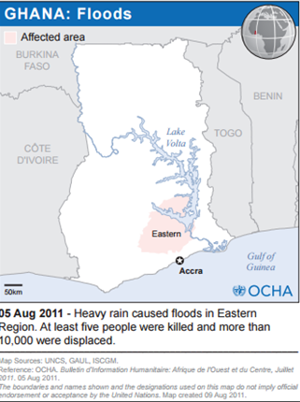
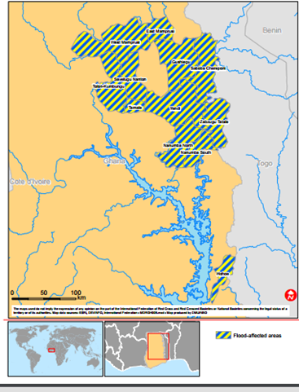
Ghana Floods
2009
2011
2013
Notes:
Source: Relief Web: http://reliefweb.int/report/ghana/act-alliance-alert-floods-ghana
While we may not attribute all floods to climate change, there is increase in their occurrence in West African countries, and this has exacerbated migration, disease outbreaks, and food insecurity.
Note: Correlation of flooding and disease outbreaks – Cholera in particular
Floods occur in different regions of the country each time
2015-2016 Floods in Greater Accra region

Slide 19
4. Drought
Droughts have become more common, especially in the tropics and subtropics, since the 1970s.
By 2080, the proportion of arid and semi-arid lands in Africa is likely to increase by 5-8% under a range of climate scenarios
Notes:
The Sahel region in particular,
The Kalahari

Slide 20
Floods in East Africa
Image © AlJazeera
Notes:
Source: http://350africa.org/2014/12/12/8-ways-climate-change-is-already-affecting-africa/

Slide 21
5. Water
Access to water may be the single biggest cause of conflict and war in Africa in the next 25 years. Such wars are most likely to be in countries where rivers or lakes are shared by more than one country.
By 2020, a population of between 75 and 250 million and 350-600 million by 2050 will be exposed to increased water stress.
Notes:
Climate change and variability are likely to impose additional pressures on water availability, water accessibility and water demand in Africa.

Slide 22
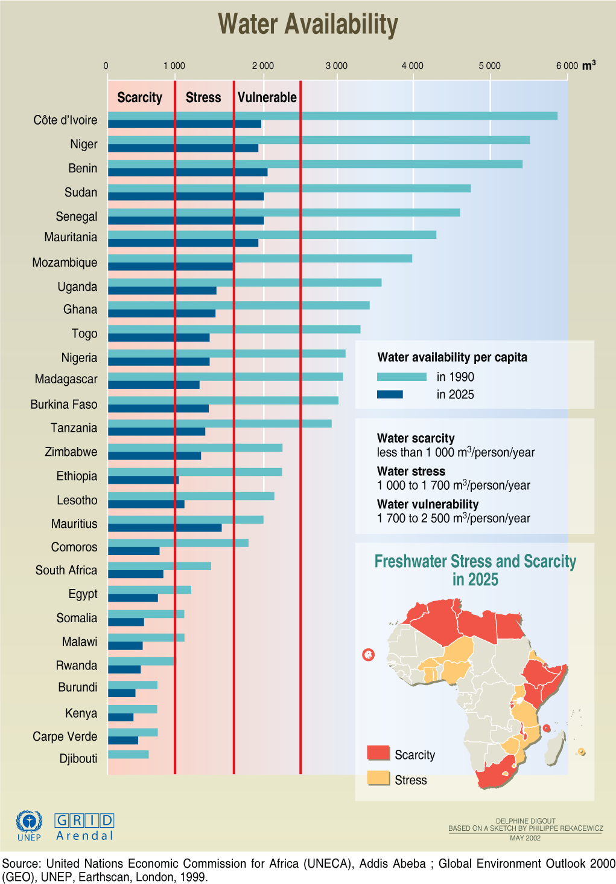
Water availability per capita in Africa in 1990 and projected in 2025.

Slide 23
Water stress in West Africa
Compared to previous decades, the mean annual rainfall has decreased since 1970s, by 10% in the wet tropical zone to more than 30% in the Sahelian zone while the average discharge of the region’s major river systems dropped by 40 to 60% (Niasse 2005).
Notes:
Source: Niasse (2005) Climate-Induced Water Conflict Risks in West Africa: Recognizing and Coping with Increasing Climate Impacts on Shared Watercourses https://www.researchgate.net/profile/Madiodio_Niasse/publication/237699436_Climate-Induced_Water_Conflict_Risks_in_West_Africa_Recognizing_and_Coping_with_Increasing_Climate_Impacts_on_Shared_Watercourses/links/5440fe550cf2a76a3cc60e7c.pdf
Source two: http://know.climateofconcern.org/index.php?option=com_content&task=article&id=96
If the trends in climate contexts that took place over the last three decades continue to prevail, West Africa will experience decreased freshwater availability.
When the water levels of Africa's huge rivers drop, whole economies suffer. Ghana, for example, has become totally reliant on the hydro-electric output of the Akosombo dam on the river Volta. Mali - one of the poorest countries on the planet - is dependent on the river Niger, which flows from Guinea through Mali to Nigeria, for food, water and transport. But great stretches of the river are now facing environmental catastrophe as a result of pollution. In Nigeria, half the population has no access to clean water, and as in much of Africa, many women walk hours and days to fetch it.

Slide 24
Zambezi river basin serving 40million people in 8 countries
10-15% reduction in rainfall and run off
Significant warming and higher evaporation rates
Extreme flooding events
Notes:
The Zambezi river basin in southern Africa is one of the most overused river systems in the world.
River Zambezi is the fourth-longest river in Africa, and its basin covers about 1.37 million square kilometres across eight countries: Angola, Botswana, Malawi, Mozambique, Namibia, Tanzania, Zambia, and Zimbabwe.
The basin is home to about 40 million people who depend on the river for fish, drinking water, agricultural irrigation, electricity production, mining
- The impacts on rainfall, runoff and floods affect hydropower production as well as other economic activities dependent on the basin ecosystem.
CDKN: http://cdkn.org/2015/04/feature-zambezi-competing-claims-climate-change/?loclang=en_gb
International Rivers: https://www.internationalrivers.org/resources/dam-dependent-zambezi-basin-unprepared-for-climate-change-7677
UNU Wider: https://www.wider.unu.edu/publication/regional-climate-change-greater-zambezi-river-basin
Springer: http://link.springer.com/article/10.1007/s10584-014-1230-0

Slide 25
The Nile Basin
Egypt has warned that it will use force to protect its access to waters of the Nile, which also run through Ethiopia and Sudan.
Population increase and climate change will cause greater competition for more scarce water.
Notes:
There is already fierce national competition over water for irrigation and power generation in the Nile river basin
Cairo warned in 1991 that it was ready to use force to protect its access to waters of the Nile, which also runs through Ethiopia and Sudan. If the populations of these countries continue to rise, competition for water could be fierce.
Sources:
Graph: http://www.nercdtp.leeds.ac.uk/research-experience-placements/ancient-egyptians-and-climate-change/
Further reading:
http://www.futuredirections.org.au/publication/conflict-on-the-nile-the-future-of-transboundary-water-disputes-over-the-world-s-longest-river/
https://www.wilsoncenter.org/sites/default/files/NavigatingPeaceIssuePKM.pdf
http://www.basin-info.net/river-basins/nile-basin-research-n-africa/hydrology

Slide 26
6. Agriculture
By 2020, in some countries, yields from rain-fed agriculture could be reduced by up to 50%.
Crop net revenues could fall by as much as 90% by 2100, with small-scale farmers being the most affected.
Notes:
Agricultural production, including access to food, in many African countries is projected to be severely compromised.
This would adversely affect food security in the continent and exacerbate malnutrition.

Slide 27
Sub-Saharan Africa: 22% yield losses by 2050
30% in South Africa and Zimbabwe
2% for sorghum
35% for wheat
Overall negative effects on yields of major cereal crops
(A2 scenario, IPCC AR5)
Notes:
Jones & Thornton, 2003 on maize in Africa and Latin America

Slide 28
Climate Change & Crop Yields
Without emissions cuts, much of Africa will become unsuitable for growing key crops
More than 300M Africans depend on maize as a main food source. With climate change, maize crop yields in parts of Africa will reduce by as much as 40% by 2050, with the largest decreases in western Tanzania, Malawi and the Sahel.
Notes:
However, recent research suggests that much of sub-Saharan Africa will become increasingly unsuitable for growing maize – and other staple crops – as the climate warms this century. This includes some of the major cereal-producing areas in eastern and southern Africa.
Up to 60% of areas that currently grow beans, and up to 30% of areas that grow maize and bananas could no longer be suitable in a warmer climate.
Even if take action now, maize will be affected due to past emissions concentration in the atmosphere. As such there is need to take mitigation actions now to ensure that we limit the long-term impacts of climate change on crop yields.
Source: https://www.carbonbrief.org/guest-post-three-ways-to-boost-crop-resilience-to-climate-change
Overall, African governments will need to prepare for possible large losses in national production potentials, and production areas, of up to 15% by 2050 and over 30% by 2100.
https://www.carbonbrief.org/climate-change-threatens-staple-crops-in-africa-study-says?post_id=10153616047061296_10153616047766296#_=_

Slide 29
The Tragedy of Egypt
With climate change:
Projected decline in precipitation alongside a projected population increase.
Sea-level rise could impact the Nile Delta, and the people living in the delta and other coastal areas.
High degree of uncertainty on the flow of River Nile
Temperature rise will likely reduce the productivity of major crops and increase their water requirements, thereby, directly decreasing crop water-use efficiency.
Agriculture consumes about 85% of the annual total water resources, and plays a significant role in the national economy, contributing about 20% of GDP.
More than 70% of the cultivated area depends on low-efficiency surface irrigation systems, which cause high water losses, a decline in land productivity, water logging and salinity problems.
Notes:
Current demand for water exceeds availability and is getting worse due to climate change.
Source: IPCC 2007
http://know.climateofconcern.org/index.php?option=com_content&task=article&id=105

Slide 30
7. Sea-level rise
Africa has close to 320 coastal cities and millions of people living in low elevation (<10-m) coastal zones.
Sea-level rise will increase the high socio-economic and physical vulnerability of these coastal cities and communities.
Sea level rise and flooding affecting coastal populations and infrastructure (9.4.8) in Eastern and West Africa.
Mangroves and coastal degradation affects fisheries and tourism

Slide 31
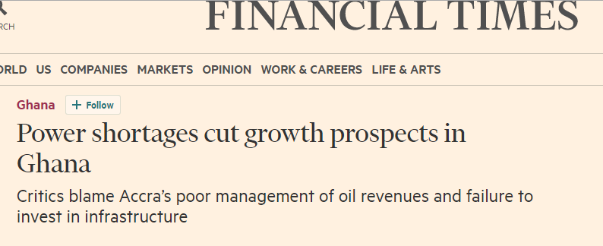
8. Energy Dumsor: Ghana Energy Crisis
Varying water levels cause instability in electricity at the Akosombo hydroelectric dam that contributes about half of Ghana’s electricity.
Increasing reliance of a modern, urbanising economy on electricity
Notes:
Lasted 2014, 2015 and still experienced occasionally in 2016
Financial Times: https://next.ft.com/content/fa56bb02-2481-11e5-bd83-71cb60e8f08c
Other articles: http://www.theafricareport.com/West-Africa/electricity-ghanas-power-crisis-deepens.html
http://thechronicle.com.gh/ghana-electricity-crisis-dumsor-the-causes-disadvantages-and-solutions/

Slide 32
Sub-Saharan Africa primary energy mix by sub-region, 2012
Source: IEA Africa Energy Outlook 2014
Notes:
Link: http://www.iea.org/publications/freepublications/publication/WEO2014_AfricaEnergyOutlook.pdf

Slide 33
Crude oil exports from Africa’s west coast by destination
Source: IEA Africa Energy Outlook 2014
Notes:
Link: http://www.iea.org/publications/freepublications/publication/WEO2014_AfricaEnergyOutlook.pdf

Slide 34
Sub-Saharan hydropower capacity and remaining potential projections
Source: IEA Africa Energy Outlook 2014

Slide 35
Energy-related CO2 emissions by selected country & region in the new policies scenario
Source: IEA Africa Energy Outlook 2014
Notes:
Link: http://www.iea.org/publications/freepublications/publication/WEO2014_AfricaEnergyOutlook.pdf

Slide 36
THE GOOD NEWS
Adaptation and Mitigation in Africa

Slide 37
The Sahel Revolution
Since the early 1990’s, farmers in Niger have re-greened approximately 5 million hectares of degraded land, an area the size of Costa Rica or South Carolina.
This has increased crop yields soil fertility, as well as sequestered carbon.
Notes:
Niger is one of the poorest countries in the world. Each year trees would sprout up in crops that would then be cut back to keep the fields clear, but once it was recognized the importance of letting these trees sprout
Source: THE QUIET REVOLUTION: How Niger’s farmers are re-greening the parklands of the Sahel
http://www.worldagroforestry.org/downloads/publications/PDFs/BL17569.PDF
To get a better photo of the Farmer-Managed Natural Regeneration in Niger (GM)

Slide 38
Sources of Greenhouse Gas Emissions
South Africa:
<5% of emissions from agriculture
>90% of emissions from energy
Burkina Faso:
90% of emissions from agriculture
<2% of emissions from energy

Slide 39
Emissions
Africa’s energy consumption = 3.2% global energy consumption
South Africa and North Africa countries represent 75% of Africa’s energy consumtpion.
Africa’s CO₂ emissions from energy use increased by 2.5% in 2014.
Africa uses only 7% of its production capacity of hydroelectric energy.
(AFD, 2009; BP, 2014)
Notes:
http://www.bp.com/content/dam/bp/pdf/energy-economics/statistical-review-2015/bp-statistical-review-of-world-energy-2015-africa-insights.pdf
http://www.energy-for-africa.fr/files/file/study/l-energie-en-afrique-a-l-horizon-2050.pdf

Slide 40
The Moroccan Green Plan
The Moroccan Green Plan implemented to fight poverty and climate change has led to the promotion of small-scale agriculture and a more responsible use of natural resources.
Notes:
http://www.sciencedirect.com/science/article/pii/S0167880912001648
Climate change, vulnerability and adaptation in North Africa with focus on Morocco
Schilling et al., 2012
For instance, direct seeding has enabled to reduce considerably the water footprint of Moroccan agriculture.

Slide 41
Global Renewable Energy Trends
Wind power capacity grew by 17.4% in 2015
Solar grew by 32.6% in 2015
China is the largest generator of solar.
Notes:
The Gurdian, June 2016: https://www.theguardian.com/environment/2016/jun/08/world-carbon-emissions-stopped-growing-in-2015-says-bp

Slide 42
Climate benefits of renewable energy in Africa
Notes:
With the right policy and investment choices ($70 Billion per year), the eastern and southern Africa power pool countries, could cut their annual CO2 emissions by 310 megatonnes (mt) and save 2,500 Mt in cumulative emissions by 2030, while increasing electricity supply 2.5 times. They will also contribute to strengthening energy security, job creation, and economic opportunities, putting the regions on a climate resilience and low carbon pathway
Source: IRENA, ACEC, 2015

Slide 43
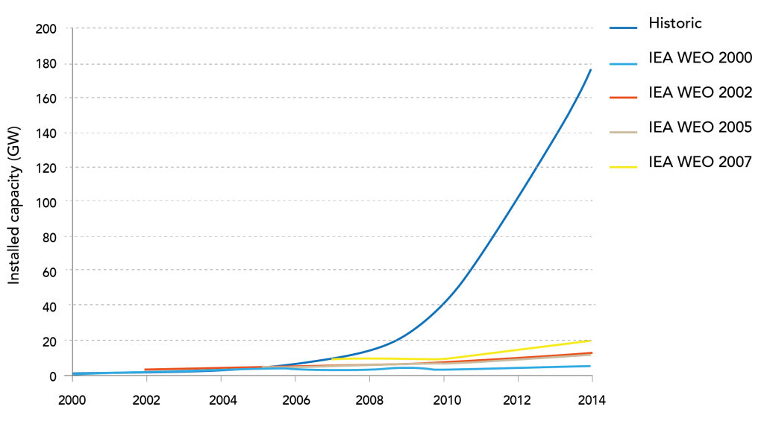
Renewable energy capacity is growing much faster than predicted by the International Energy Agency.
Source: Greenpeace

Slide 44
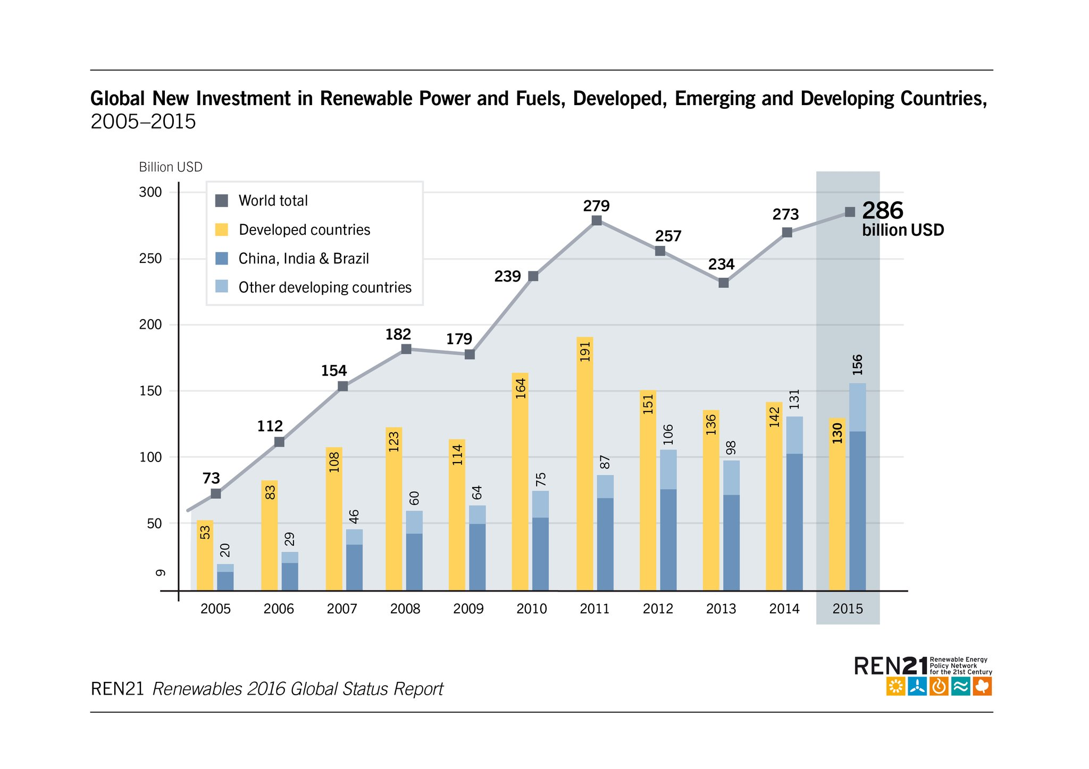
Since 2013, the world has been adding more capacity for renewable power each year than coal, natural gas, and oil combined.
Developing countries are investing more in renewable energy than developed countries.
Source: Bloomberg

Slide 45
Solar Energy
Notes:
Source: IRENA 2016
The key benefits of doubling renewable energy
Limit average global temperature rise to 2degC or below (when coupled with energy efficiency
Avoid upto 12 gigatonnes of energy-reated CO2 emmissions in 2030
24.4 million jobs in the RE sector by 2030 compared to 9.2 million in 2014
Reduce air pollution enough to save up to 4 million lives per year
Boost global GDP by upto $ 1.3 trillion

Slide 46
Solar
Solar power has the potential to cover 13% of global electricity share by 2030.
By 2025 the average cost of electricity from solar power PV could reduce by 59%
But requires:
Investment
Policy Support
Technology Improvements and Transfer to developing countries

Slide 47
50% Renewable Energy in Morocco by 2030

Slide 48
Rwanda’s Solar Field
8.5MW Solar Farm increasing power generation by 5% (equivalent to powering 15,000 homes and creating 350 local jobs)
Co-currently avoids emissions from energy sources and increases uptake of utility-scale clean energy options.
Source: cleantechnica.com
Notes:
Gigawatt Global
Links:
Guardian:

Slide 49
Green Jobs in Renewable Energy Sector
Notes:
Source: IRENA
There is potential to increase employment opportunities in Africa by increasing investments in renewable energy

Slide 50
Africa Clean Energy Corridor (ACEC)
Adopted January 2014
Eastern, Southern and Western Africa
Angola, Botswana, Burundi, the Democratic Republic of Congo, Djibouti, Egypt, Ethiopia, Kenya, Lesotho, Malawi, Mozambique, Namibia, South Africa, Sudan, Swaziland, Uganda, the United Republic of Tanzania, Zambia and Zimbabwe.
Support: France, Italy, New Zealand, the United Arab Emirates and the United States
Notes:
Source: IRENA
Africa Clean Energy Facility- also financed the Rwanda Solar Farm

Slide 51
Clean Energy Solutions for Africa
Africa Clean Energy Finance Initiative (ACEF)
Sustainable Energy for All (SE4ALL) Africa Hub
Africa Renewable Energy Fund (AfDB)
Sustainable Energy Fund for Africa (SEFA) (AfDB)
National-level clean energy policies e.g. Rwanda, Kenya etc.
Notes:
http://www.afdb.org/en/news-and-events/article/african-renewable-energy-fund-aref-launched-with-100m-committed-capital-and-anchor-investments-from-afdb-and-sefa-12901/
SE4ALL: http://se4all.org/
ACEF: https://www.opic.gov/press-releases/2015/africa-focused-renewable-energy-initiative-reaches-full-commitment-initial-20-million-investment%20

Slide 52
SOUTH AFRICA

Slide 53
South Africa - Emissions
One of world’s top 15 energy intensive economies – significant emissions intensity and emissions per capita
In 2010, total GHG emissions were estimated at 544,314CO2eq (excluding FOLU) having increased by 21% between 2000 and 2010. If FOLU component is included in the AFOLU sector, emissions declined to 518 239 CO2eq in 2010
Significant sources of emissions - energy industries (solid fuels), other emissions from energy production, iron and steel production and energy industries (liquid fuels)
Energy sector contributed 75.1% of total GHG emissions, which increased to 78.7% in 2010. AFOLU is the second largest contributor followed by IPPU (industrial processes and products). AFOLU contributed 12.2% in 2000 and declined to 9.5% in 2010, while IPPU contributed 10% in 2000 and declined to 8.1% in 2010. the waste sector showed a steady increase in contribution from 2.6% in 2010 to 3.7% in 2010.

Slide 54
South Africa- Climate Impacts
Greater sub-continental warming in the northern region
Greater impacts on the arid regions, due to a broader reduction of rainfall in the ranges of 5 to 10%.
Temperature will rise in the ranges of 1 to 3degreesC.
Increasing incidents of drought, floods, and prolonged dry spells, followed by intense storms.
Increase in early winter rainfall in the summer rainfall regions.
Source: National climate change response strategy -2004

Slide 55
South Africa - Climate Impacts (Cont’d)
Health impacts as a result of increased temperature and rainfall
Rangelands- 70% of SA land surface – increase cost of ranching, and frequent fire outbreaks
Agriculture - Production of maize will decline by 20% in the western drier areas
Increase in pests and diseases and invasive plants due to temperature rise- reducing productivity.

Slide 56
South Africa - Responses
National commitment - reduce national emissions to 34% below BAU levels by 2020 and 42% by 2025
Emissions need to decrease by 0.2% per year, for SA to achieve the above target
Carbon Tax Bill (2015) - R120/ton and increasing at 10% a year during the first phase of implementation 2015-2020
Second Bric nation after India whose carbon tax is $1.07/ton (at the time) of coal produced, or imported to the country
Renewable Energy Independent Power Procurement programme (REIPP)- target of 10000 gwh

Slide 57
Challenges – South Africa
The power sector in SA contributes 45% of emissions in comparison to 26% globally
In the absence of an electricity mix, the emissions will increase by 2% annually (Dept of energy projections)

Slide 58
KENYA

Slide 59
The Climate Challenge in Kenya
Frequent incidences of severe and damaging frost - the 2012 frost resulted in 30 percent tea crop loss in Nandi County.
Kenya will experience a 20 percent rainfall decrease by 2030, which will translate to losses in agricultural production in affected areas of up to US$ 178 per hectare.
Drought in the Arid and Semi-Arid Lands ASALs) is leading to a loss of animals.
Notes:
Source: Addressing Climate change: successes from Kenya, 2015, Ministry of Environment, Water and Natural Resources

Slide 60
Addressing Climate Change in Kenya – Priority Response Areas
Low Carbon, climate resilient development pathways
Adaptation
National Drought Management Authority
National Drought Contingency Fund - facilitates early payment to reduce the time between warning of drought stress and response at the county level, reflecting a policy shift from crisis management to risk management. The Fund is the first of its kind in Africa and is expected to reduce the destructive impact of droughts.
Mitigation – mitigating while reducing vulnerability (sustainable development)
Geothermal power generation
Wind power- Turkana and Ngong
Mini-grids & clean household energy – improved stoves, biogas, solar, etc.
Transport- Standard Rail Gauge; Bus Rapid Transport System – Nairobi
Forestry – schools green programme; REDD+ projects
Notes:
Adaptation is priority for the Kenyan government – reducing vulnerability and building adaptive capacities of affected communities.

Slide 61
Sustainable Food System in Africa
We are thinking of climate beyond energy by moving into agriculture
Developing a model to help us understand what it will take to achieve a sustainable food system while meeting our climate goals
National models for Ethiopia, Morocco, Ghana, and Rwanda (would you like for your country?)
The process started in 2016 in Morocco and entails research, meetings with relevant stakeholders (govt, non-govt etc), modelling, testing and testing.
There is an emphasis of thinking about agriculture beyond production to include resilience, climate mitigation and adaptation
The model attempts to feature various variables- production, crops, livestock, water, emissions, land use change and soil
A live Demo if interested in the course of this week
For Ethiopia, we are using their 2030 targets as set out in their Climate Resilient and Green Economy Plan while for the other countries, this translates to their Nationally Determined Contributions (NDCs)
For those interested in a simulation of the same, a game is currently being developed and tested.
Demo ALPS url (private): https://staging.cwc.climateinteractive.org/alps/

Slide 62
Is it time to think of Mid-century actions/impacts?
Source: New York Times Why Build Kenya’s First Coal Plant? Hint: Think China : https://www.nytimes.com/2018/02/27/climate/coal-kenya-china-power.html
Notes:
In brief, China has set its emissions targets of …Le’ts demonstrate this on C-ROADS.
However, to meet these targets, they are ‘exporting’ their emissions to the highlighted countries which would be equivalent to ….? (tons of CO2 maybe)
What is Amu power providing in return
Energy for economic growth
Incomes – 600 households receiving compensation for their land
Assurance that the project will bring in ‘a lot of money’
Does the country has other options? Overall, the country has this potential
Solar
Wind
Renewable energy

Slide 63
Wondering what next?
Become a facilitator and look for places/audiences where you can facilitate the event
Introduce it to your colleagues at workplace, church, mosque, community, residents association, business, school etc.
Play with our other tools, read our blogs
Spread the world to others who might find these materials relevant

