Slide 1
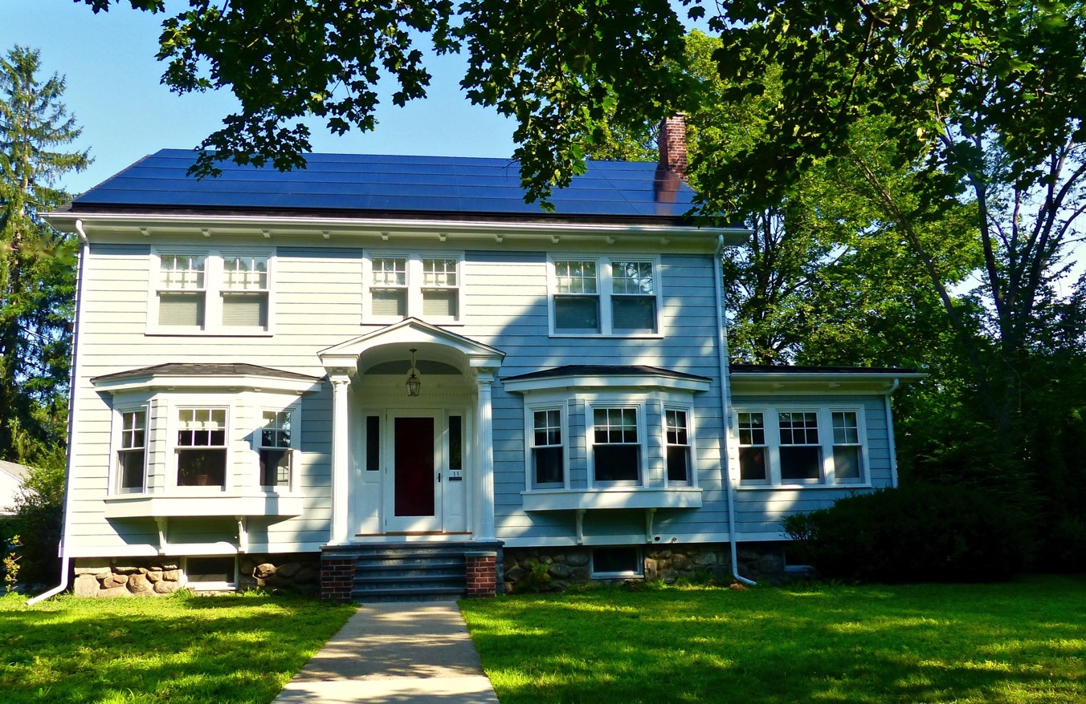
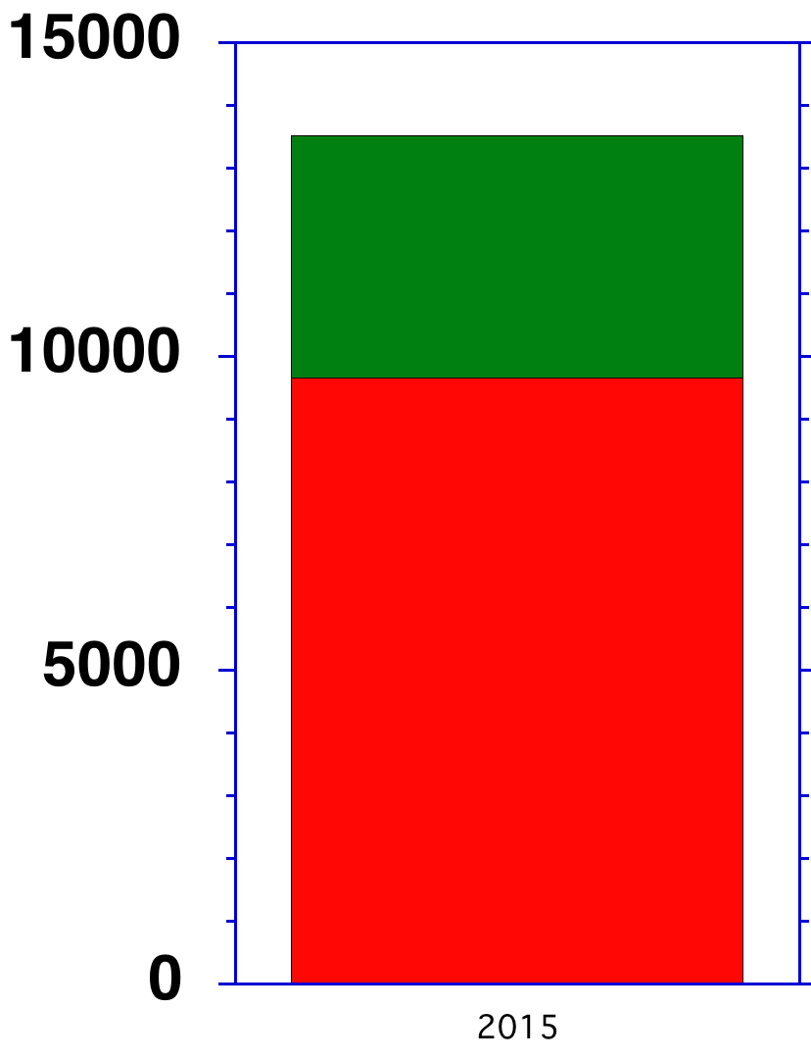
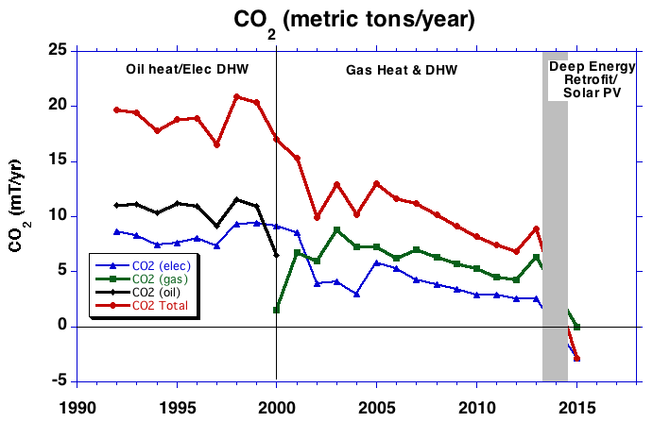
What can you do?
From Energy User to Producer
Cut your personal footprint
Retrofit, insulate, upgrade, go solar
Year 1:
Solar Generation: 13,720 kWh
Total Energy Use: 9,654 kWh
Net Production: 6,460 kWh
Net Production: 54% more than usage
Total Generation
Surplus
kWh
Other Alums with Zero Net Homes:
Mark Doughty
David Miller
You?
Please email me w/details
jsterman@mit.edu
Usage

Slide 2
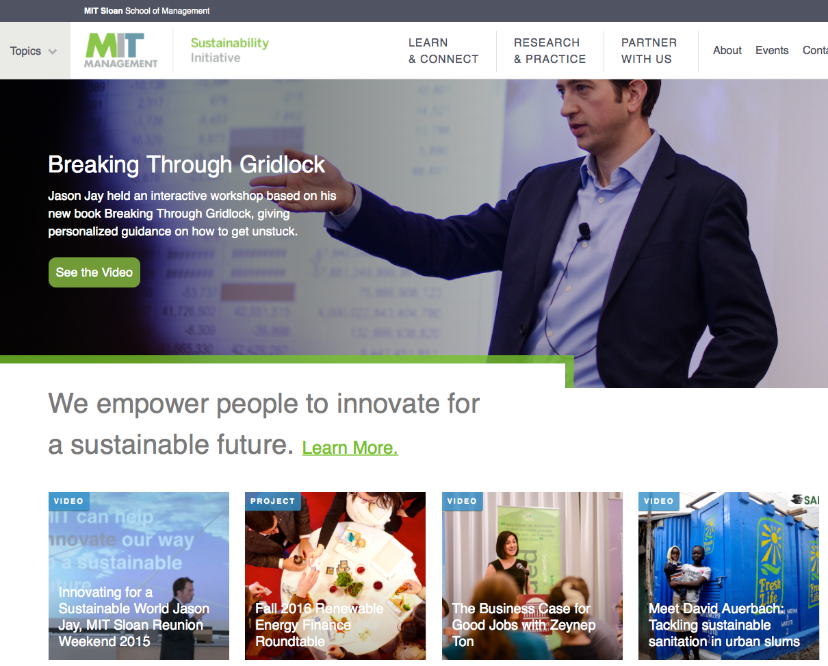
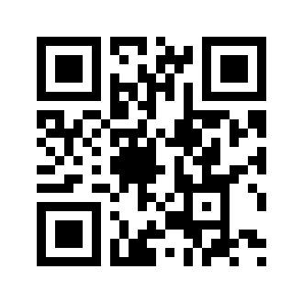
What can you do?
Engage with MIT and Sloan:
Make a contribution to the MIT Sloan Annual Fund which supports the MIT Sloan Sustainability Initiative: https://giving.mit.edu/give
Renewable Energy Finance Roundtables
MIT Sloan/Climate Interactive Simulation and Education project
http://mitsloan.mit.edu/sustainability

Slide 3
What can you do?
Engage with MIT and Sloan:
Make a contribution to the MIT Sloan Annual Fund which supports the MIT Sloan Sustainability Initiative: https://giving.mit.edu/give
Renewable Energy Finance Roundtables
MIT Sloan/Climate Interactive Simulation and Education project
Support Campus Climate Action: fossilfreemit.org
Support a stronger MIT climate action plan: email President Reif (reif@mit.edu)
http://www.fossilfreemit.org/

Slide 4
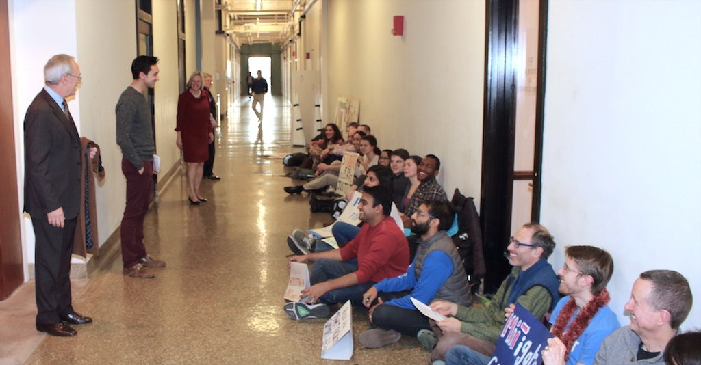
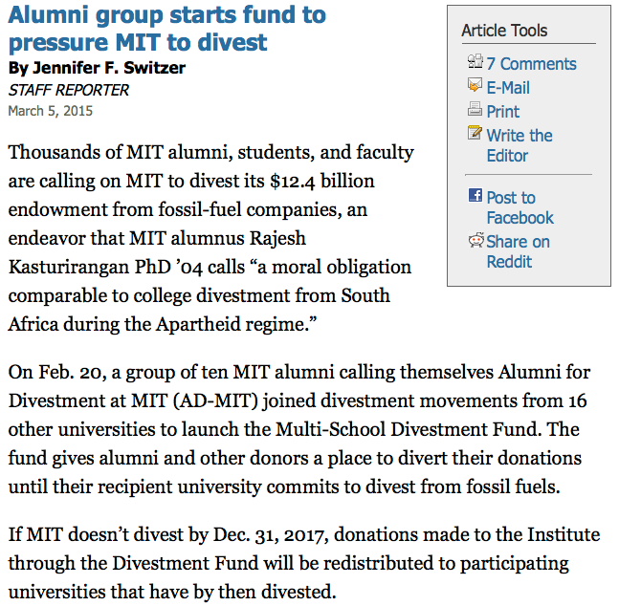
Historic student/faculty/alumni
sit-in for climate action: 116 days
MIT Alumni for Climate Action Leadership (MITACAL) http://www.mitacal.org

Slide 5
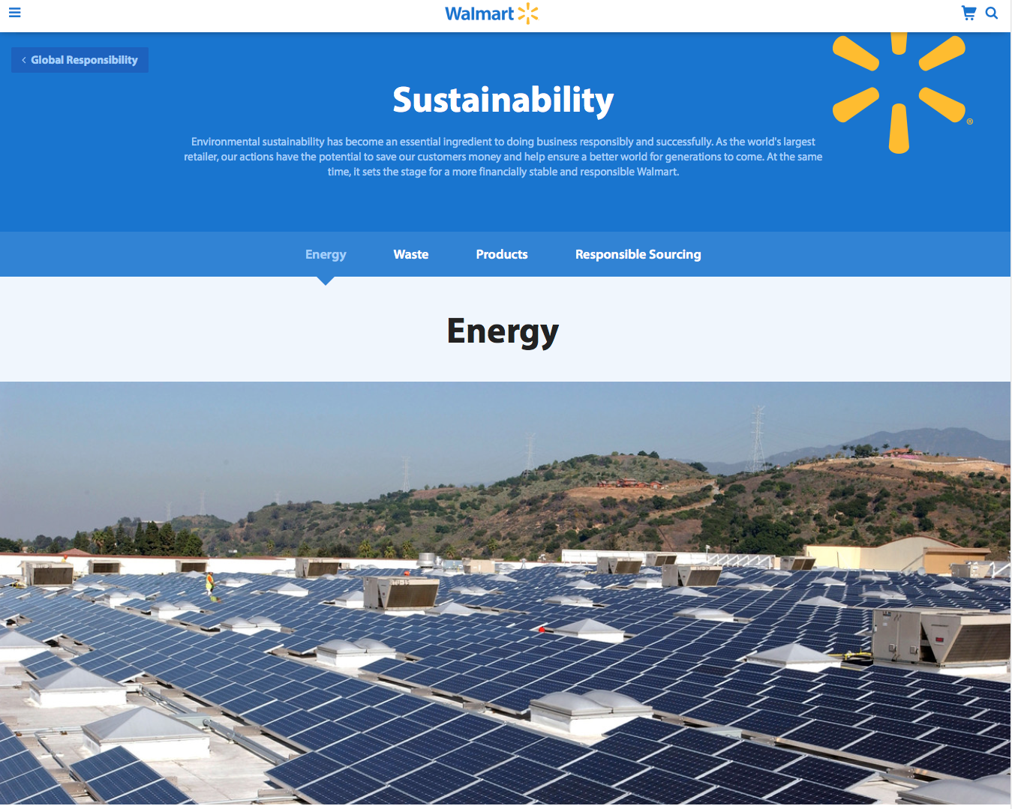
What can you do?
Get Active
Find out what your company/organization is doing
Offer to help launch and strengthen sustainability programs
Encourage your firm to advocate for strong climate action at all levels of government (local, state, federal, international)

Slide 6
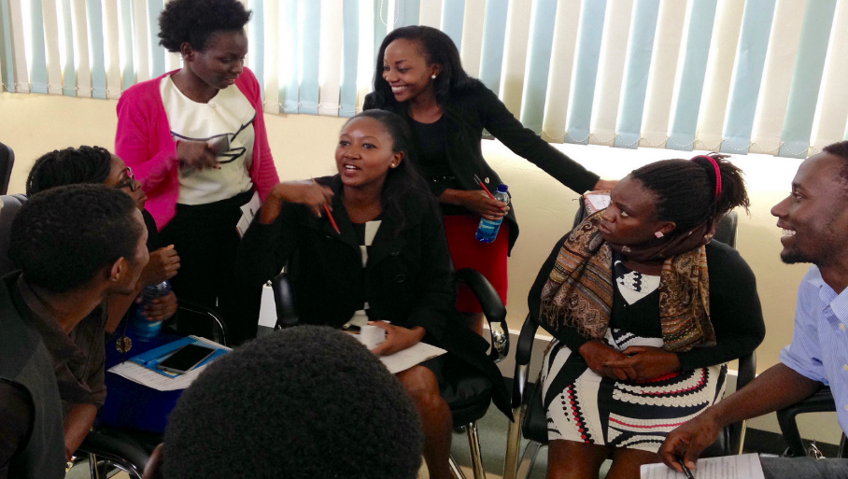
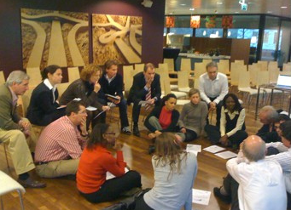
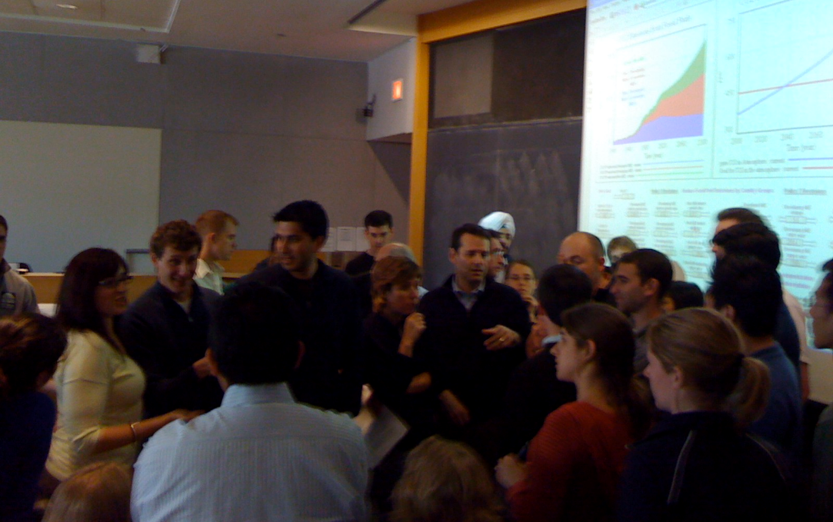
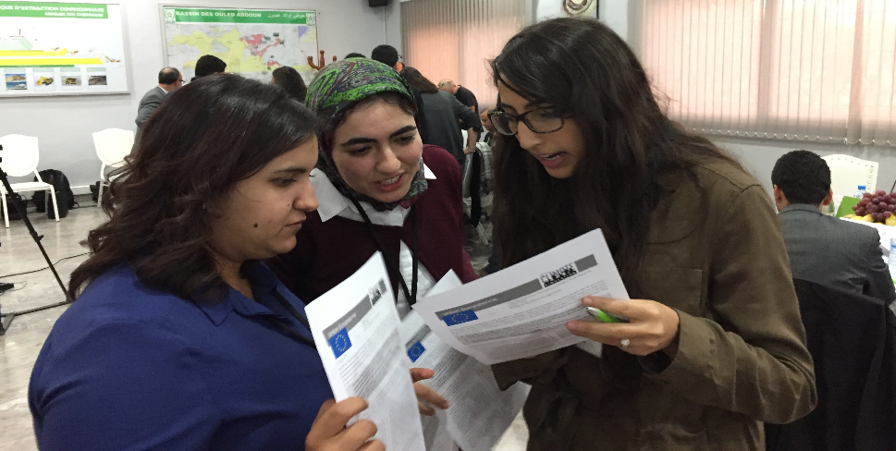
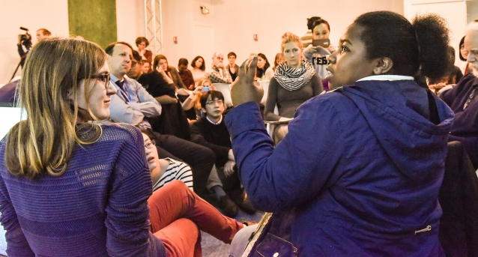
Hyderabad
What can you do?
Get Active
Learn to run World Climate and bring it to your community (climateinteractive.org)
Kenya
Germany
Netherlands
MIT
Morocco
Paris

Slide 7
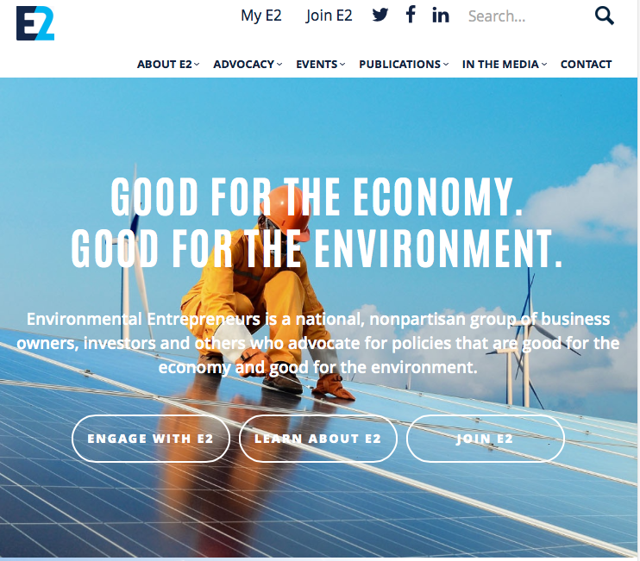
What can you do?
Get active as a business leader
Join business groups advocating for climate smart policies
Visit your lawmakers

Slide 8
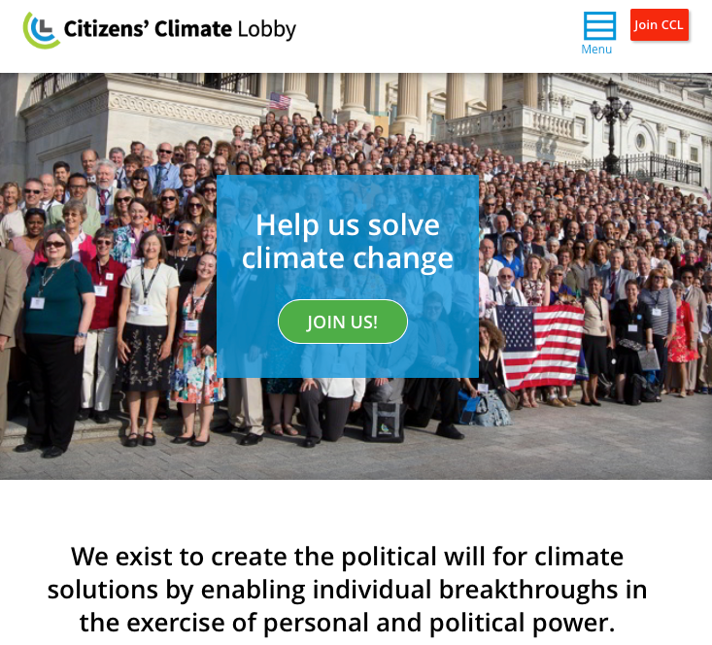
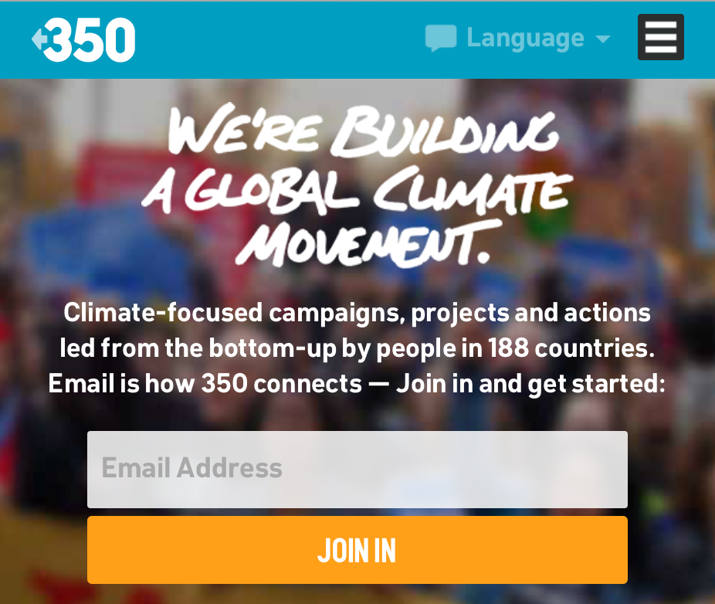
What can you do?
Get Active as a Citizen
Join
Contact
Teach

Slide 9
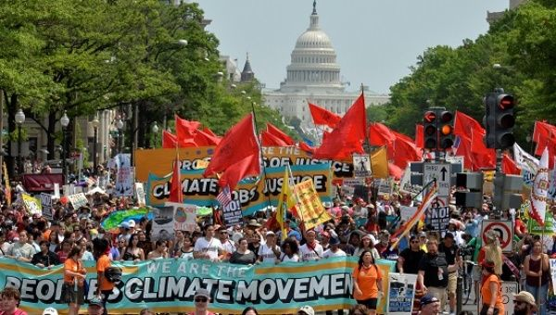
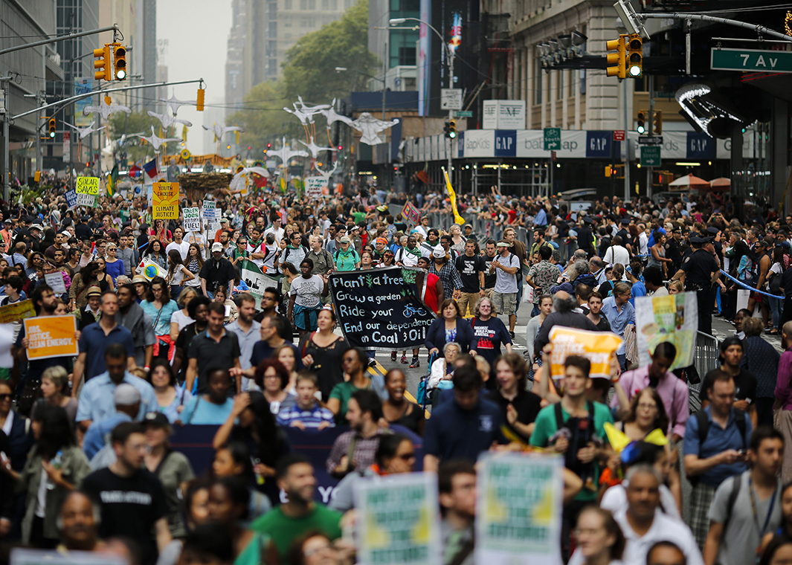
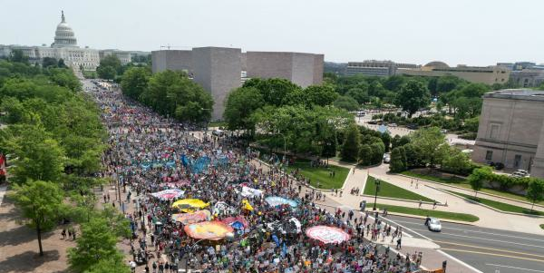
What can you do?
Get Active as a Citizen
Join, Contact
Listen, Teach
March, Protest

