Slide 1
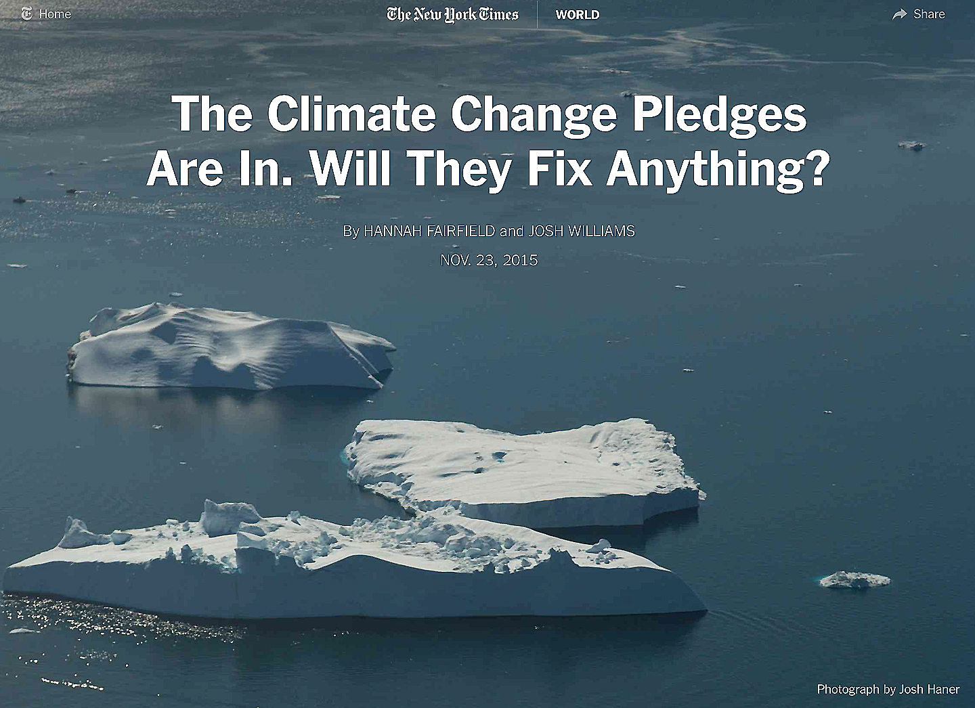

Slide 2
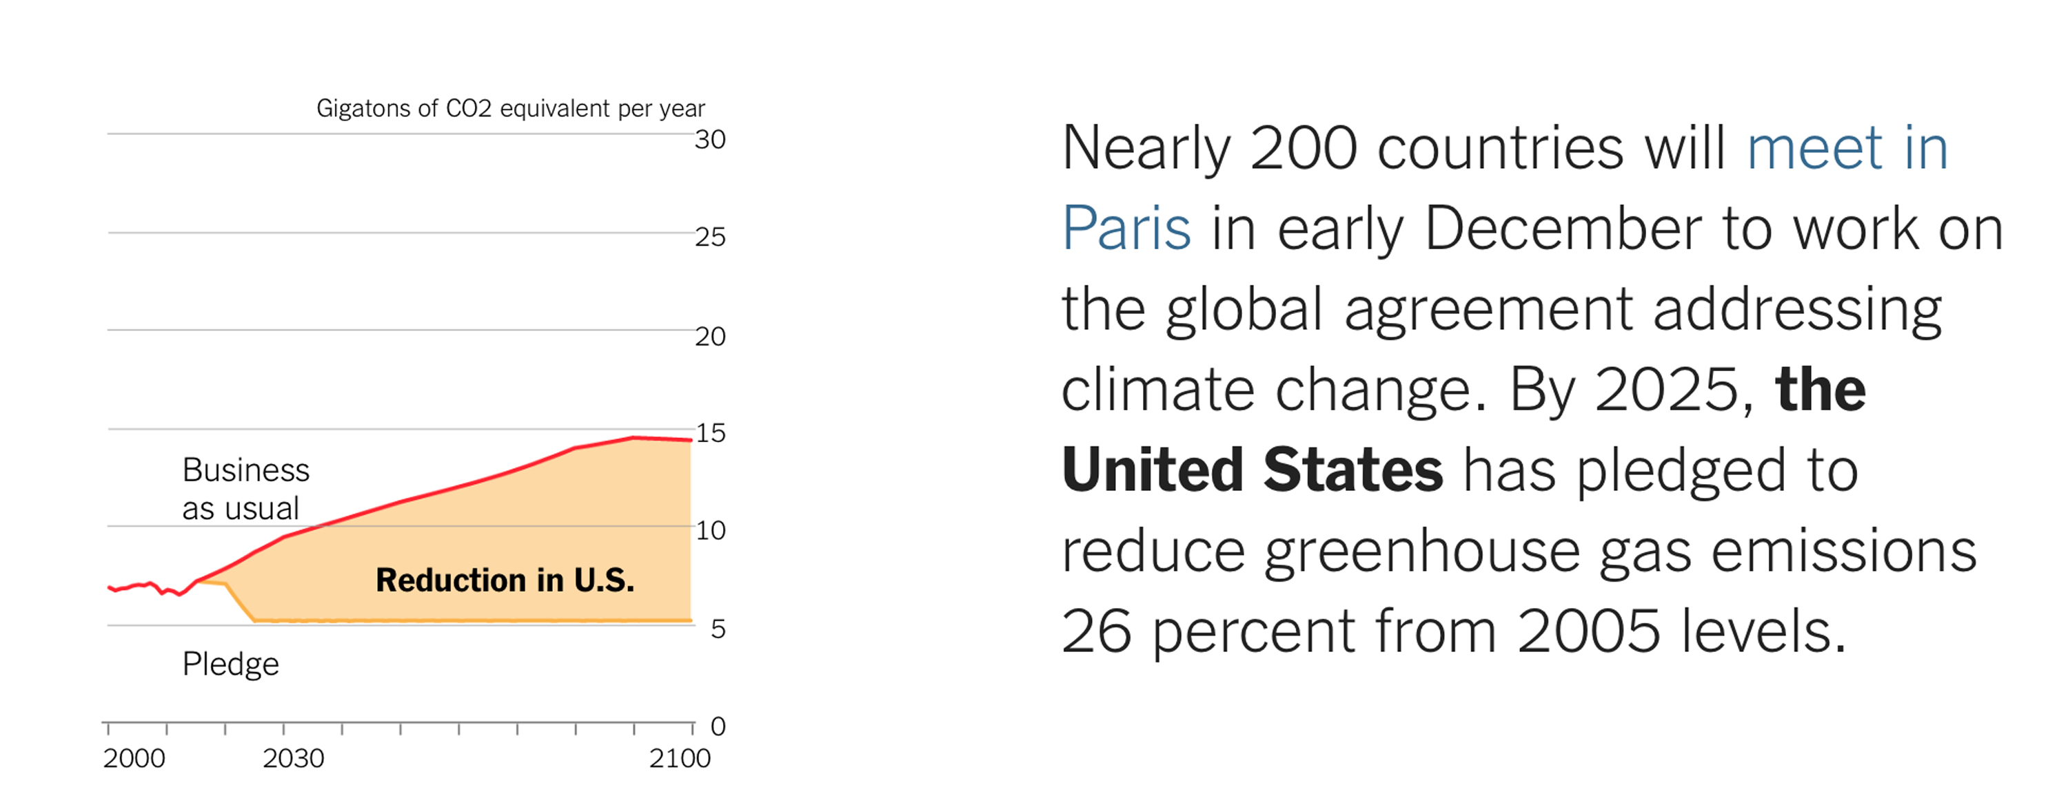

Slide 3
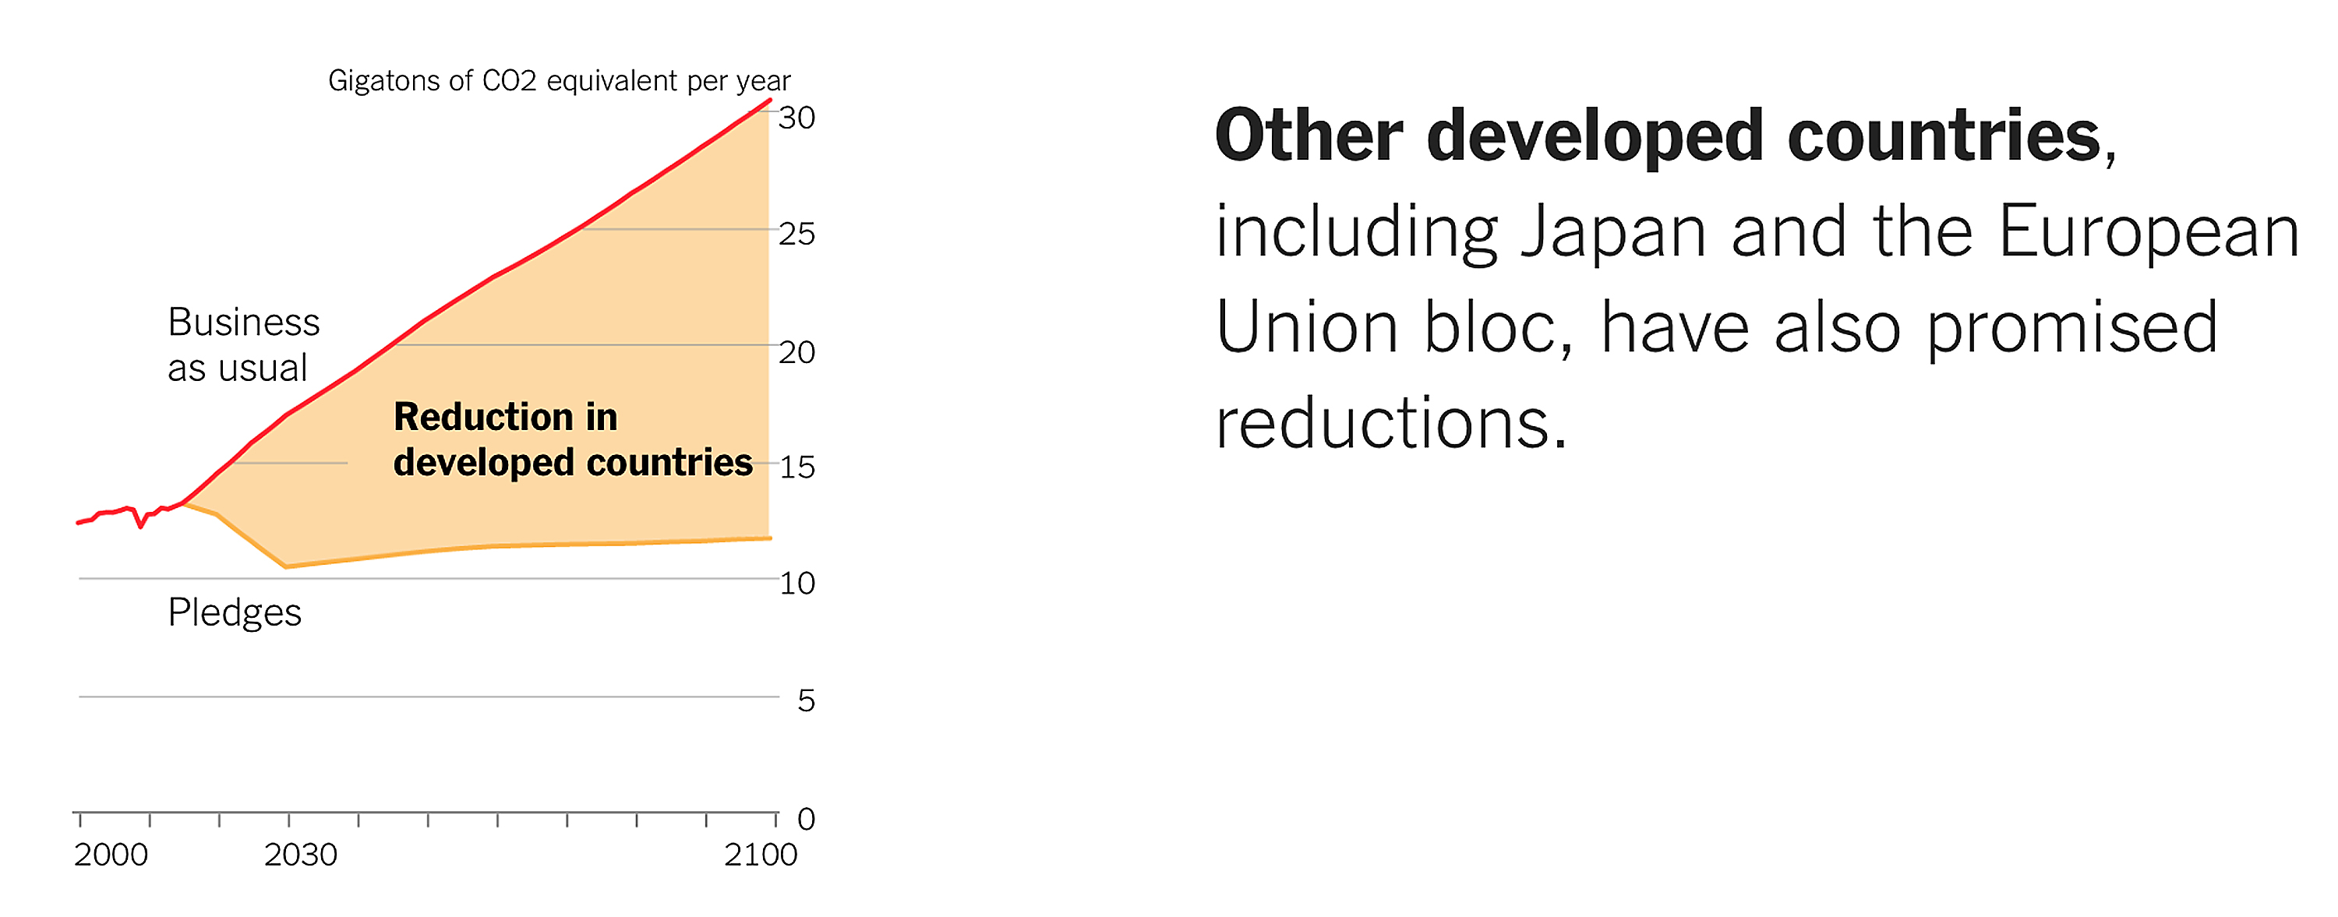

Slide 4
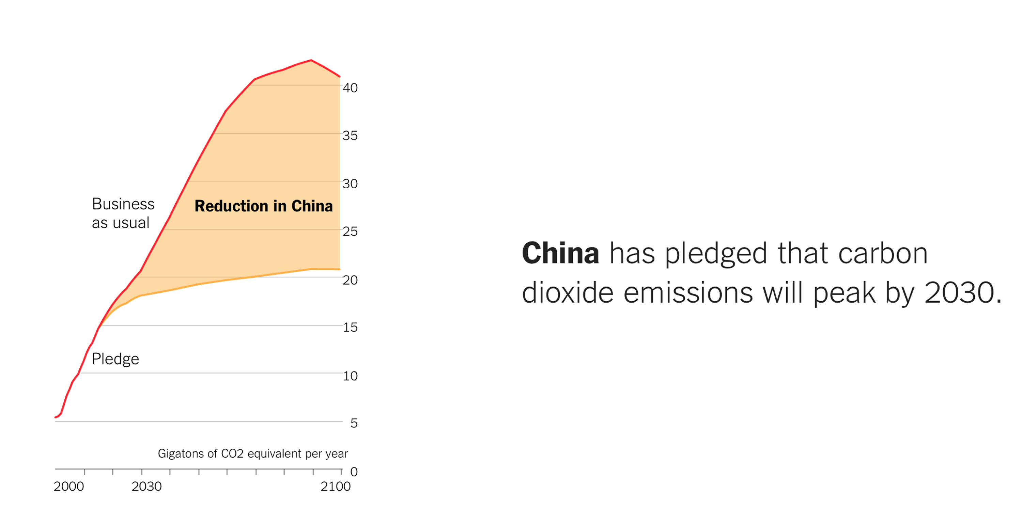

Slide 5
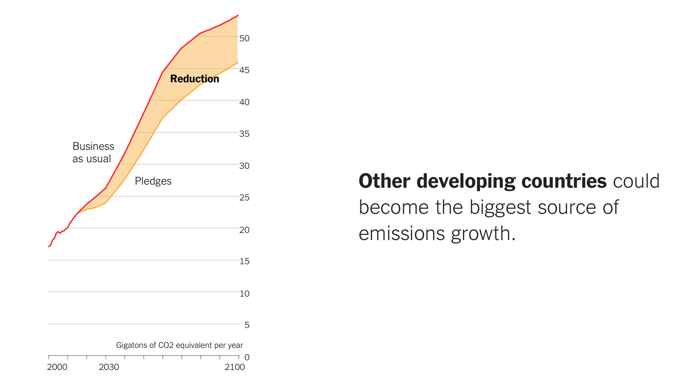

Slide 7
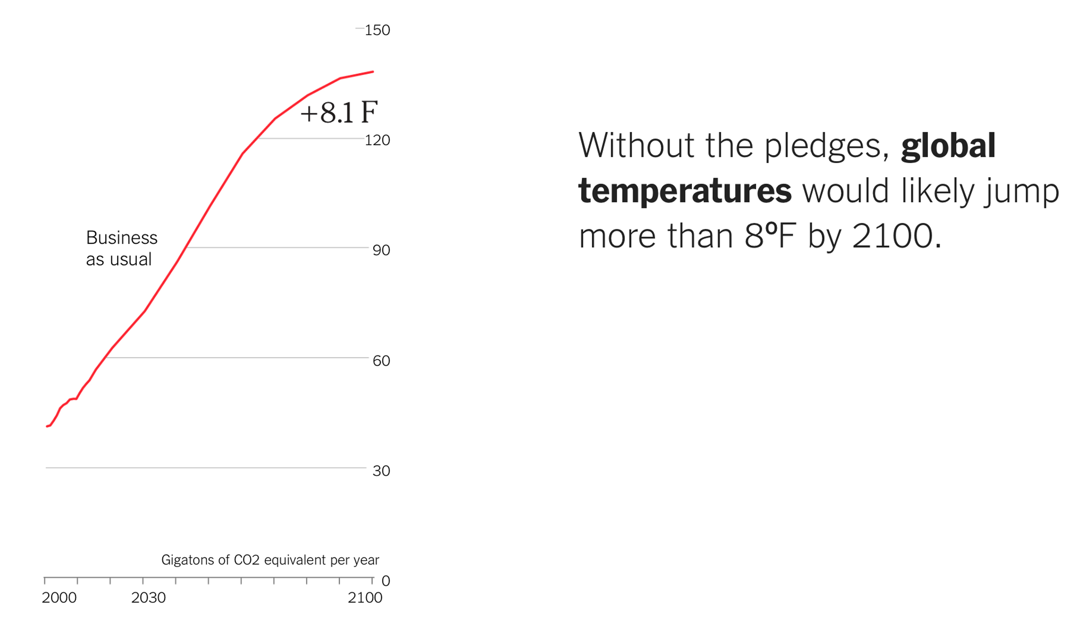
(+4.5 ºC)

Slide 8
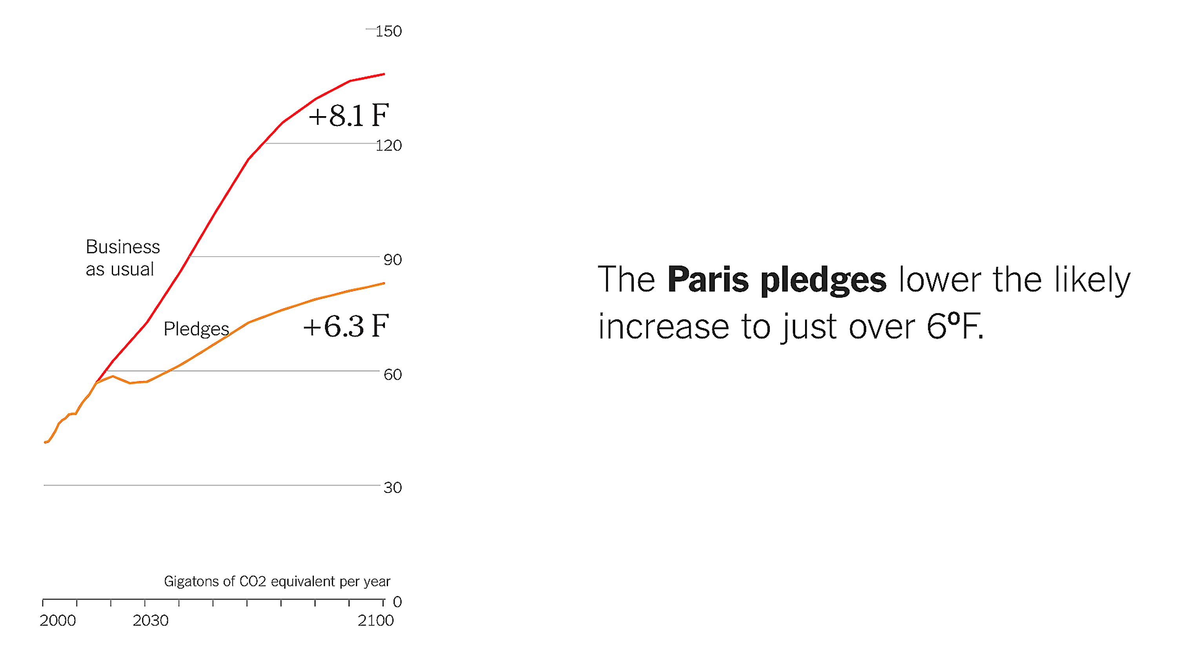
(+4.5 ºC)
(+3.5 ºC)

Slide 9
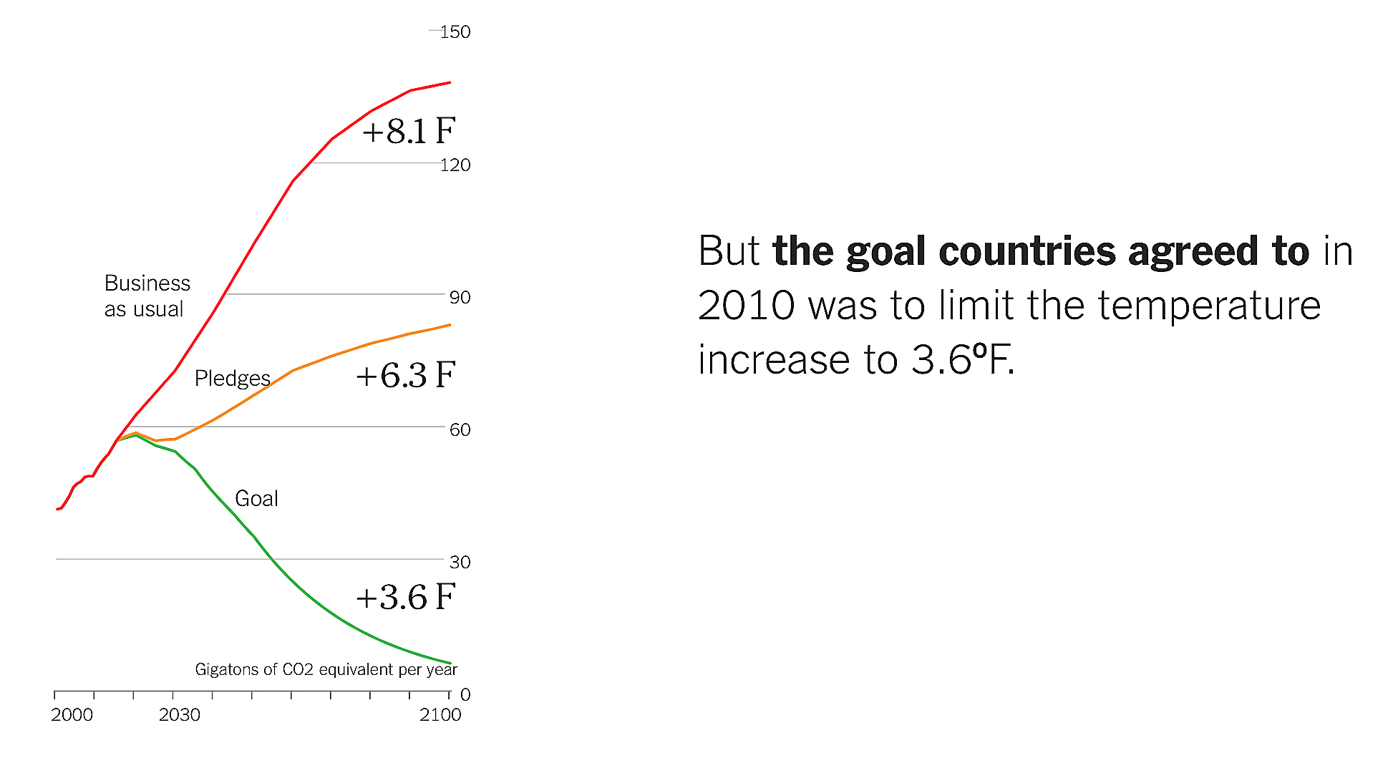
(+4.5 ºC)
(+3.5 ºC)
(+2.0 ºC)

Slide 10
(+4.5 ºC)
(+3.5 ºC)
2030
(+2.0 ºC)

Slide 11
2100
2050
(+4.5 ºC)
(+3.5 ºC)
(+2.0 ºC)

